Slide 1
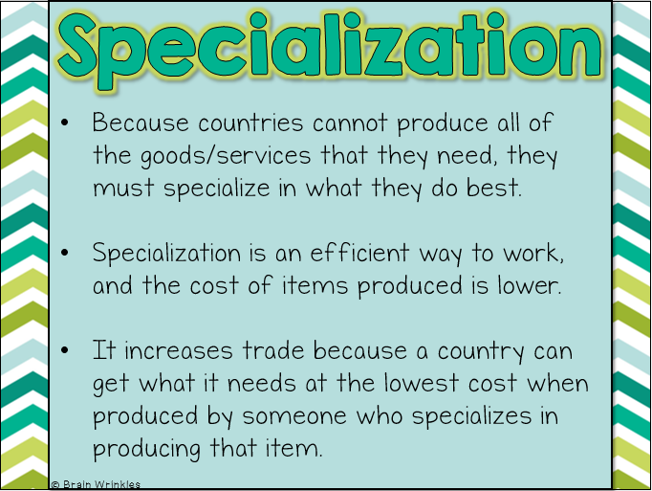
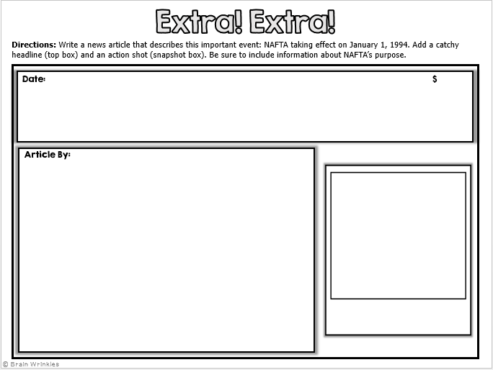
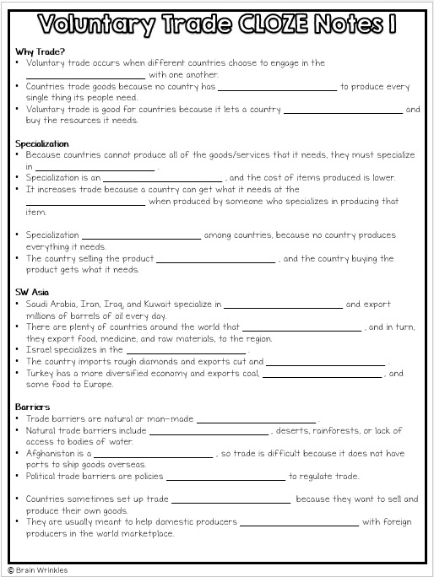
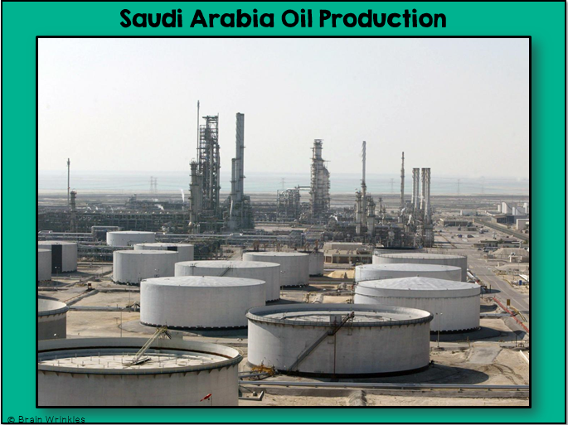
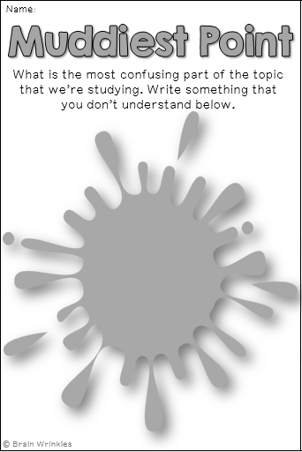
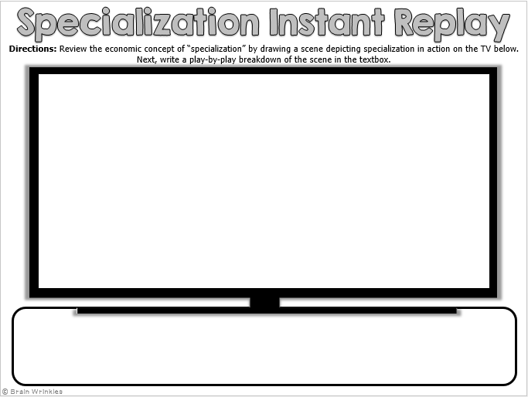
Southwest Asia’s
VOLUNTARY TRADE & OPEC
VOLUNTARY
TRADE & OPEC
Presentation, Graphic Organizers, & Activities

Slide 2
STANDARDS:
SS7E6 The student will explain how voluntary trade benefits buyers and sellers in Southwest Asia (Middle East).
Explain how specialization encourages trade between countries.
Compare and contrast different types of trade barriers, such as tariffs, quotas, and embargos.
Explain the primary function of the Organization of Petroleum Exporting Countries (OPEC).
Explain why international trade requires a system for exchanging currencies between nations.
© Brain Wrinkles

Slide 3
TEACHER INFO: CLOZE Notes
The next pages are handouts for the students to use for note-taking during the presentation. (Print front to back to save paper and ink.)
Check the answers as a class after the presentation.
© Brain Wrinkles

Slide 4
Why Trade?
Voluntary trade occurs when different countries choose to engage in the _______________________ with one another.
Countries trade goods because no country has _______________________ to produce every single thing its people need.
Voluntary trade is good for countries because it lets a country _______________________ and buy the resources it needs.
Specialization
Because countries cannot produce all of the goods/services that it needs, they must specialize in _______________________ .
Specialization is an _______________________ , and the cost of items produced is lower.
It increases trade because a country can get what it needs at the _______________________ when produced by someone who specializes in producing that item.
Specialization _______________________ among countries, because no country produces everything it needs.
The country selling the product _______________________ , and the country buying the product gets what it needs.
SW Asia
Saudi Arabia, Iran, Iraq, and Kuwait specialize in _______________________ and export millions of barrels of oil every day.
There are plenty of countries around the world that _______________________ , and in turn, they export food, medicine, and raw materials, to the region.
Israel specializes in the _______________________ .
The country imports rough diamonds and exports cut and _______________________ .
Turkey has a more diversified economy and exports coal, _______________________ , and some food to Europe.
Barriers
Trade barriers are natural or man-made _______________________ .
Natural trade barriers include _______________________ , deserts, rainforests, or lack of access to bodies of water.
Afghanistan is a _______________________ , so trade is difficult because it does not have ports to ship goods overseas.
Political trade barriers are policies _______________________ to regulate trade.
Countries sometimes set up trade _______________________ because they want to sell and produce their own goods.
They are usually meant to help domestic producers _______________________ with foreign producers in the world marketplace.
© Brain Wrinkles
Voluntary Trade CLOZE Notes 1

Slide 5
Countries sometimes set up trade _______________________ because they want to sell and produce their own goods.
They are usually meant to help domestic producers _______________________ with foreign producers in the world marketplace.
Tariffs
Tariffs are _______________________ placed on imported goods.
They cause the consumer to _______________________ for an imported item, thus increasing the demand for a lower priced-item produced domestically.
For example, Saudi Arabia and Egypt have recently _______________________ on food imports to help citizens cope with rapidly increasing food prices.
Quotas
Quotas are _______________________ on the amount of a good that can be imported into a country.
Quotas can cause shortages, which cause _______________________ .
Embargoes
Embargoes are another _______________________ to trade.
In an embargo, nations _______________________ with a country at all.
Examples
After Iraq invaded Kuwait in 1990, the United Nations placed an _______________________ , only allowing it to export enough oil to buy its citizens’ food.
After the 9/11 attacks on the United States, the UN place an embargo on Afghanistan and members could _______________________ to the country.
The US has had several embargoes with Iran over the past twenty years because of Iran’s _______________________ .
© Brain Wrinkles
Voluntary Trade CLOZE Notes 2

Slide 6
Currency Exchange
Currency is something that is _______________________ and can be used to purchase goods and services in a market.
Because countries have _______________________ , international trade require a system for exchanging currencies between nations.
Money from one country must be _______________________ of another country to pay for goods in that country.
Exchange Rate
What the _______________________ in terms of another country’s currency is called the exchange rate.
For example, an exchange rate of 3 Turkish lira to the US dollar means that 3 lira are worth the _______________________ .
Foreign exchange makes it easier to trade all _______________________ .
OPEC
In 1960, Iran, Iraq, Saudi Arabia, Kuwait, and Venezuela formed an organization called the Organization of _______________________ Countries (OPEC).
OPEC’s purpose is to unify _______________________ in order to promote stability in the world oil market and ensure a regular supply of petroleum to other countries.
OPEC sets the prices and _______________________ produced by its member nations.
Function
Before 1960, the amount of oil produced worldwide was _______________________ for it.
Because of this, oil _______________________ and oil-producing countries made less money.
When OPEC was formed, oil production was controlled and the _______________________ worldwide.
Oil prices rose and oil-producing countries _______________________ .
© Brain Wrinkles
Voluntary Trade CLOZE Notes 3

Slide 7
Ame
Southwest Asia’s
VOLUNTARY
TRADE
Specialization, Trade Barriers, Currency Exchange, & OPEC
© Brain Wrinkles

Slide 8
Specialization
© Brain Wrinkles

Slide 9
Why Trade?
Voluntary trade occurs when different countries choose to engage in the exchange of goods with one another.
Countries trade goods because no country has all the resources necessary to produce every single thing its people need.
Voluntary trade is good for countries because it lets a country sell its own resources and buy the resources it needs.
© Brain Wrinkles

Slide 10
Specialization
Because countries cannot produce all of the goods/services that they need, they must specialize in what they do best.
Specialization is an efficient way to work, and the cost of items produced is lower.
It increases trade because a country can get what it needs at the lowest cost when produced by someone who specializes in producing that item.
© Brain Wrinkles

Slide 11
Specialization
Specialization encourages trade among countries, because no country produces everything it needs.
The country selling the product makes a profit, and the country buying the product gets what it needs.
© Brain Wrinkles

Slide 12
SW Asia
Saudi Arabia, Iran, Iraq, and Kuwait specialize in oil production and export millions of barrels of oil every day.
There are plenty of countries around the world that import Middle Eastern oil, and in turn, they export food, medicine, and raw materials, to this region.
Israel specializes in the diamond industry.
The country imports rough diamonds and exports cut and polished diamonds.
Turkey has a more diversified economy and exports coal, textiles, and some food to Europe.
© Brain Wrinkles

Slide 13
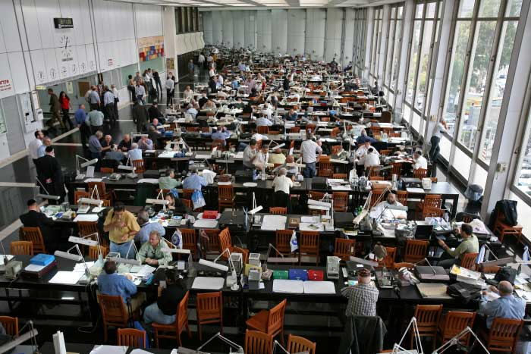
Israel Diamond Exchange
© Brain Wrinkles

Slide 14
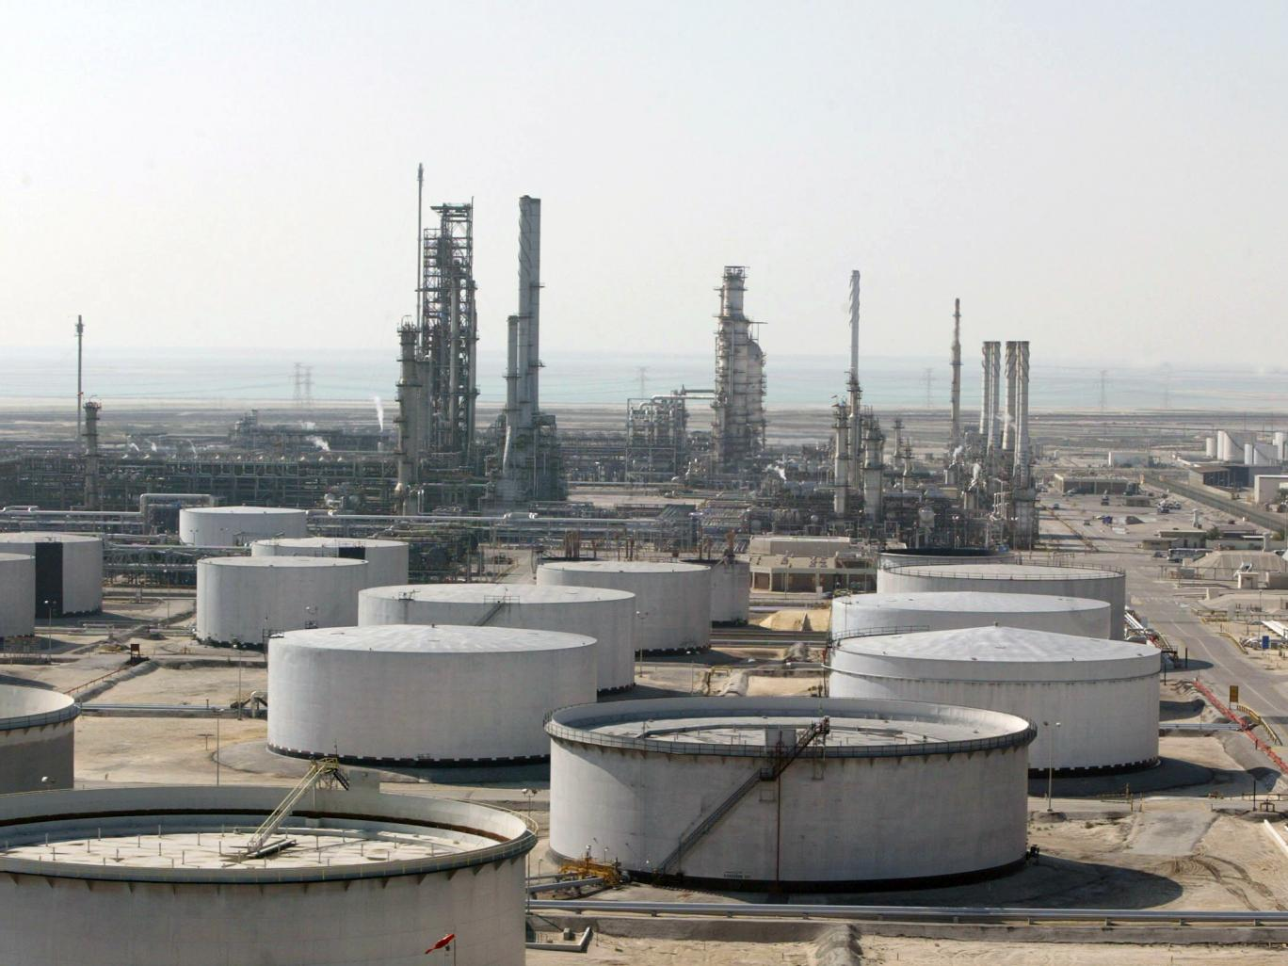
Saudi Arabia Oil Production
© Brain Wrinkles

Slide 15
Trade
Barriers
© Brain Wrinkles

Slide 16
Barriers
Trade barriers are natural or man-made obstacles to voluntary trade.
Natural trade barriers include mountain ranges, deserts, rainforests, or lack of access to bodies of water.
Afghanistan is a landlocked country, so trade is difficult because it does not have ports to ship goods overseas.
Political trade barriers are policies passed by a government to regulate trade.
© Brain Wrinkles

Slide 17
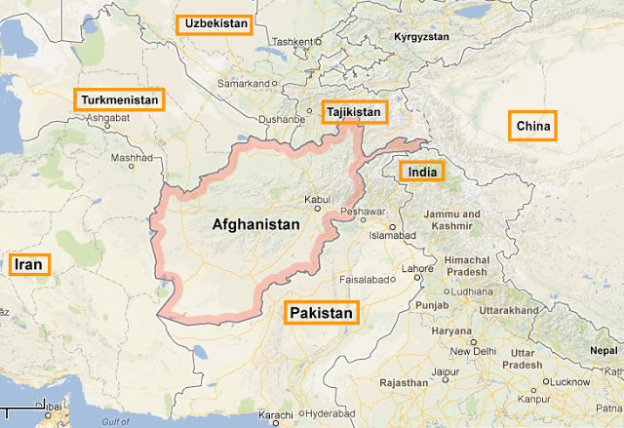
© Brain Wrinkles

Slide 18
Barriers
Countries sometimes set up trade barriers to restrict trade because they want to sell and produce their own goods.
They are usually meant to help domestic producers remain competitive with foreign producers in the world marketplace.
© Brain Wrinkles

Slide 19
Tariffs
Tariffs are taxes placed on imported goods.
They cause the consumer to pay a higher price for an imported item, thus increasing the demand for a lower priced-item produced domestically.
For example, Saudi Arabia and Egypt have recently lowered tariffs on food imports to help citizens cope with rapidly increasing food prices.
© Brain Wrinkles

Slide 20
Quotas
Quotas are limits on the amount of a good that can be imported into a country.
Quotas can cause shortages, which cause prices to rise.
© Brain Wrinkles

Slide 21
Embargoes
Embargoes are another political barrier to trade.
In an embargo, nations refuse to trade with a country at all.
© Brain Wrinkles

Slide 22
Examples
After Iraq invaded Kuwait in 1990, the United Nations placed an embargo on Iraq, only allowing it to export enough oil to buy its citizens’ food.
After the 9/11 attacks on the United States, the UN place an embargo on Afghanistan and members could not sell weapons to the country.
The US has had several embargoes with Iran over the past twenty years because of Iran’s involvement with terrorism.
© Brain Wrinkles

Slide 23
Currency
Exchange
© Brain Wrinkles

Slide 24
Currency Exchange
Currency is something that is assigned value and can be used to purchase goods and services in a market.
Because countries have different forms of currency, international trade require a system for exchanging currencies between nations.
Money from one country must be converted into the currency of another country to pay for goods in that country.
© Brain Wrinkles

Slide 25
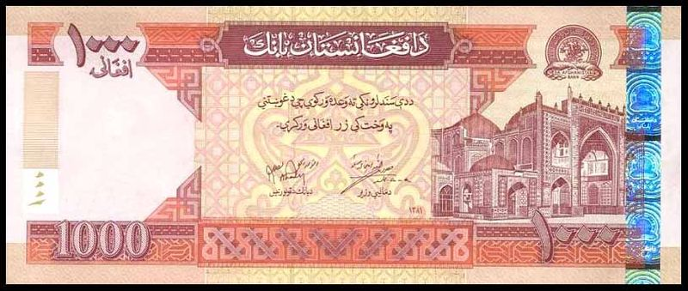
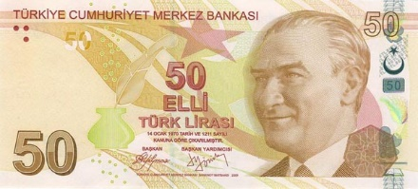
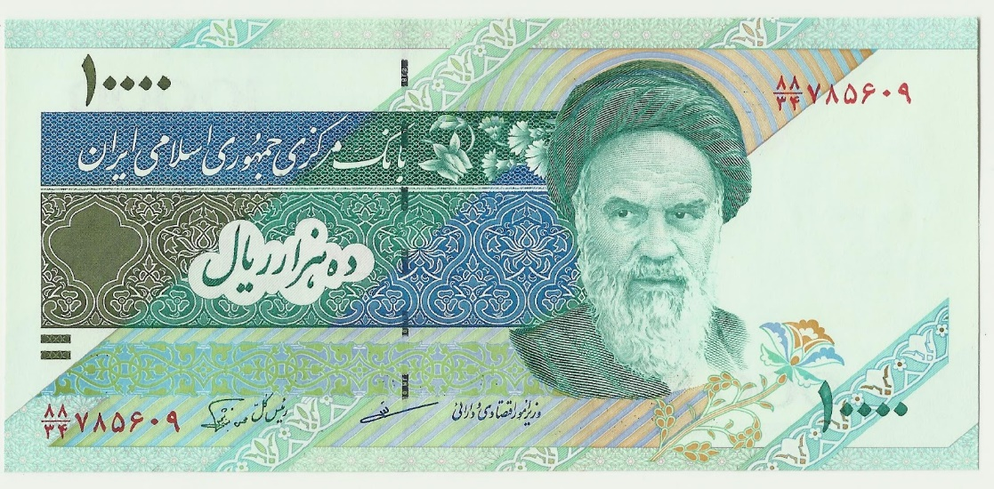
Afghanistan afghani
Turkish lira
Iranian rial
© Brain Wrinkles

Slide 26
Exchange Rate
What the currency of a nation is worth in terms of another country’s currency is called the exchange rate.
For example, an exchange rate of 3 Turkish lira to the US dollar means that 3 lira are worth the same as 1 dollar.
Foreign exchange makes it easier to trade all around the world.
© Brain Wrinkles

Slide 27
Nation | Currency | Exchange Rate Against US Dollar 2016
Turkey | Lira | 2.9
Saudi Arabia | Riyal | 3.7
Israel | Shekel | 3.8
Afghanistan | Afghani | 67.5
Iraq | Dinar | 1,176
Iran | Rial | 30,568
© Brain Wrinkles

Slide 28
OPEC
© Brain Wrinkles

Slide 29
OPEC
In 1960, Iran, Iraq, Saudi Arabia, Kuwait, and Venezuela formed an organization called the Organization of Petroleum Exporting Countries (OPEC).
OPEC’s purpose is to unify petroleum prices in order to promote stability in the world oil market and ensure a regular supply of petroleum to other countries.
OPEC sets the prices and amount of oil produced by its member nations.
© Brain Wrinkles

Slide 30
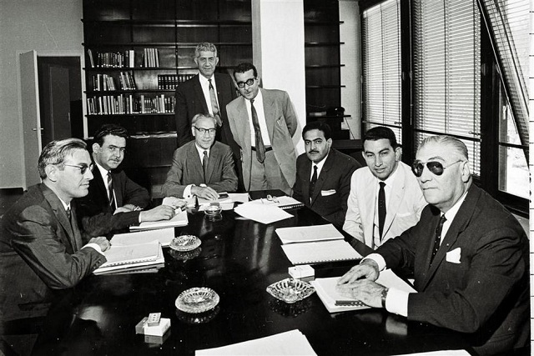
OPEC Conference 1960
© Brain Wrinkles

Slide 31
Function
Before 1960, the amount of oil produced worldwide was greater than the demand for it.
Because of this, oil prices were low and oil-producing countries made less money.
When OPEC was formed, oil production was controlled and the demand increased worldwide.
Oil prices rose and oil-producing countries made more money.
© Brain Wrinkles

Slide 32
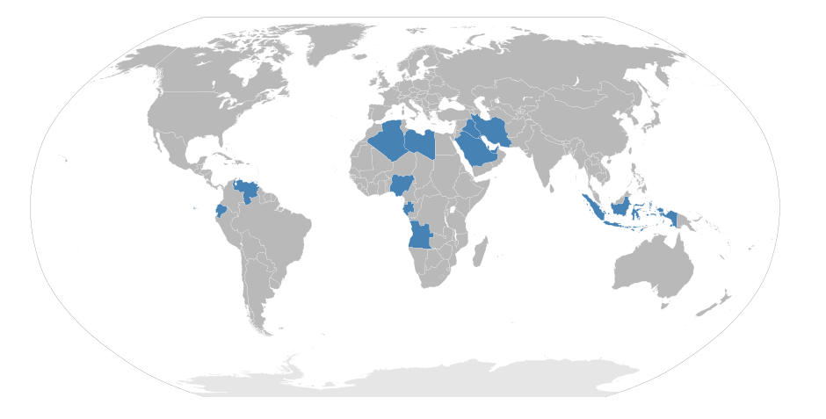
Current OPEC Members
© Brain Wrinkles

Slide 33
Extra! Extra!
Directions: Write a news article that describes this important event: OPEC being formed in 1960. Add a catchy headline (top box) and an action shot (snapshot box). Be sure to include information about OPEC’s purpose.
Date:
$
Article By:
© Brain Wrinkles

Slide 34
TEACHER INFO: Comprehension Check
Print off the Comprehension Check handout for each student.
Students will complete the assignment after discussing the presentation. This can also be used as a quiz!
© Brain Wrinkles

Slide 35
1. Give an example of specialization:
2. What are two advantages to specialization?
3. What type of trade barrier involves adding a special tax on imported goods?
4. What trade barrier restricts the quantity of an item that is brought into a country?
5. What is an embargo?
6. . How did the United Nations punish Iraq when it invaded Kuwait in 1990?
7. Why has the US placed several embargoes against Iran over the past two decades?
8. What does OPEC stand for?
9. Who were the founding members of OPEC?
10. What is OPEC’s function?
11. Why must people exchange currency?
12. What is worth more: one US dollar or one Turkish lira?
© Brain Wrinkles
Voluntary Trade
Comprehension Check

