Slide 1
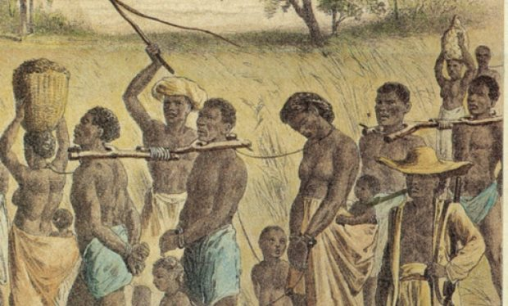
Crash Course: The Atlantic Slave Trade (11:07)

Slide 2
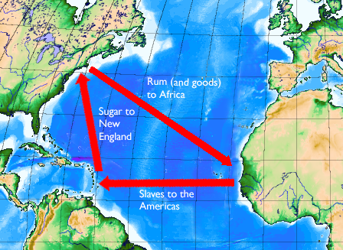
Objective: To examine the causes and effects of the Triangular Trade.
Notes:
Helpful Hints:
Distribute the Triangular Trade cloze sheet.
Make sure every student has two contrasting colored pencils. (or have them share if there aren’t enough)
Walk them through the process of labeling the two trade routes contained in the presentation using a different color for each route; begin by labeling the land masses.
If time, view the concluding videos.

Slide 3
England
.
tobacco, rice, indigo
American Colonies
.
guns, textiles
slaves
Africa
West Indies

Slide 4
England
.
.
American Colonies
sugar, molasses
rum, iron
Africa
West Indies
slaves

Slide 5
England
.
tobacco, rice, indigo
.
American Colonies
.
guns, textiles
sugar, molasses
rum, iron
slaves
Africa
West Indies
slaves

