Slide 1
Independence of
South Sudan
Political, Economic, & Social
Conflicts
© 2014 Brain Wrinkles

Slide 2
Standards
SS7CG2 The student will explain the structures of the modern governments of Africa.
b. Explain how political, economic, and social conflicts resulted in the independence of South Sudan.
© 2014 Brain Wrinkles

Slide 3
Teacher Directions – CLOZE Notes
The next page is a handout for the students to use for note-taking during the presentation. (*Some of the notes are captions on the picture slides.)
Check the answers as a class after the presentation.
© 2014 Brain Wrinkles

Slide 4
Colonization
______________________established colonial rule of the region (Sudan) in the 19th century.
In ______________, the British divided the region into two territories: the Arabic-speaking Muslim north, and the mostly English-speaking Christian and Animist south.
One Nation
In the 1940s, Great Britain merged the two areas together to be one nation with a ______________________ government and ___________________as the official language.
The South felt discriminated against because the government was based in the Northern city of ______________________.
Independence
In _____, Sudan gained its ______________________ from Great Britain, but there was still a lot of tension between the north and south.
1st Civil War
The first of Sudan’s two civil wars broke out in 1955 and lasted until _____.
The two sides finally settled on a ______________________ that lasted for 10 years.
Islamic Law
Fighting began again when the northern government established ______________________ throughout the country.
______________________ at attempts to impose Islamic law on the whole country.
Dictator Omar ______________________ seized power in 1989 and continued to impose radical Islamic law.
20+ years of fighting have led to the displacement of over ______________________ and the deaths of ______________________.
Secession
In 2005, the northern and southern parts of Sudan signed a ______________.
In January 2011, nearly _______ of South Sudanese voters called for independence.
South Sudan became an independent country on ______________________.
Salva Kiir ______________________, the first President of South Sudan.
Oil Control
Most of the ______________________ are in South Sudan, but the factories, ______________________, shipping ports, etc., are in Sudan.
The region exports billions of dollars of oil per year. Southern states produce more than _______of it, but receive only ______________________, causing tensions between the two countries.
Negotiating a deal is critical to both countries’ _____________in the future.
South Sudanese War
In __________________, a political power struggle broke out between President Kiir and his ex-deputy Riek Machar.
This has caused a civil war between the major ______________________ within the country.
© 2014 Brain Wrinkles
South Sudan CLOZE Notes

Slide 5
Colonization
Great Britain established colonial rule of the region (Sudan) in the 19th century.
In 1924, the British divided the region into two territories: the Arabic-speaking Muslim north, and the mostly English-speaking Christian and Animist south.
One Nation
In the 1940s, Great Britain merged the two areas together to be one nation with a northern government and Arabic as the official language.
The South felt discriminated against because the government was based in the Northern city of Khartoum.
Independence
In 1956, Sudan gained its independence from Great Britain, but there was still a lot of tension between the north and south.
1st Civil War
The first of Sudan’s two civil wars broke out in 1955 and lasted until 1972.
The two sides finally settled on a peace agreement that lasted for 10 years.
Islamic Law
Fighting began again when the northern government established Islamic law throughout the country.
Southerners were angered at attempts to impose Islamic law on the whole country.
Dictator Omar al-Bashir seized power in 1989 and continued to impose radical Islamic law.
20+ years of fighting have led to the displacement of over 4 million people and the deaths of 1.5 million.
Secession
In 2005, the northern and southern parts of Sudan signed a peace accord.
In January 2011, nearly 99% of South Sudanese voters called for independence.
South Sudan became an independent country on July 9, 2011.
Salva Kiir Mayardit, the first President of South Sudan.
Oil Control
Most of the oil reserves are in South Sudan, but the factories, pipelines, shipping ports, etc., are in Sudan.
The region exports billions of dollars of oil per year. Southern states produce more than 80% of it, but receive only 50% of the profits, causing tensions between the two countries.
Negotiating a deal is critical to both countries’ peace in the future.
South Sudanese War
In December 2013, a political power struggle broke out between President Kiir and his ex-deputy Riek Machar.
This has caused a civil war between the major ethnic groups within the country.
© 2014 Brain Wrinkles
South Sudan CLOZE Notes
KEY

Slide 6
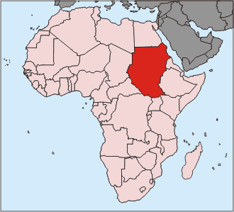
Sudan
Before 2011
© 2014 Brain Wrinkles

Slide 7
Colonization
Great Britain established colonial rule of the region (Sudan) in the 19th century.
In 1924, the British divided the region into two territories: the Arabic-speaking Muslim north, and the mostly English-speaking Christian and Animist south.
© 2014 Brain Wrinkles

Slide 8
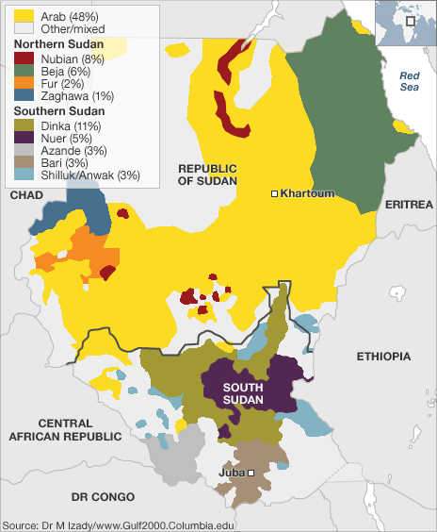
The northern region is home to mainly Arab-speaking Muslims. But in the southern region, there is no dominate culture. The Dinka and Nuer are the largest of nearly 200 ethnic groups.
© 2014 Brain Wrinkles

Slide 9
One Nation
In the 1940s, Great Britain merged the two areas together to be one nation with a northern government and Arabic as the official language.
Southern Sudan was shut out of the new government.
© 2014 Brain Wrinkles

Slide 10
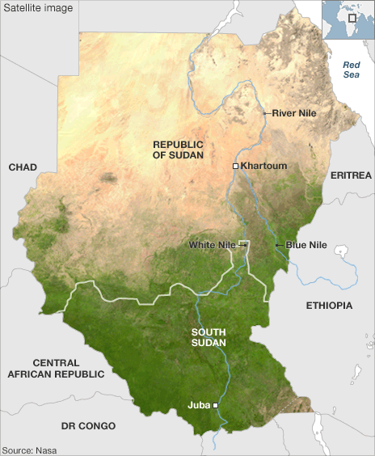
The South felt discriminated against because the government
was based in the Northern city
of Khartoum.
© 2014 Brain Wrinkles

Slide 11
Khartoum
© 2014 Brain Wrinkles

Slide 12
Independence
In 1956, Sudan gained its independence from Great Britain, but there was still a lot of tension between the north and south.
South Sudanese were not happy with northern rule.
© 2014 Brain Wrinkles

Slide 13
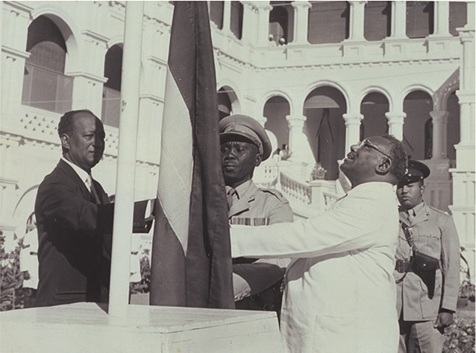
Sudan’s flag raised at its independence ceremony in 1956.
© 2014 Brain Wrinkles

Slide 14
1st Civil War
The first of Sudan’s two civil wars broke out in 1955 and lasted until 1972.
The two sides finally settled on a peace agreement that lasted for 10 years.
© 2014 Brain Wrinkles

Slide 15
Islamic Law
Fighting began again when the northern government established Islamic law throughout the country.
Southerners were angered at attempts to impose Islamic law on the whole country.
© 2014 Brain Wrinkles

Slide 16
Islamic Law
Civil war had been going on between the North and South for most of Sudan’s history.
Dictator Omar al-Bashir seized power in 1989 and continued to impose radical Islamic law.
© 2014 Brain Wrinkles

Slide 17
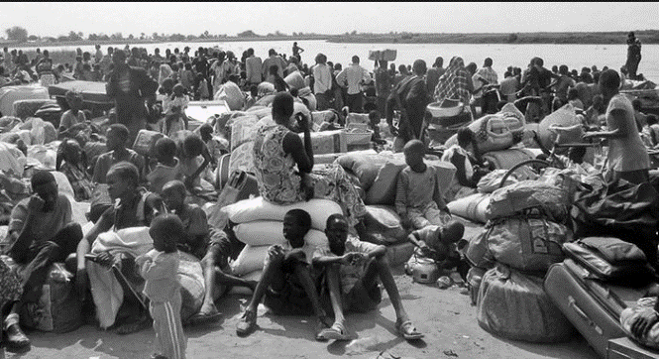
20+ years of fighting have led to the displacement of over 4 million people and the deaths of 1.5 million.
© 2014 Brain Wrinkles

Slide 18
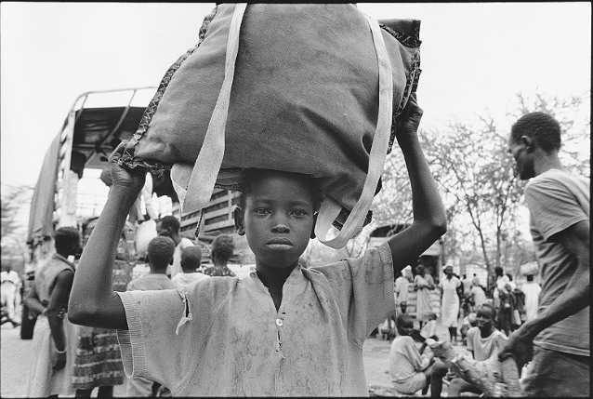
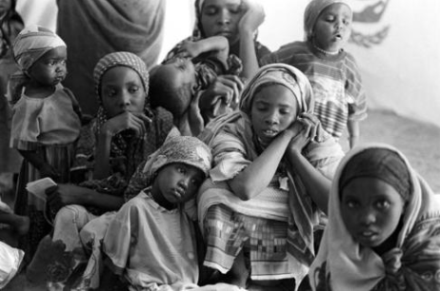
© 2014 Brain Wrinkles

Slide 19
Secession
In 2005, the northern and southern parts of Sudan signed a peace accord.
This allowed the South to rule itself for six years and then vote in a referendum for independence.
In January 2011, nearly 99% of South Sudanese voters called for independence.
© 2014 Brain Wrinkles

Slide 20
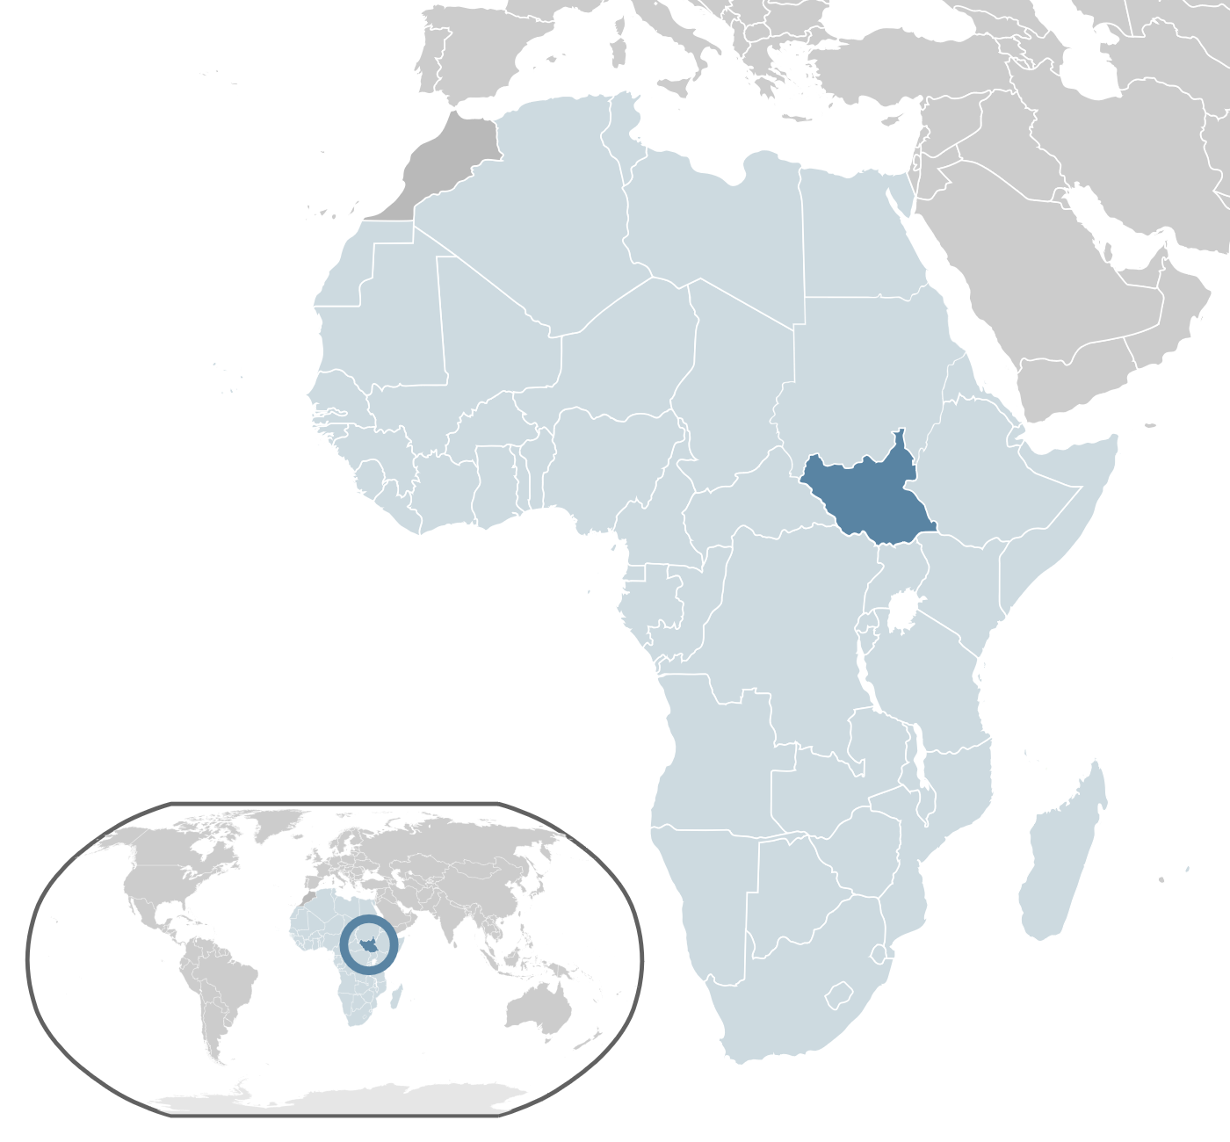
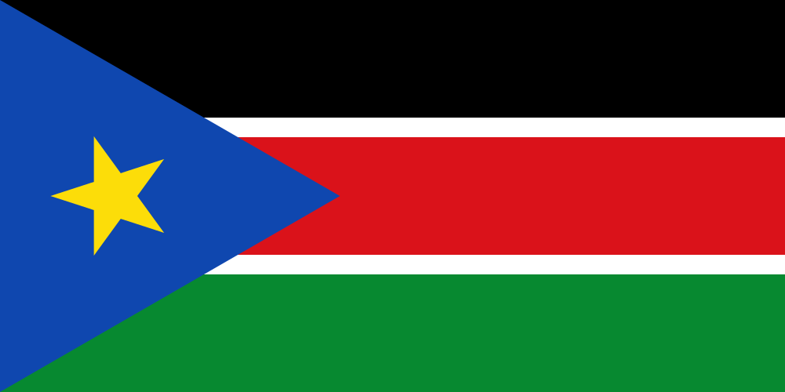
South Sudan became an independent country on July 9, 2011.
© 2014 Brain Wrinkles

Slide 21
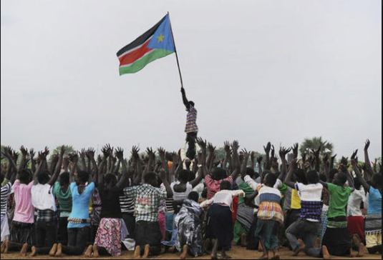
© 2014 Brain Wrinkles

Slide 22
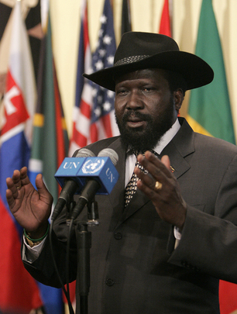
Salva Kiir Mayardit, the first President of South Sudan.
(His trademark hat was a gift from former US President George W. Bush.)
© 2014 Brain Wrinkles

Slide 23
Oil Control
Unfortunately, there are still problems between the two countries.
Sudan and South Sudan are tied economically by oil.
Most of the oil reserves are in South Sudan, but the factories, pipelines, shipping ports, etc., are in Sudan.
© 2014 Brain Wrinkles

Slide 24
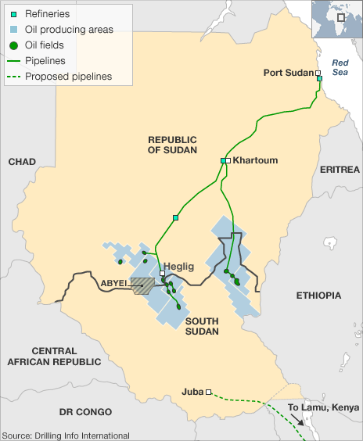
The region exports billions of dollars of oil per year.
Southern states produce more than 80% of it, but receive only 50% of the profits, causing tensions between the two countries.
© 2014 Brain Wrinkles

Slide 25
Oil Control
Both countries continue to disagree on how to divide oil wealth and settling border disputes.
Negotiating a deal is critical to both countries’ peace in the future.
© 2014 Brain Wrinkles

Slide 26
South Sudanese War
In December 2013, a political power struggle broke out between President Kiir and his ex-deputy Riek Machar.
This has caused a civil war between the major ethnic groups within the country.
Up to 10,000 people are estimated to have been killed.
More than 800,000 people have been displaced inside South Sudan and more than 250,000 people have fled to neighboring countries as a result of the conflict.
© 2014 Brain Wrinkles

Slide 27
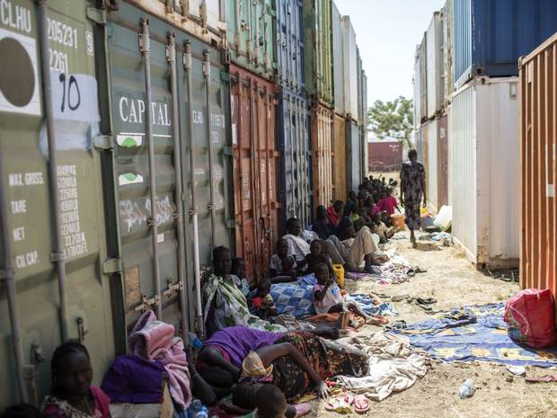
Displaced people who have fled the recent fighting in South Sudan.
© 2014 Brain Wrinkles

Slide 28
Teacher Directions – Foldable
The next page is for an Interactive Foldable.
Print out the foldable page for each student.
The students will cut the template out along the thick outside lines.
Next, they will cut along the thin lines that divide each section, stopping at the gray rectangle.
They should attach the side of the template (gray rectangle) to their notebooks.
They will now be able to open up each flap and write the definitions underneath.
The students will write the social, political, and economic conflicts that led to South Sudan’s independence inside of each flap.
*If time allows, have students color the flaps.
© 2014 Brain Wrinkles

Slide 29
South Sudan’s Independence
© 2014 Brain Wrinkles
Social
Conflicts
Political
Conflicts
Economic
Conflicts

Slide 30
Teacher Directions – South Sudan “Birth Announcement”
Have the students create a card to announce the “birth” of South Sudan.
In the 1st box, they will write a description about how and why it was formed (include the political, social, and economic reasons).
In the 2nd box, they will draw an illustration to represent South Sudan’s independence.
In the third box, they will write a commentary about how people in the region feel about the formation of South Sudan. (They should include how people in the South and people in the North feel.)
© 2014 Brain Wrinkles

Slide 31
South Sudan’s Birth Announcement
Directions: Create a card to announce the “birth” of South Sudan. 1. Write a description about how and why it was formed (include the political, social, and economic reasons). 2. Draw an illustration to represent the event. 3. Write a commentary about how people in the region feel about the formation of South Sudan (there should be more than one perspective).
It’s a___________!
Date of Birth:
1.
2.
3.
© 2014 Brain Wrinkles

Slide 32
Teacher – S.W.B.S. Ticket Out the Door
Give each student a SWBS Ticket Out the Door. The students will summarize South Sudan’s independence by following the format below:
Somebody -- (South Sudan)
Wanted – (what were they trying to do/what was the goal?)
But – (what was the problem/what got in the way?)
So – (what ended up happening?)
© 2014 Brain Wrinkles

Slide 33
S. W. B. S.
S. W. B. S.
Somebody:
Wanted:
But:
So:
Somebody:
Wanted:
But:
So:
© 2014 Brain Wrinkles
© 2014 Brain Wrinkles

Slide 34
Thank You!
Thank you so much for downloading this file. I sincerely hope you find it helpful and that your students learn a lot from it! I look forward to reading your feedback in my store.
If you like this file, you might want to check out some of my other products that teach social studies topics in creative, engaging, and hands-on ways.
Best of luck to you this school year,
Ansley at Brain Wrinkles
© 2014 Brain Wrinkles

Slide 35
Terms of Use
© 2014 Brain Wrinkles. Your download includes a limited use license from Brain Wrinkles. The purchaser may use the resource for personal classroom use only. The license is not transferable to another person. Other teachers should purchase their own license through my store.
This resource is not to be used:
By an entire grade level, school, or district without purchasing the proper number of licenses. For school/district licenses at a discount, please contact me.
As part of a product listed for sale or for free by another individual.
On shared databases.
Online in any way other than on password-protected website for student use only.
© Copyright 2014. Brain Wrinkles. All rights reserved. Permission is granted to copy pages specifically designed for student or teacher use by the original purchaser or licensee. The reproduction of any other part of this product is strictly prohibited. Copying any part of this product and placing it on the Internet in any form (even a personal/classroom website) is strictly forbidden. Doing so makes it possible for an Internet search to make the document available on the Internet, free of charge, and is a violation of the Digital Millennium Copyright Act (DMCA).
Thank you,
Ansley at Brain Wrinkles
Clipart, fonts, & digital papers for this product were purchased from:
© 2014 Brain Wrinkles

