Slide 1
SS7H3c
Rebuilding
Japan
After World War 11
© 2015 Brain Wrinkles

Slide 2
Standards
SS7H3 The student will analyze continuity and change in Southern and Eastern Asia leading to the 21st century.
c. Explain the role of the United States in the rebuilding of Japan after WWII.
© 2015 Brain Wrinkles

Slide 3
Pearl Harbor
On December 7, 1941, Japanese airplanes made a surprise attack on the US naval base at ______________________________ in Hawaii.
More than ______________________________ , and many US battleships and airplanes were destroyed.
US Enters WWII
The next day, ______________________________ asked Congress to declare war on Japan.
They agreed and the US officially ____________________________________________ .
On December 11, ______________________________ declared war on the US.
The US was now deeply involved in WWII on the ______________________________ .
Island Hopping
In 1944, the US followed an “______________________________ ” campaign in the Pacific.
US forces attacked island after island ______________________________ .
This campaign brought American troops closer and ______________________________ .
Japan’s Soldiers
Fighting Japan was difficult because the Japanese were ______________________________ .
The Japanese soldiers never gave up and were willing to ______________________________ for their country.
Japanese __________________________________________________ into US ships on purpose, fully expecting to die.
Iwo Jima
In February 1945, American forces invaded the ______________________________ .
The island was important because it was ______________________________ and it was a good place for US planes to land.
The Japanese protected the island with ______________________________ .
It was a fierce battle, but the ______________________________ eventually took the island.
© 2015 Brain Wrinkles
Rebuilding Japan
CLOZE Notes 1

Slide 4
Atomic Bombs
The Allies thought about invading Japan, but were worried that too many ______________________________ .
______________________________ made a difficult decision to use nuclear weapons against Japan.
He warned the Japanese government to surrender, but they ______________________________ .
On August 6, 1945, an American bomber plane dropped the first atomic bomb ever used in war on the ______________________________ .
A few days later, the US dropped a ______________________________ .
Both cities were ______________________________ , and the Japanese finally agreed to surrender.
Japan is the ______________________________ in the world that has been attacked by nuclear weapons.
VJ Day
The two sides signed formal surrender papers on the US battleship Missouri on ______________________________ .
This day is officially known as ________________________________________________________ .
Destruction
After Japan’s surrender, Japan’s ______________________________ were devastated.
_______________________________________________ and the emperor was exposed as a mere mortal and not a god.
The country’s ______________________________ (transportation, communication, sewage, water, and electric systems) was demolished.
US Occupation
The US had a plan to occupy and rebuild Japan in a way that would guarantee the country would ______________________________ to others in the future.
______________________________ was sent to oversee Japan’s restoration.
The US occupied Japan from ______________________________ .
© 2015 Brain Wrinkles
Rebuilding Japan
CLOZE Notes 2

Slide 5
MacArthur’s Help
General MacArthur ordered Japan’s military to be disbanded and __________________________________________________ .
He also directed that government and military leaders involved in World War II were brought to ______________________________ .
In addition, MacArthur helped Japan install a new ______________________________ .
Government
MacArthur decided that Japan would be a ______________________________ in order to preserve the emperor’s role in the country’s culture.
He wrote Japan’s constitution, still referred to as The MacArthur Constitution, and it is still considered one of the ______________________________ in the world today.
The constitution set up a ________________________________________________________________________ .
Japanese citizens were granted many of the _____________________________________________________ .
Reparations
Japan’s constitution also prevents the country from ______________________________ of fighting with other countries (unless they are attacked first).
After signing the new constitution, the Japanese government pledged to ______________________________ to the countries that they harmed during WWII.
The Japanese were also ___________________________________________________________ in any way.
Economy
The US offered ______________________________ to help kick start Japan’s economy after WWII.
This money coupled with a strong ______________________________ led to a boom in Japan’s economic growth.
Much like the US, Japan leans towards a ______________________________ , which motivates its citizens to develop new ideas and expand businesses.
Japan Today
On ______________________________ , Japan became a fully sovereign nation.
America’s occupation and MacArthur’s rebuilding of Japan has had a _____________________________________________.
Today, the country has one of the most _________________________________________________ in the world.
Japan also has one of the most _______________________________________________ in the world.
© 2015 Brain Wrinkles
Rebuilding Japan
CLOZE Notes 3

Slide 6
Background
Information

Slide 7
Pearl Harbor
On December 7, 1941, Japanese airplanes made a surprise attack on the US naval base at Pearl Harbor in Hawaii.
More than 2,400 people were killed, and many US battleships and airplanes were destroyed.
© 2015 Brain Wrinkles

Slide 8
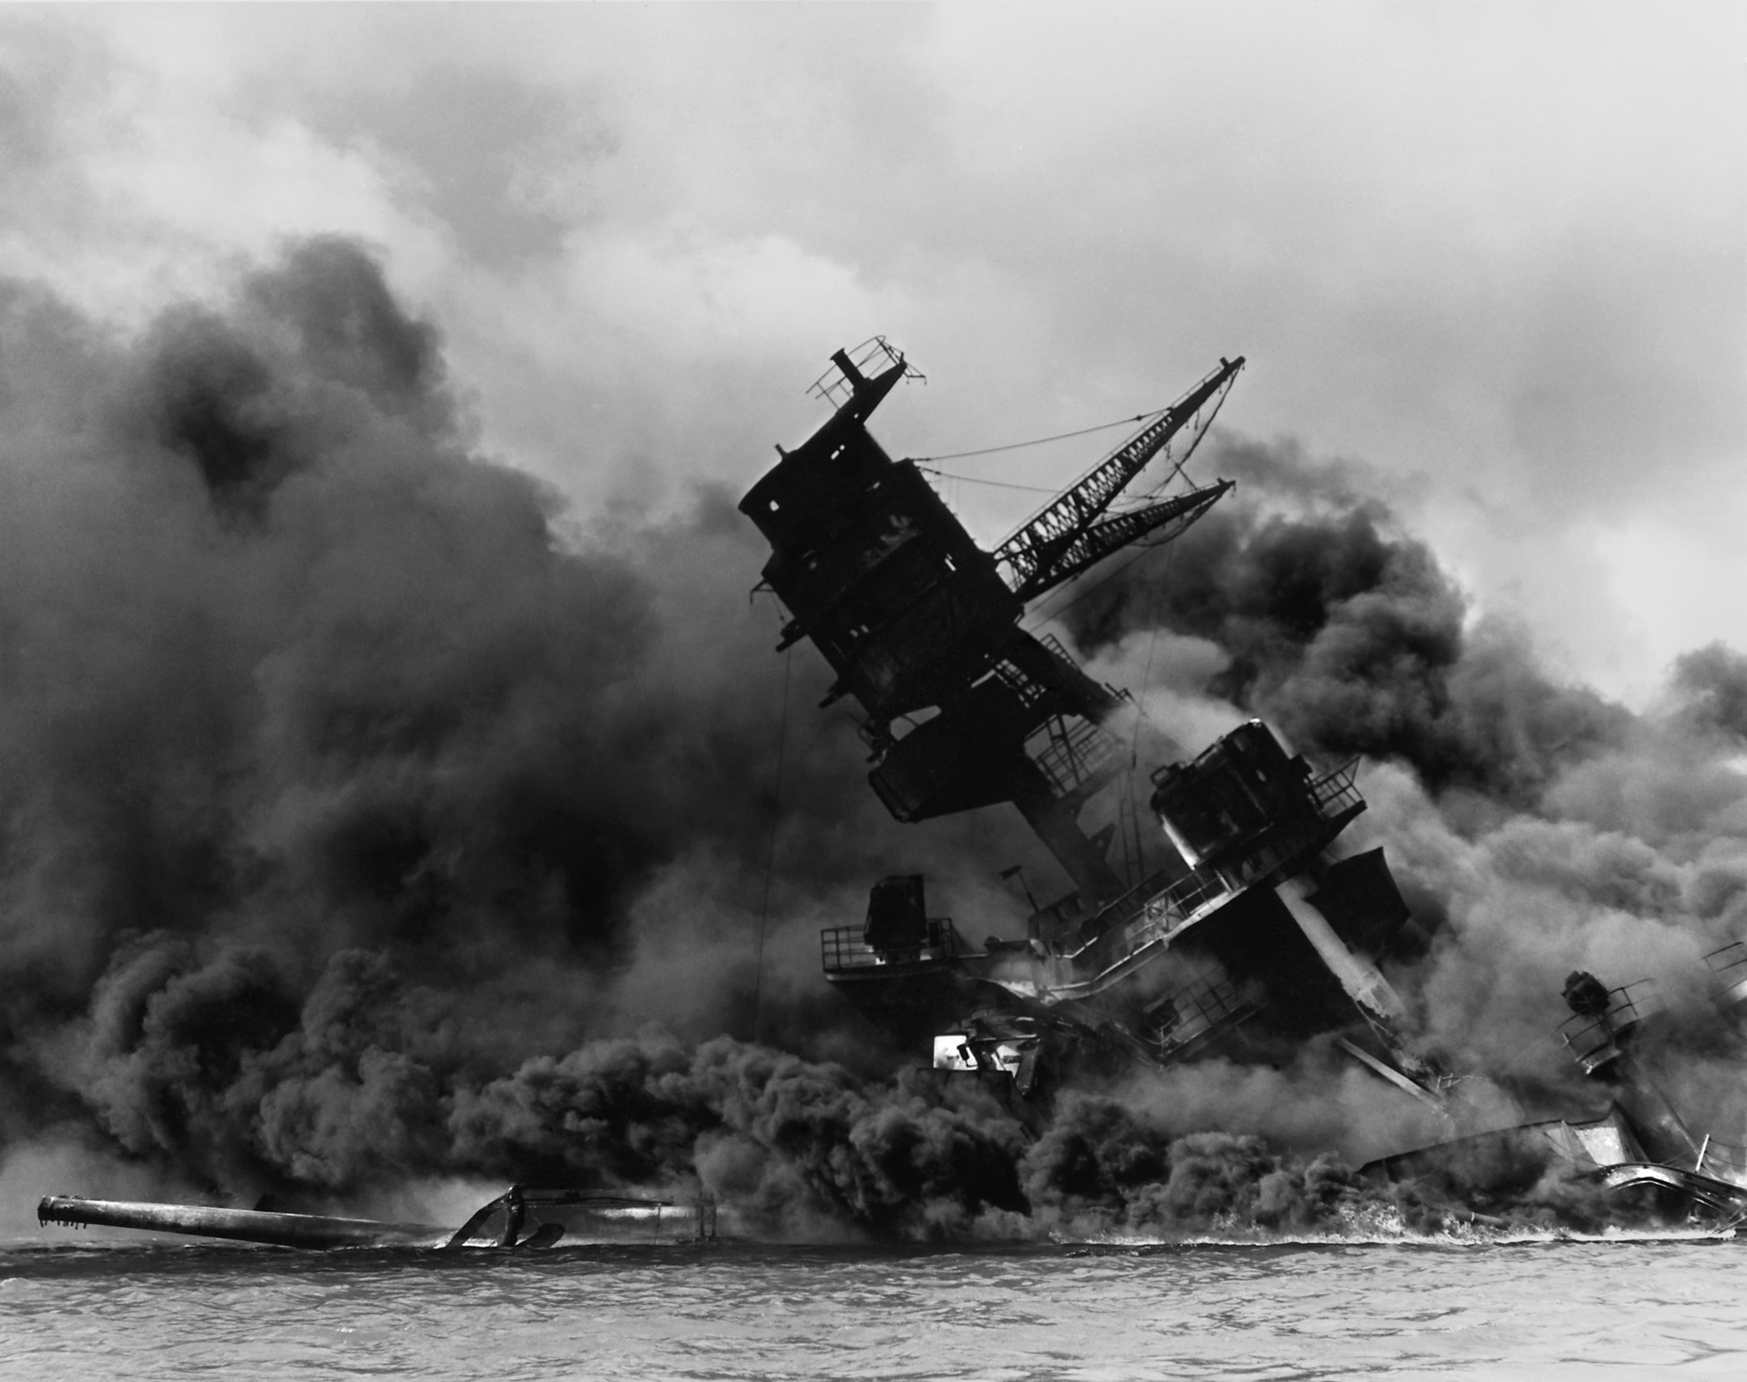
The USS Arizona After the Japanese Surprise Attack on Pearl Harbor.
© 2015 Brain Wrinkles

Slide 9
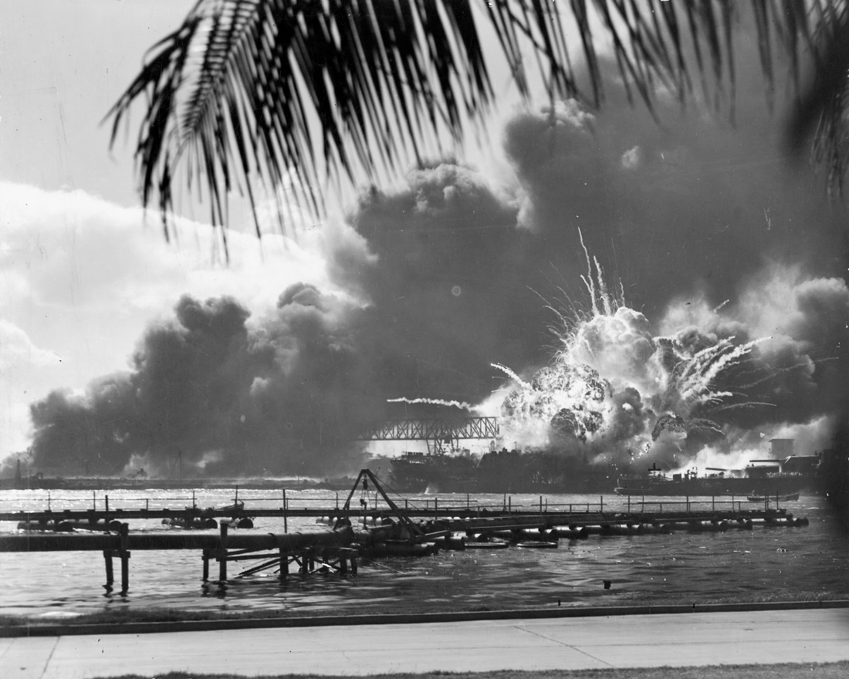
President Roosevelt called December 7, 1941, “a day that will live in infamy.”
© 2015 Brain Wrinkles

Slide 10
US Enters WWII
The next day, President Roosevelt asked Congress to declare war on Japan.
They agreed and the US officially entered WWII on December 8, 1941.
On December 11, Germany and Italy declared war on the US.
The US was now deeply involved in WWII on the side of the Allies.
© 2015 Brain Wrinkles

Slide 11
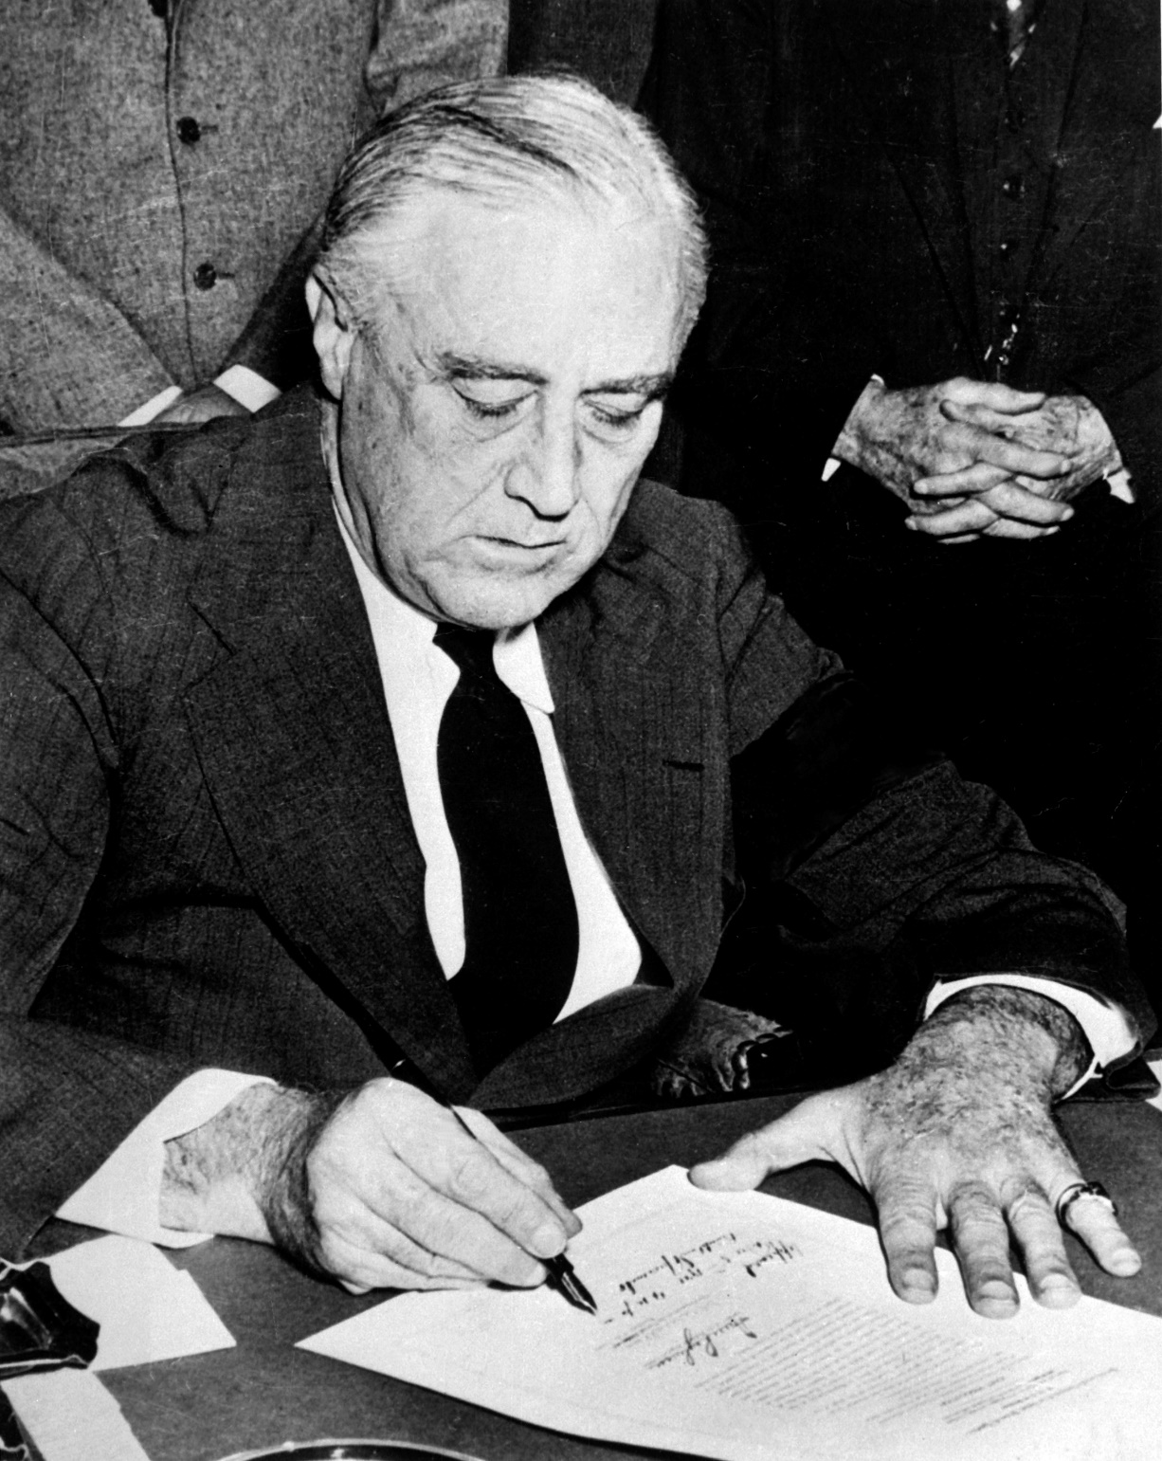
Roosevelt Signing Declaration of War Against Japan.
© 2015 Brain Wrinkles

Slide 12
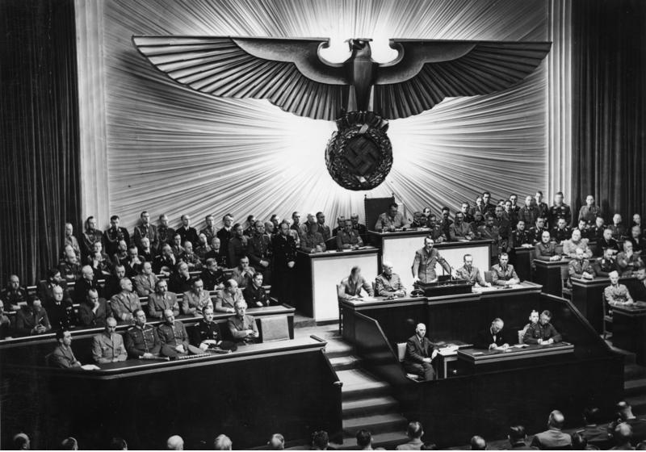
Hitler Declares War on the US – 1941.
© 2015 Brain Wrinkles

Slide 13
Island Hopping
In 1944, the US followed an “island-hopping” campaign in the Pacific.
US forces attacked island after island held by the Japanese.
This campaign brought American troops closer and closer to Japan.
© 2015 Brain Wrinkles

Slide 14
Japan’s Soldiers
Fighting Japan was difficult because the Japanese were fierce warriors.
The Japanese soldiers never gave up and were willing to sacrifice themselves for their country.
Japanese kamikaze pilots crashed their planes into US ships on purpose, fully expecting to die.
© 2015 Brain Wrinkles

Slide 15
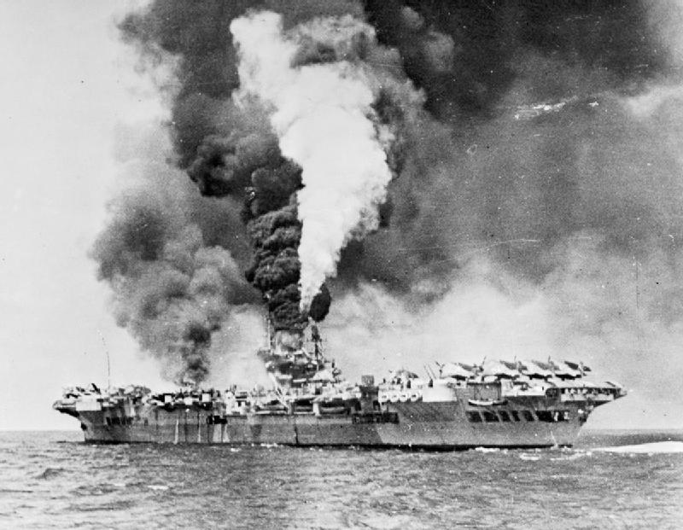
An Aircraft Carrier Hit By Kamikaze Planes – 1945.
© 2015 Brain Wrinkles

Slide 16
Iwo Jima
In February 1945, American forces invaded the island of Iwo Jima.
The island was important because it was close to Japan and it was a good place for US planes to land.
The Japanese protected the island with traps and underground tunnels.
It was a fierce battle, but the US Marines eventually took the island.
© 2015 Brain Wrinkles

Slide 17
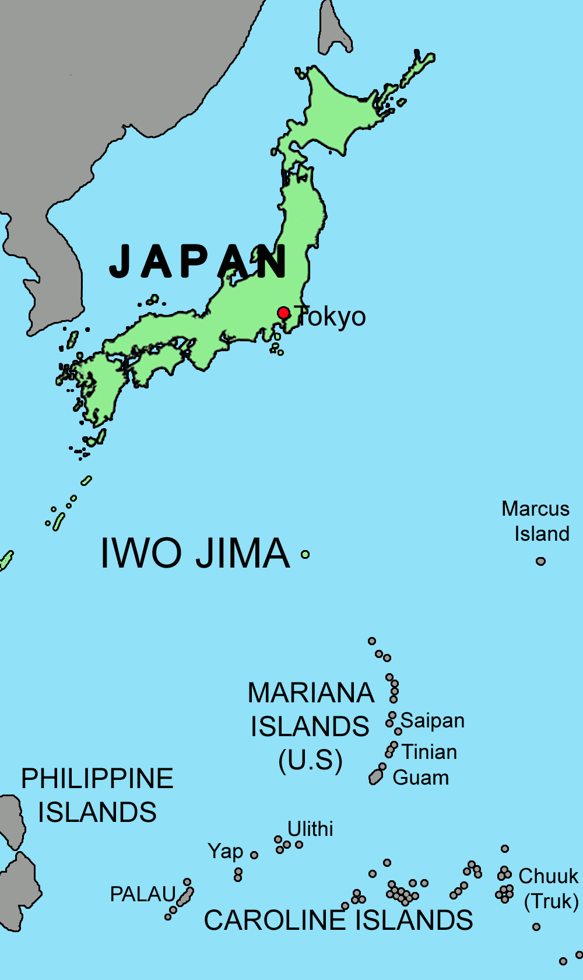
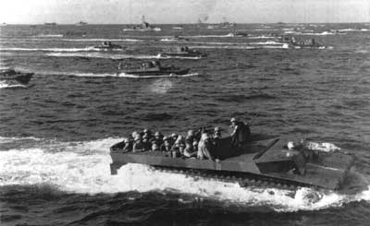
US Marines Approach Iwo Jima.
© 2015 Brain Wrinkles

Slide 18
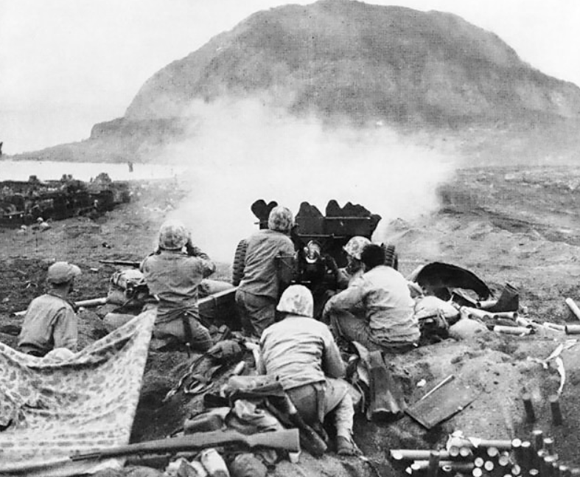
US Marines Fire at Japanese Cave Positions in Iwo Jima.
© 2015 Brain Wrinkles

Slide 19
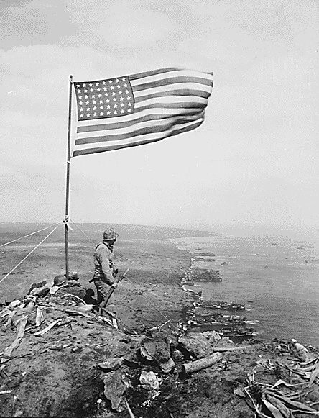
US Marines finally reached the highest point on the island and raised the American flag in victory.
© 2015 Brain Wrinkles

Slide 20
Atomic Bombs
The Allies thought about invading Japan, but were worried that too many soldiers would die.
President Harry Truman made a difficult decision to use nuclear weapons against Japan.
He warned the Japanese government to surrender, but they refused to give up.
© 2015 Brain Wrinkles

Slide 21
Atomic Bombs
On August 6, 1945, an American bomber plane dropped the first atomic bomb ever used in war on the Japanese city of Hiroshima.
A few days later, the US dropped a second bomb on Nagasaki.
Both cities were completely devastated, and the Japanese finally agreed to surrender.
Japan is the only country in the world that has been attacked by nuclear weapons.
© 2015 Brain Wrinkles

Slide 22
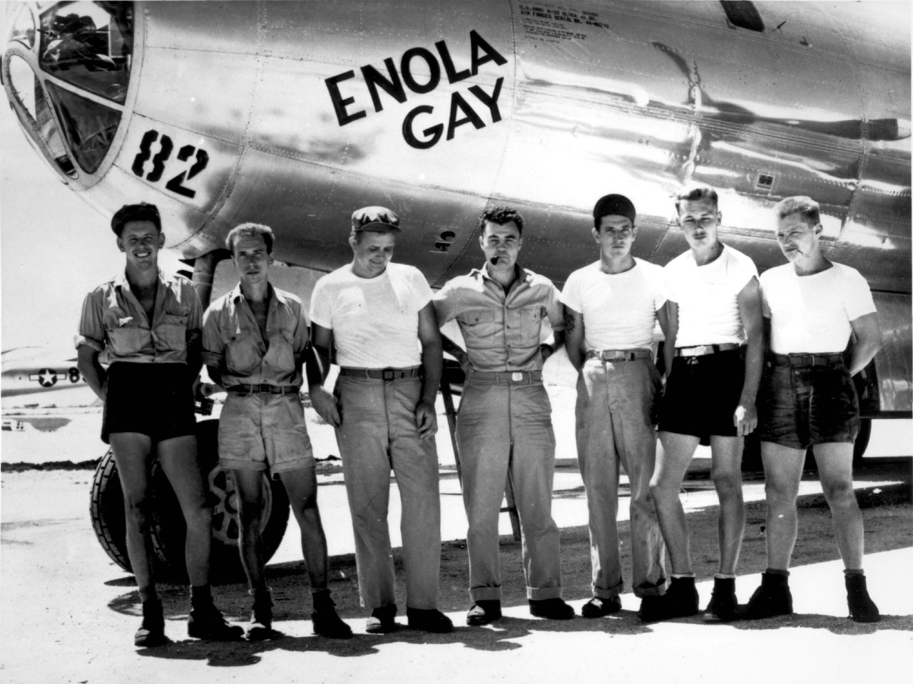
The Enola Gay dropped the “Little Boy” Atomic Bomb on Hiroshima.
© 2015 Brain Wrinkles

Slide 23
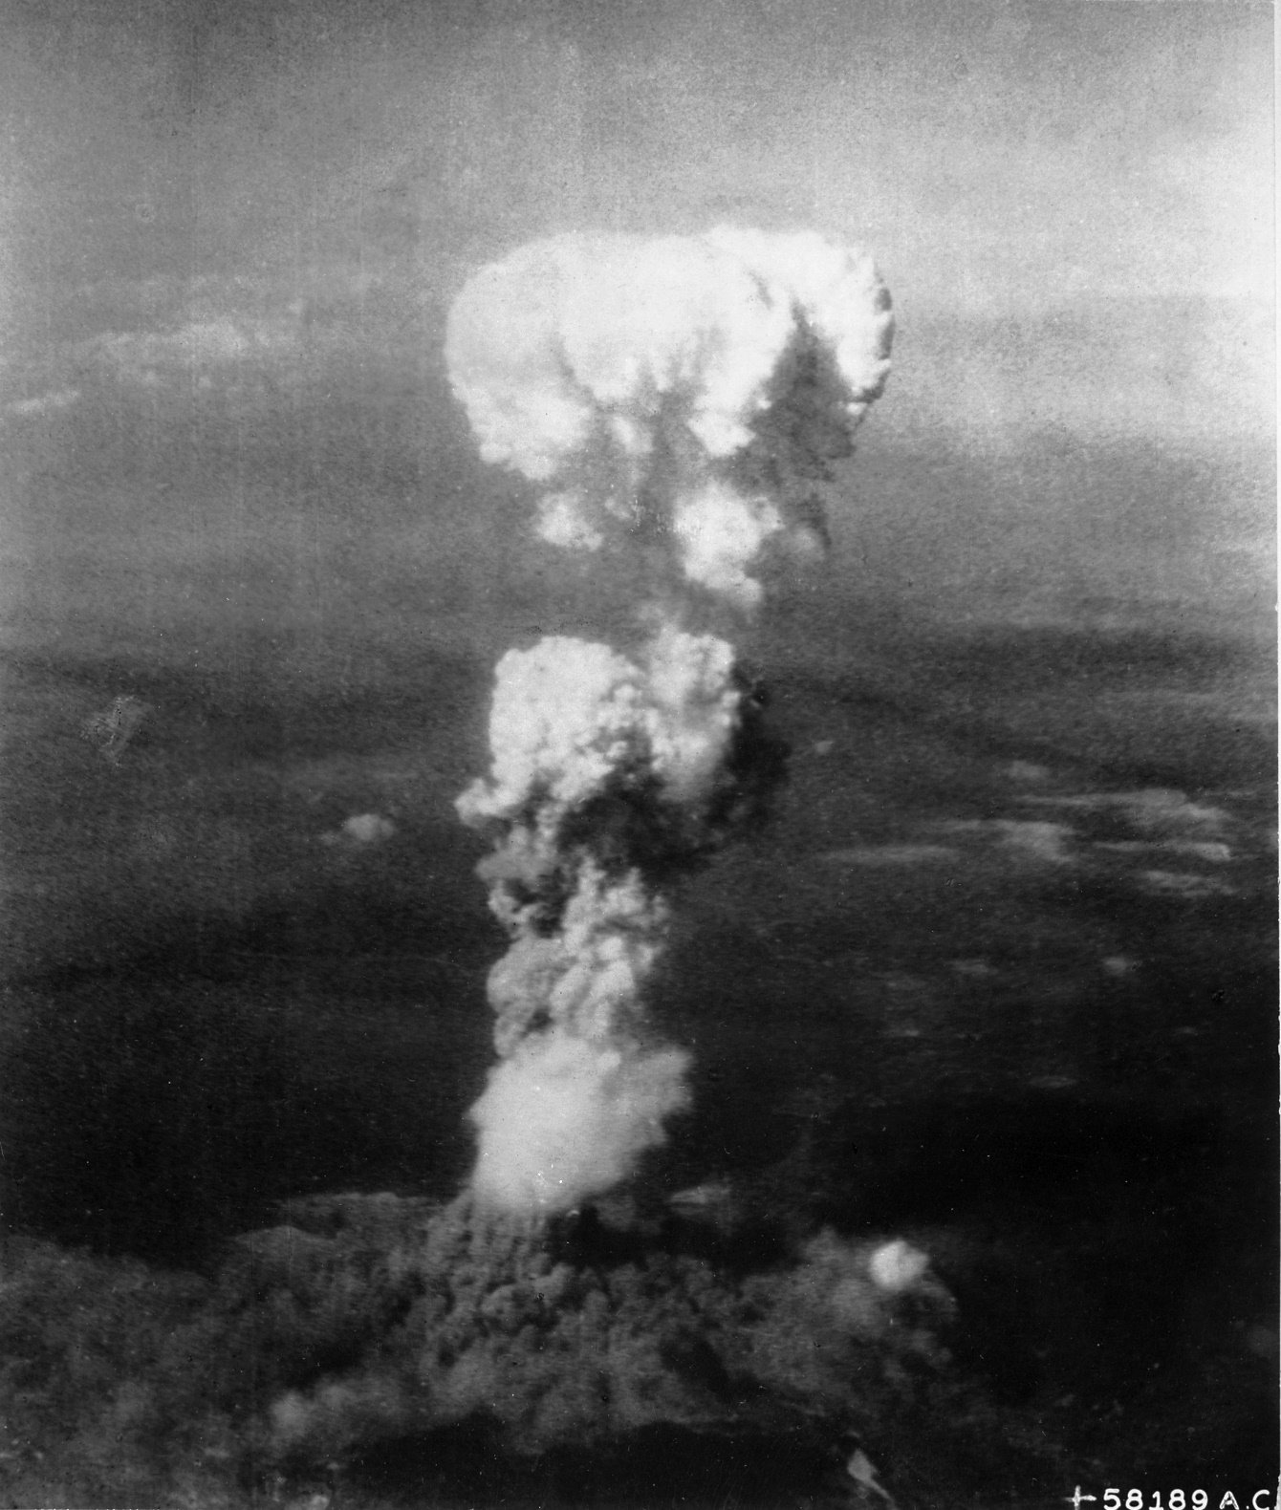
Mushroom Cloud Over Hiroshima.
© 2015 Brain Wrinkles

Slide 24
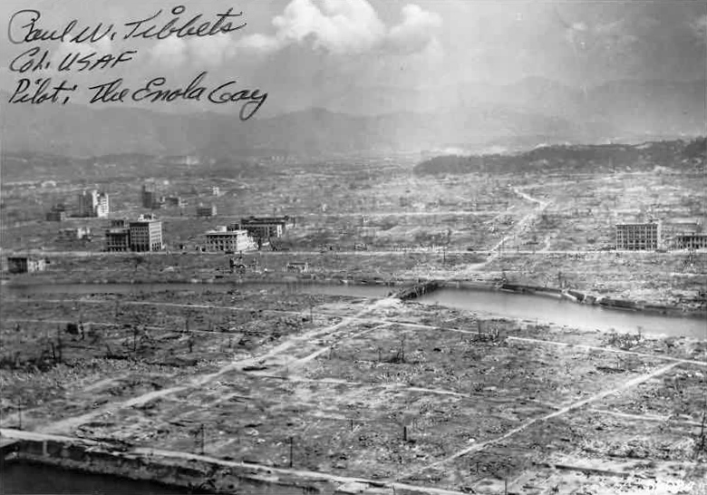
Hiroshima Aftermath
© 2015 Brain Wrinkles

Slide 25
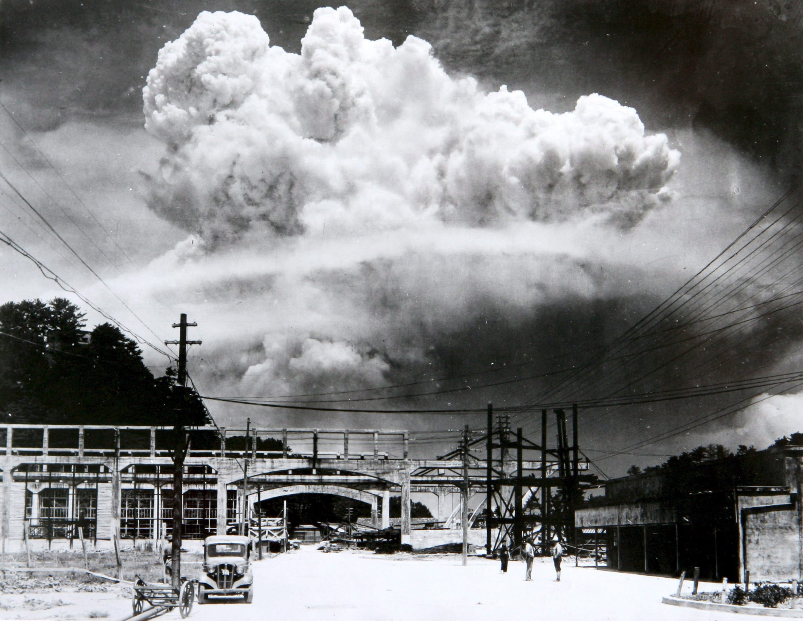
Mushroom Cloud Over Nagasaki.
© 2015 Brain Wrinkles

Slide 26
VJ Day
The two sides signed formal surrender papers on the US battleship Missouri on September 2, 1945.
This day is officially known as VJ Day – Victory in Japan Day.
© 2015 Brain Wrinkles

Slide 27
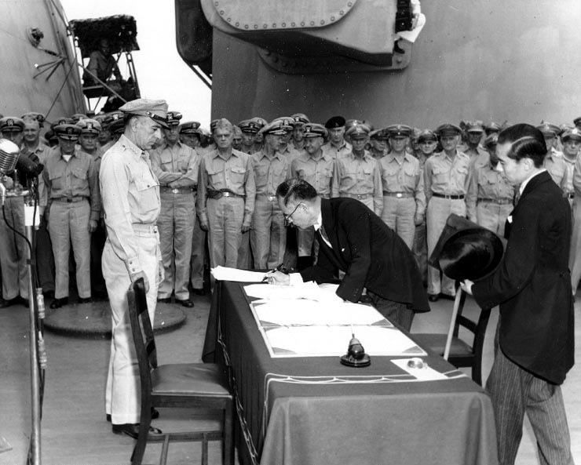
Japan Surrenders Aboard the USS Missouri,
September 2, 1945.
© 2015 Brain Wrinkles

Slide 28
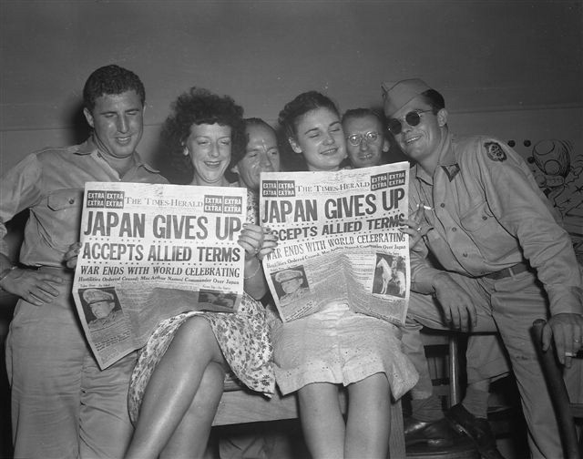
© 2015 Brain Wrinkles

Slide 29
Rebuilding
Japan
© 2015 Brain Wrinkles

Slide 30
Destruction
After Japan’s surrender, Japan’s economy and government were devastated.
Industries and farms were destroyed and the emperor was exposed as a mere mortal and not a god.
The country’s infrastructure (transportation, communication, sewage, water, and electric systems) was demolished.
© 2015 Brain Wrinkles

Slide 31
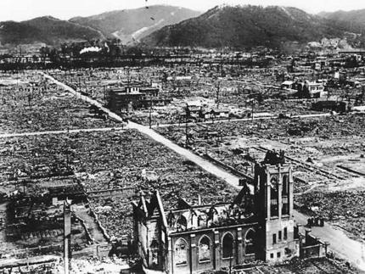
© 2015 Brain Wrinkles

Slide 32
US Occupation
The US had a plan to occupy and rebuild Japan in a way that would guarantee the country would not pose a military threat to others in the future.
General Douglas MacArthur was sent to oversee Japan’s restoration.
The US occupied Japan from 1945 to 1952.
© 2015 Brain Wrinkles

Slide 33
MacArthur’s Help
General MacArthur ordered Japan’s military to be disbanded and closed all weapons factories.
He also directed that government and military leaders involved in World War II were brought to trial and punished.
In addition, MacArthur helped Japan install a new democratic government.
© 2015 Brain Wrinkles

Slide 34
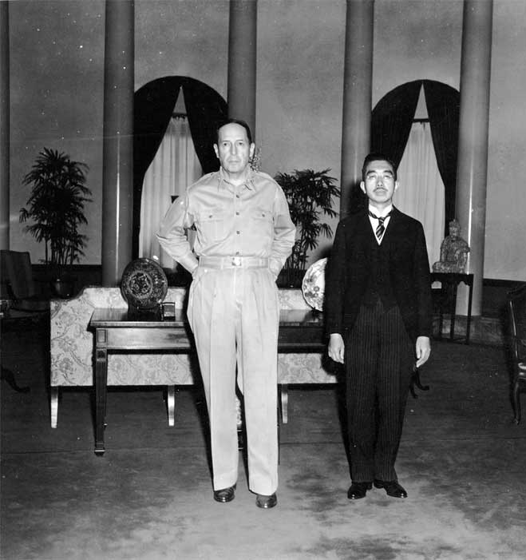
General Douglas MacArthur
and
Emperor Hirohito
© 2015 Brain Wrinkles

Slide 35
Government
MacArthur decided that Japan would be a constitutional monarchy in order to preserve the emperor’s role in the country’s culture.
He wrote Japan’s constitution, still referred to as The MacArthur Constitution, and it is still considered one of the most democratic documents in the world today.
The constitution set up a two-house parliament called a Diet.
Japanese citizens were granted many of the same rights as American citizens.
© 2015 Brain Wrinkles

Slide 36
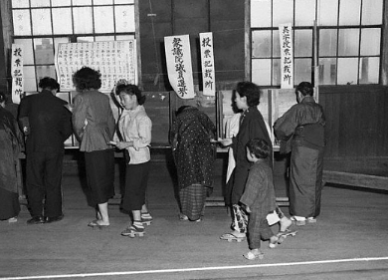
Elections in Tokyo
1952
© 2015 Brain Wrinkles

Slide 37
Reparations
Japan’s constitution also prevents the country from declaring war of fighting with other countries (unless they are attacked first).
After signing the new constitution, the Japanese government pledged to pay reparations to the countries that they harmed during WWII.
The Japanese were also not allowed to rebuild their military in any way.
© 2015 Brain Wrinkles

Slide 38
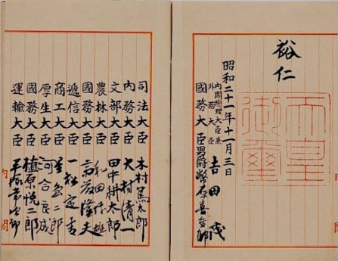
Japan’s Constitution
© 2015 Brain Wrinkles

Slide 39
Economy
The US offered financial support to help kick start Japan’s economy after WWII.
This money coupled with a strong Japanese work ethic led to a boom in Japan’s economic growth.
Much like the US, Japan leans towards a market economy, which motivates its citizens to develop new ideas and expand businesses.
© 2015 Brain Wrinkles

Slide 40
Japan Today
On April 28, 1952, Japan became a fully sovereign nation.
America’s occupation and MacArthur’s rebuilding of Japan has had a positive lasting effect.
Today, the country has one of the most stable democratic governments in the world.
Japan also has one of the most powerful industrialized economies in the world.
© 2015 Brain Wrinkles

Slide 41
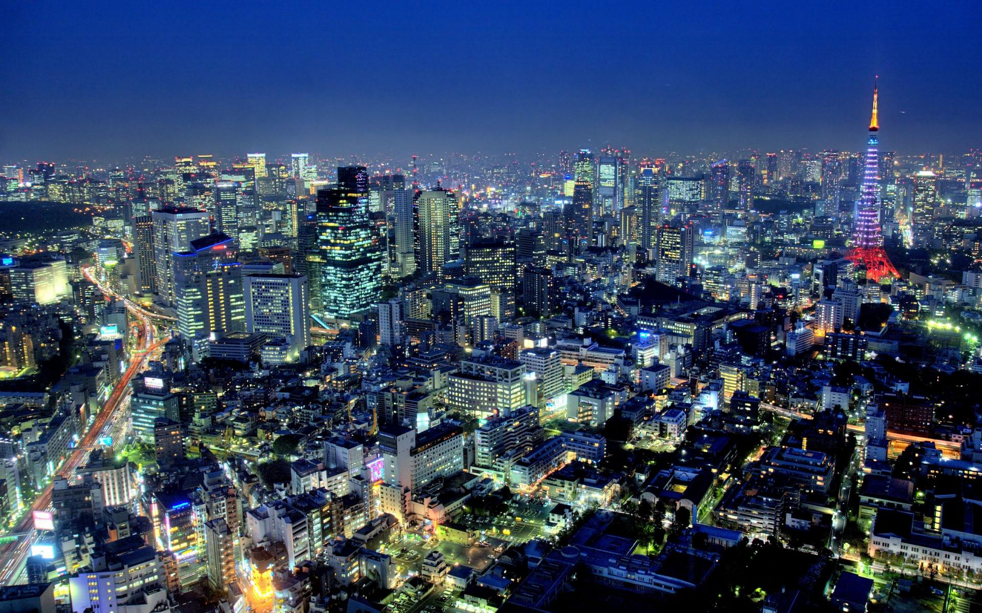
Tokyo, Japan
© 2015 Brain Wrinkles

Slide 42
Teacher Info – Comprehension Questions
Students should answer the questions after discussing the presentation. Afterwards, check and share answers as a class.
*You can also use this as a quiz!
© 2015 Brain Wrinkles

Slide 43
1. What happened on December 7, 1941?
2. How did the US react to the Japanese bombing of Pearl Harbor?
3. Why did President Truman decide to drop the atomic bombs on Japan?
4. On which Japanese city was the first atomic bomb ever used in war dropped?
5. The Japanese surrendered after the second atomic bomb was dropped on this city:
6. The day that Japan surrendered is known as:
7. Why did the US occupy Japan from 1945 to 1952?
8. What US General was given the job of rebuilding Japan?
9. What type of government was established in Japan?
10. What does Japan’s new constitution say about war?
© 2015 Brain Wrinkles
Comprehension
Questions

