Slide 1
Photo Gallery
Hiroshima

Slide 2
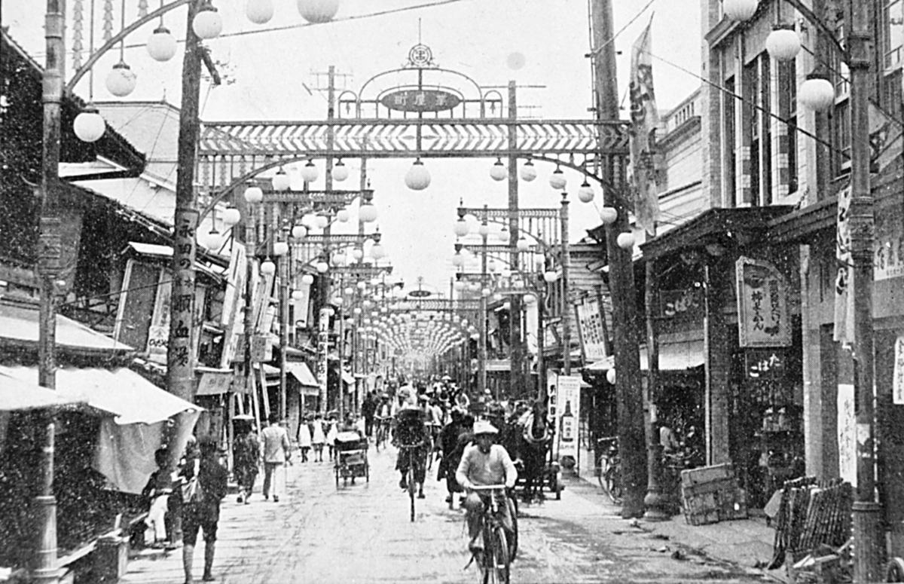
Downtown shopping district before the bomb

Slide 3
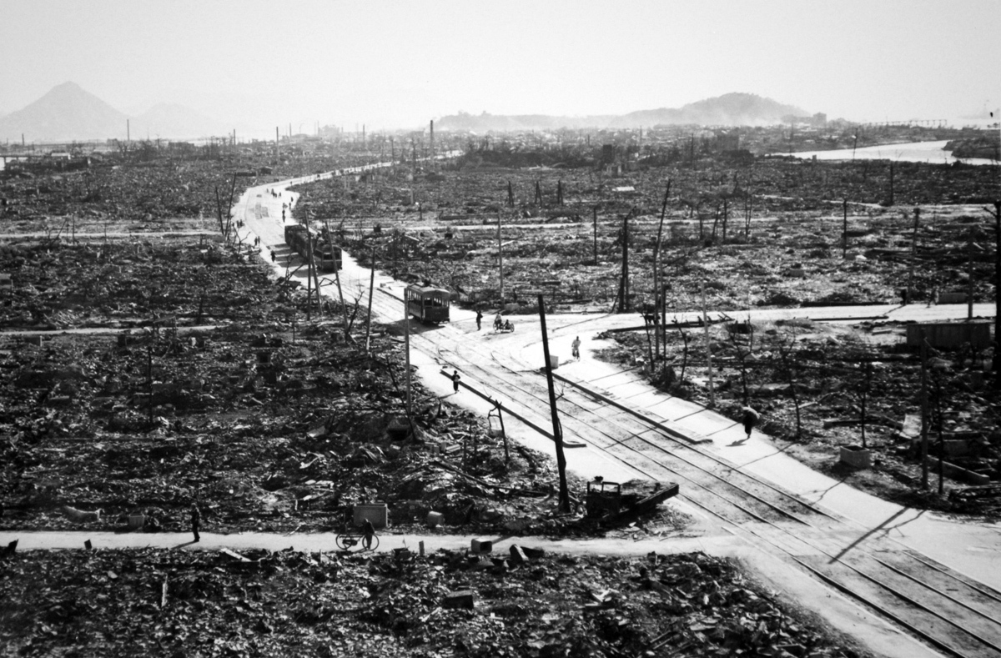
Downtown shopping district after the bomb

Slide 4
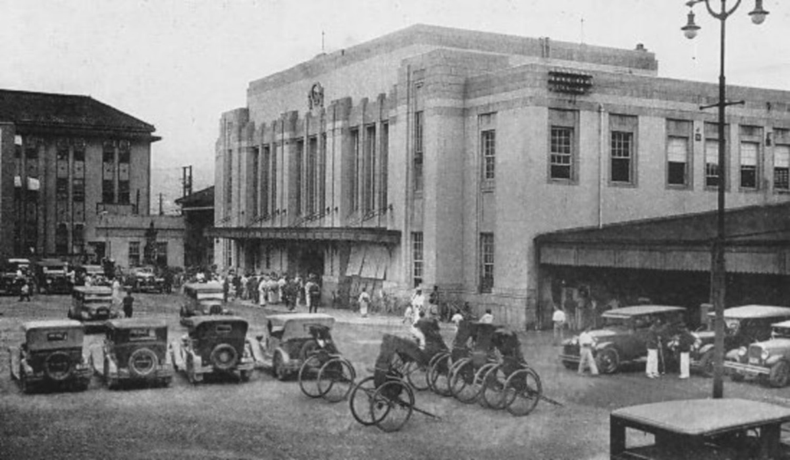
Hiroshima Station before the bomb

Slide 5
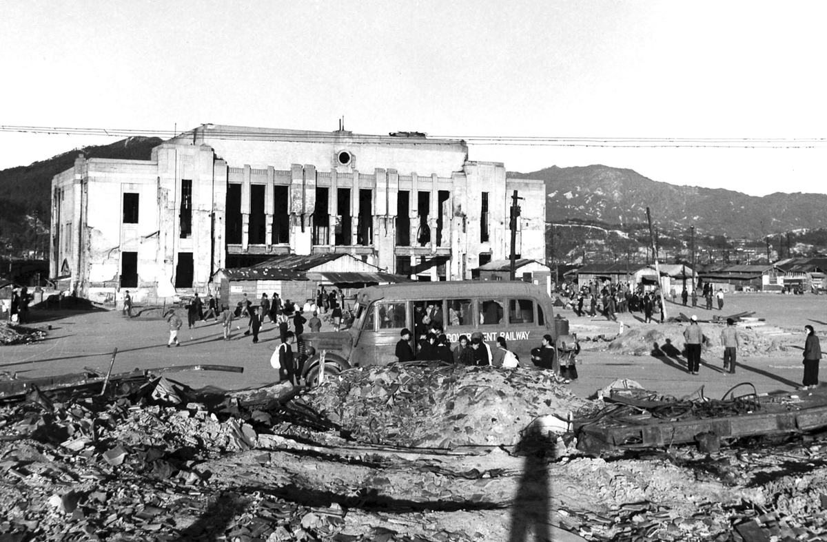
Hiroshima Station after the bomb

Slide 7
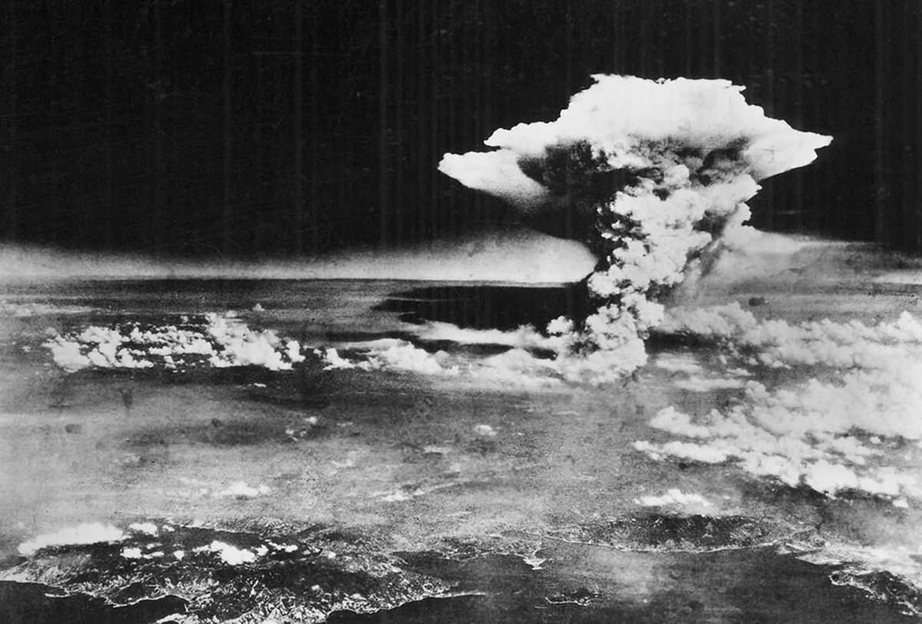
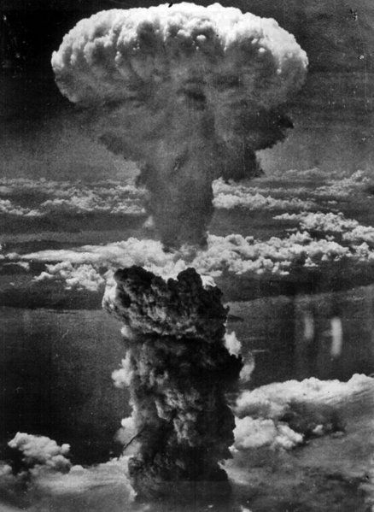

Slide 8
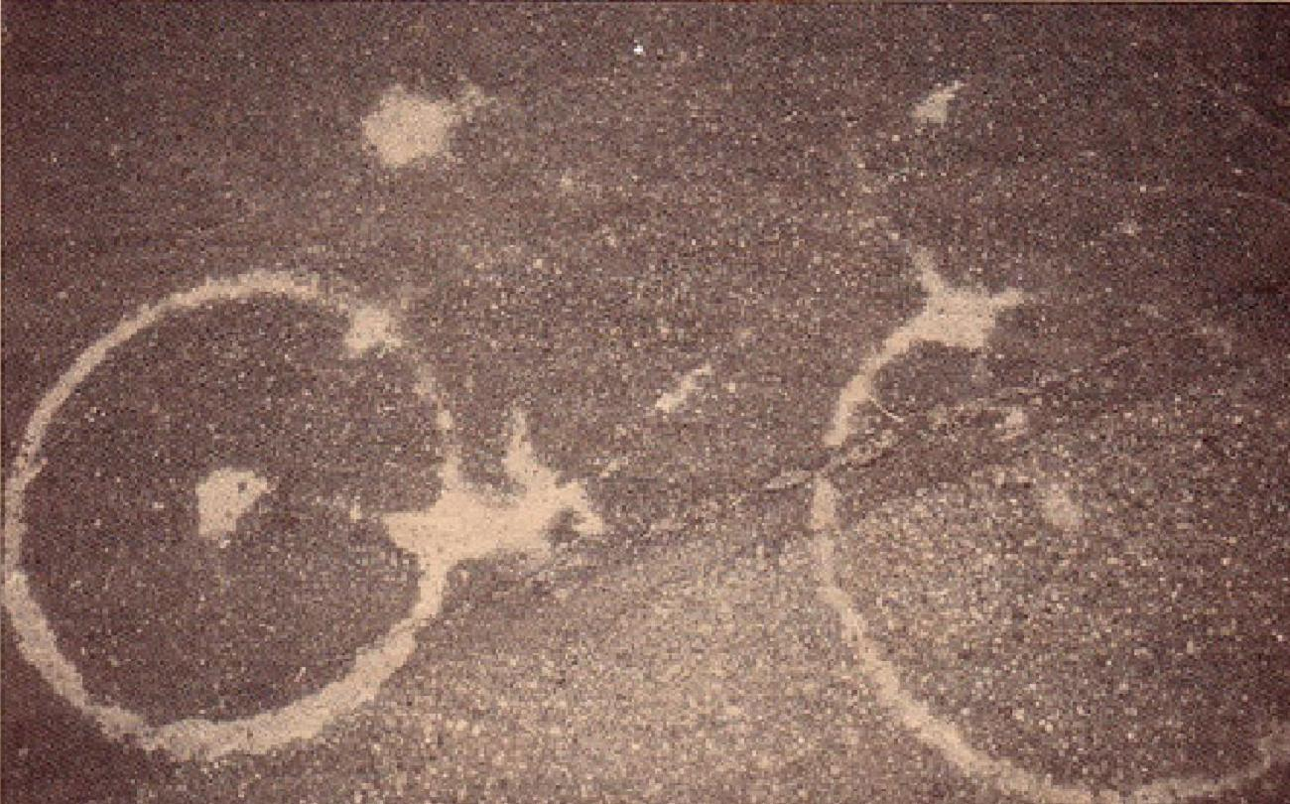
Thermal shadow of a bicycle

Slide 9
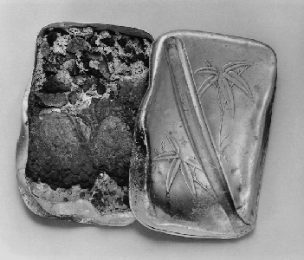
Lunch Box--Reiko Watanabe (15 at the time) was doing fire prevention work under the Student Mobilization Order, at a place 500 meters from the hypocenter. Her lunch box was found by school authorities under a fallen mud wall. Its contents of boiled peas and rice, a rare feast at that time, were completely carbonized. Her body was not found.

Slide 10
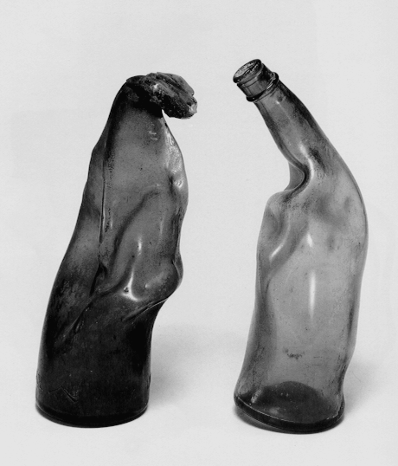
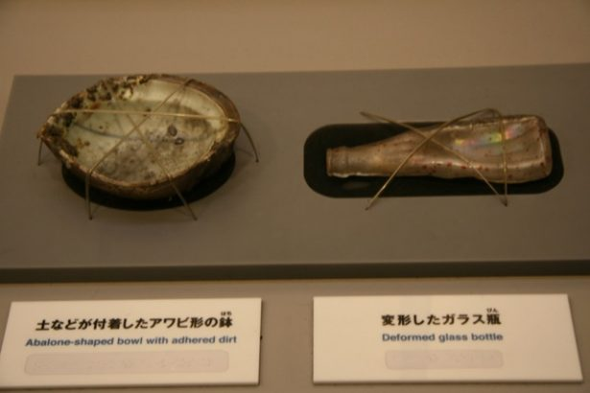

Slide 11
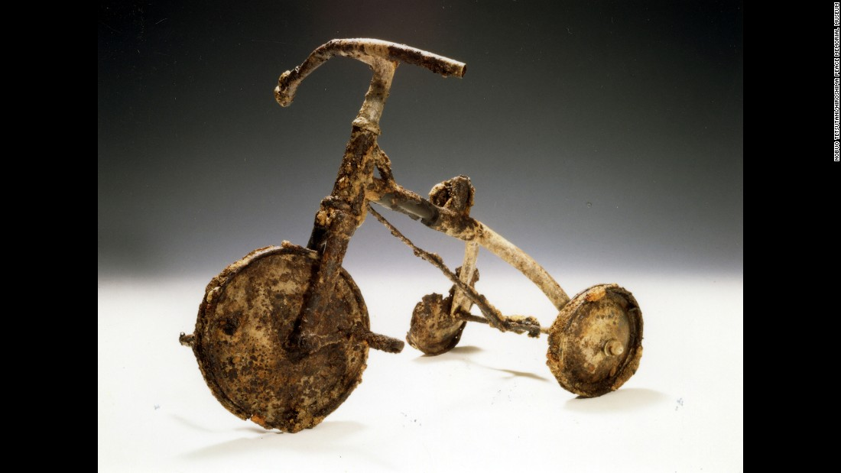

Slide 12
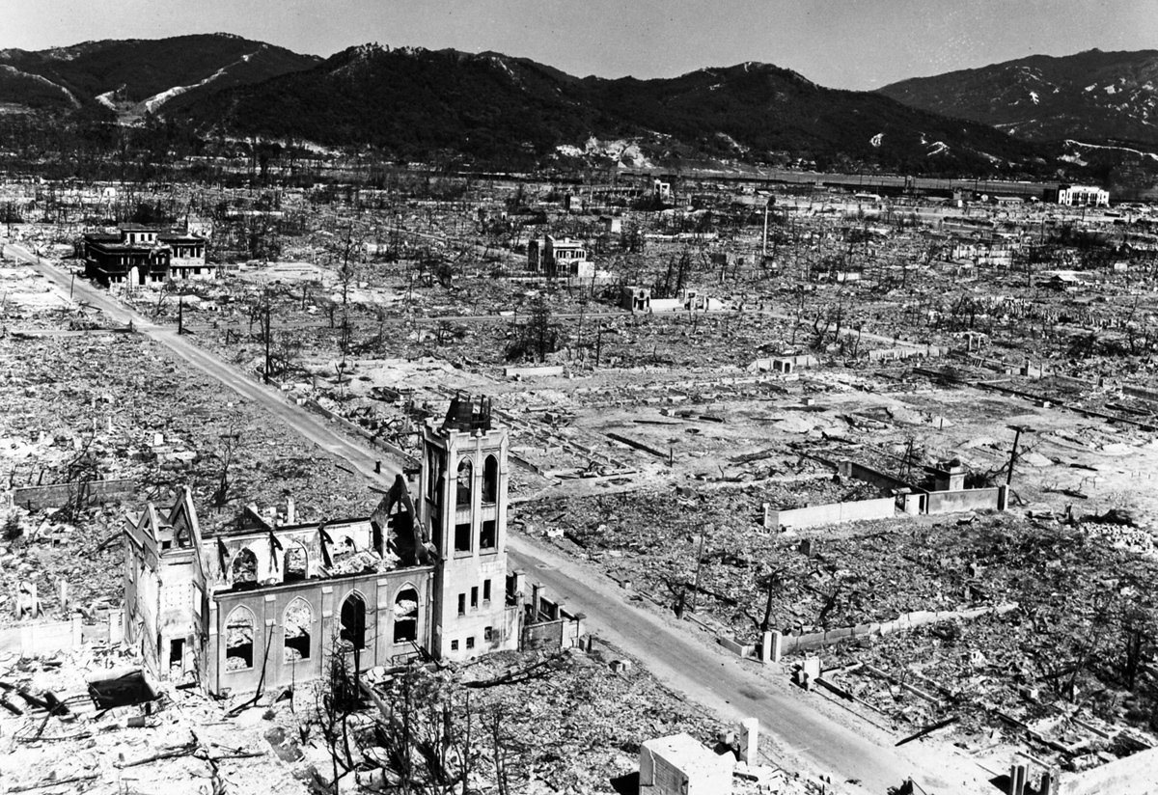

Slide 13
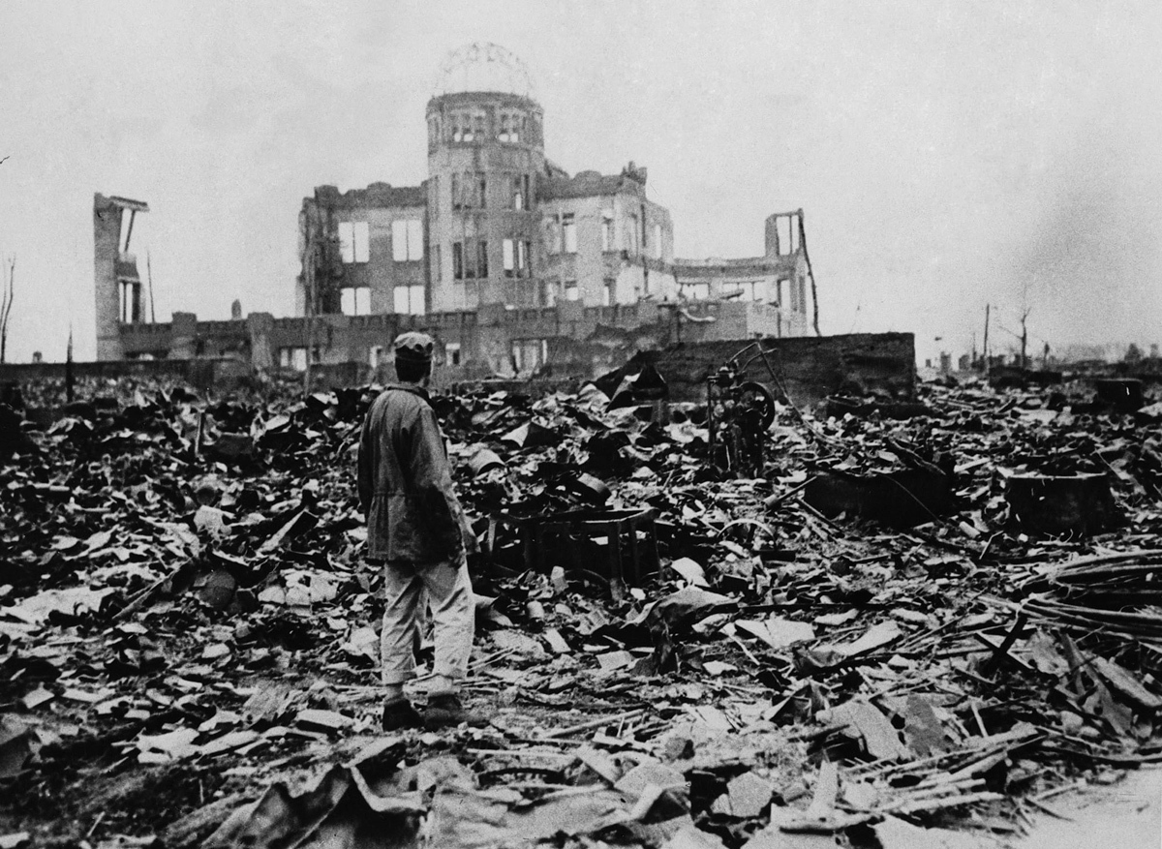

Slide 14
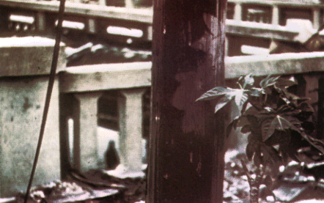
These leaves cast an atomic shadow on the telephone pole

Slide 15
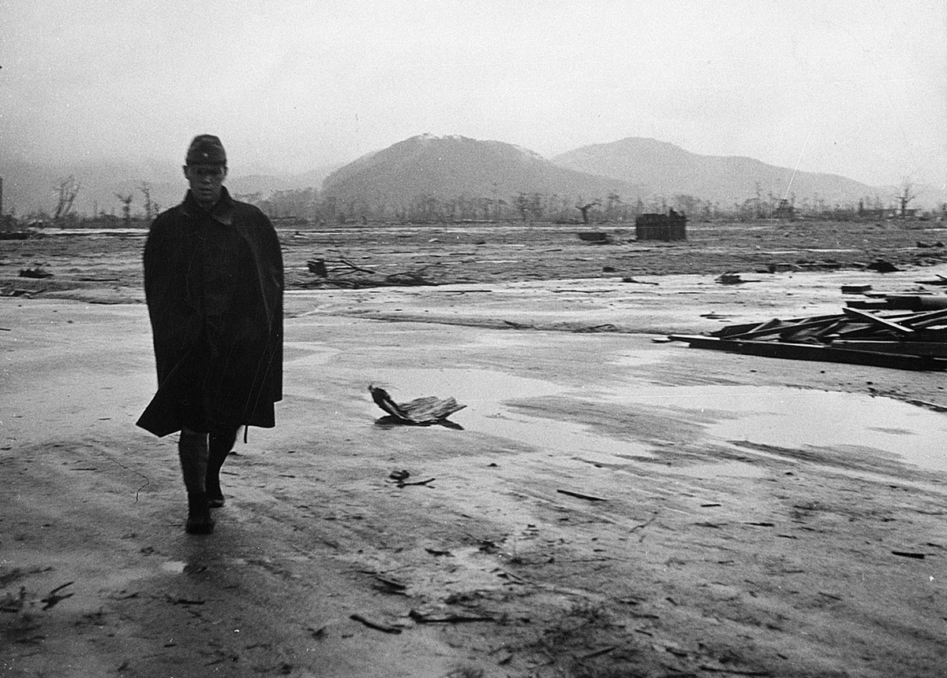

Slide 16
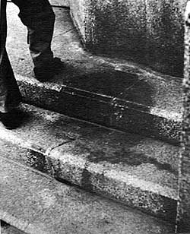
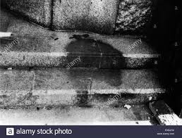
Thermal Rays Leave Human Shadow On Stone Steps

Slide 17
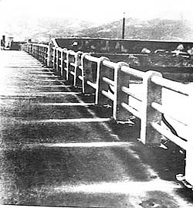
Thermal shadow of the handrail

Slide 18
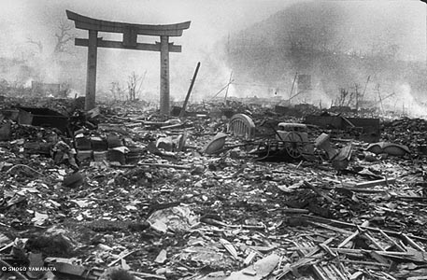

Slide 19
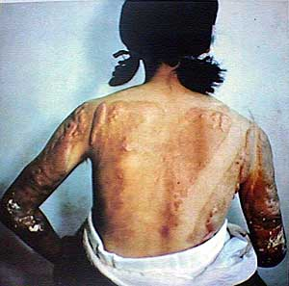
Person 1.6 Km Away From the Hypocenter

Slide 20
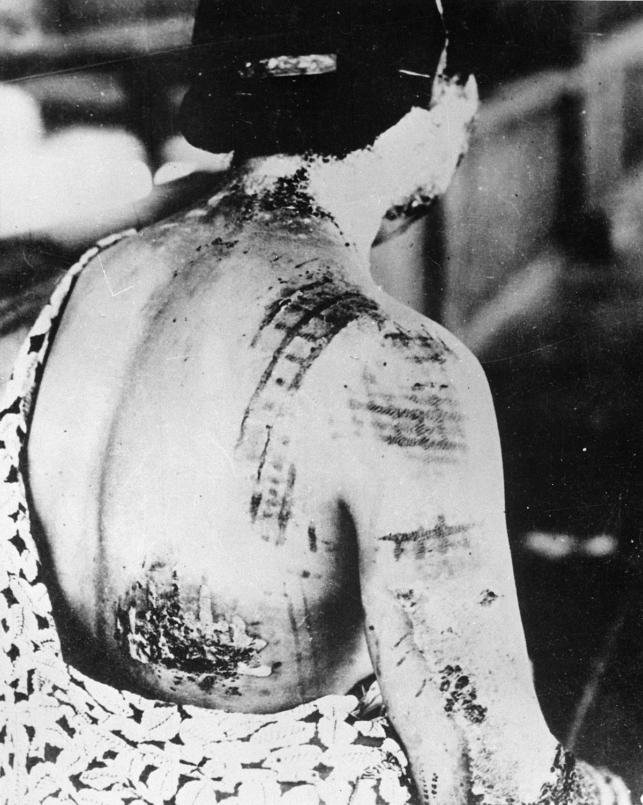
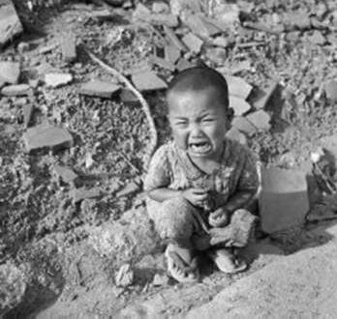

Slide 21
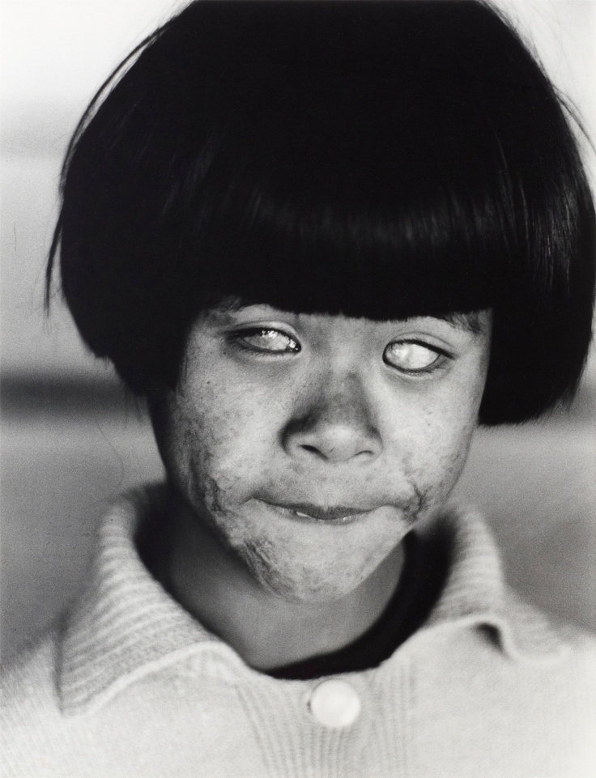
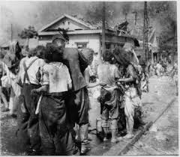
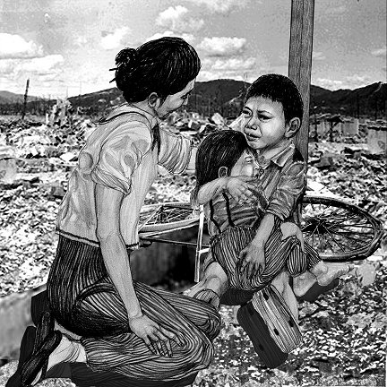

Slide 22
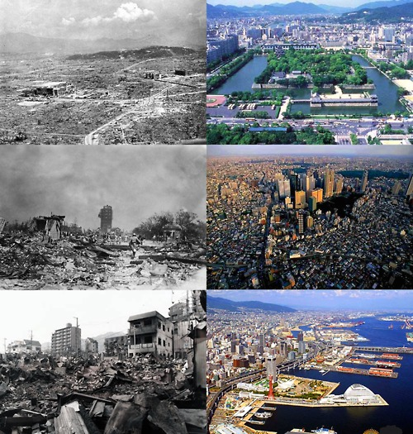
Rebuilding Japan and Relationships

