Slide 1
India’s
Independence
Nationalism & Gandhi

Slide 2
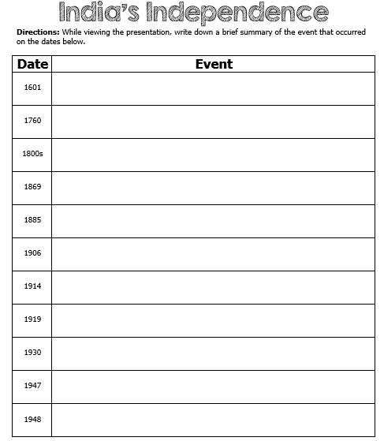

Slide 3
East India Trading Co.
In the 1601, Great Britain came to India through the East India Trading Company to set up trading forts.
At first, they were only looking to trade goods (ivory, gold, silks, dyes) and spices (cinnamon, saffron, pepper, sugar, vanilla).
By 1760, Britain had gained political and economic power over India.

Slide 4
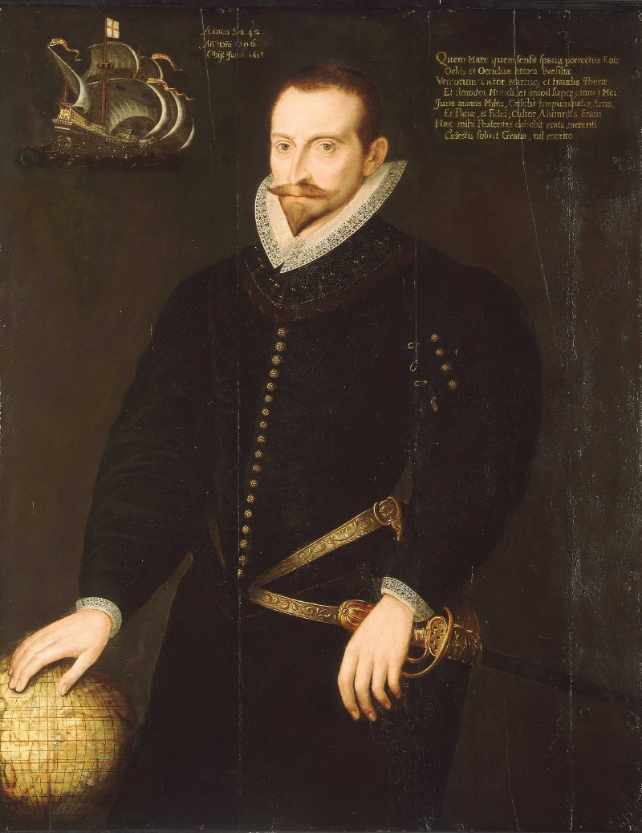
Sir James Lancaster commanded the first East India voyage in 1601.

Slide 5
Inequality
Indians began to resent being ruled by a foreign government.
They were treated as second-class citizens.
The best jobs and education were only available to the British.
Indians were also taxed heavily by the British on goods that were found in their own country.

Slide 6
Nationalism
In the 1800s, a feeling of nationalism began to surface in India.
Nationalism is a belief that people should be loyal to those with whom they share common history and customs.
The first two groups to work for the rights of Indians were the Indian National Congress in 1885 and the Muslim League in 1906.
As they became better organized, they began to call for independence from Britain.

Slide 7
WWI’s Impact
During WWI, millions of Indians joined with the British army.
The British Parliament promised that when the war ended, Indians would be able to have more control of their government.
Unfortunately, nothing changed after the war…

Slide 8
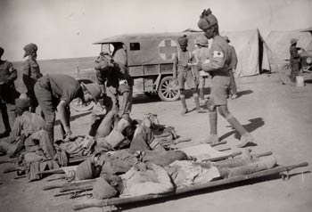
Indian Medic Troops During WWI

Slide 9
Amritsar
Many Indians were upset with the British false promises.
Those who protested were arrested and sent to jail for up to two years without a trial.
In 1919, outside of the Temple of Amritsar, British soldiers starting shooting a large group of Indians because they were gathering illegally.
During this terrible tragedy, over 400 people were killed and 1200 were injured.
It was this awful massacre that spurred Mohandas Gandhi into action to fight for India’s independence.

Slide 10
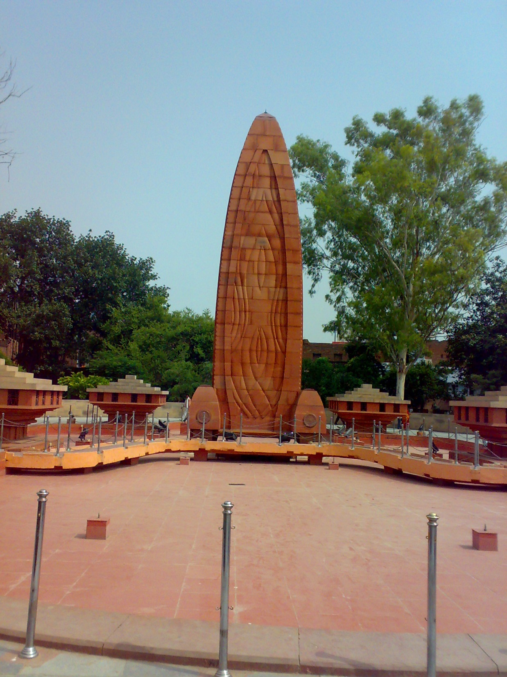
Jallianwala Memorial – Amritsar

Slide 11
Gandhi
Mohandas Karamchand Gandhi was born in India on October 2nd, 1869 and studied law in England.
After spending time in South Africa during Apartheid, he returned to India in 1914 with a determination that people should be treated equally, no matter their race or religion.
He was shocked by the way Indians were segregated and oppressed by British authorities.
After Amritsar, Gandhi decided to quit practicing law and to devote his life to fighting for the equality of all Indians.
He believed it was time for the people of India to stop obeying the unjust British laws.

Slide 12
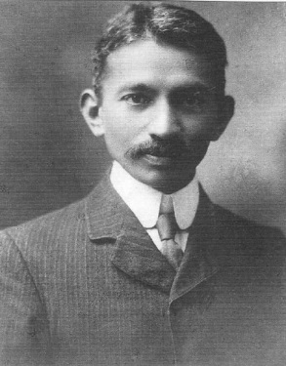
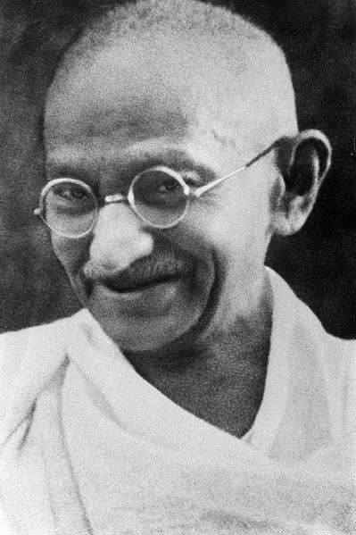
1909
Late 1930s

Slide 13
Nonviolence
Gandhi encouraged his followers to practice nonviolent protests against the British in order to bring about social change.
He developed what he called a system of civil disobedience and believed that it would make the world recognize the injustice in India and force change without using violence.
Gandhi believed that acts of goodness produced positive reactions while violence only produced negative ones.

Slide 14
Gandhi’s Handwriting –
“God is truth the way to truth lies through Ahimsa (non-violence). Sabarmati,
March 13 1927.”
M K Gandhi

Slide 15
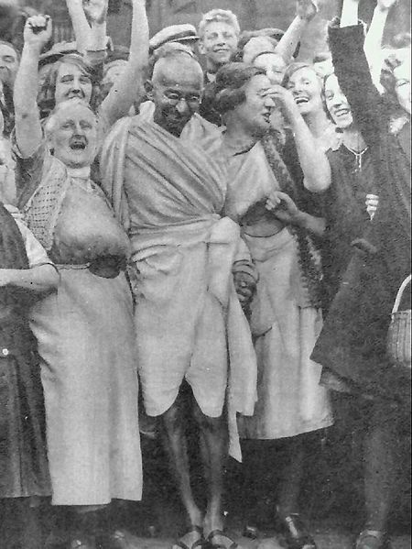
Gandhi with textile workers in 1931.

Slide 16
Social Change
Gandhi led his followers in boycotts, hunger strikes, and nonviolent protests.
In 1930, when he led a march that was aimed at closing a British salt factory, the guards responded by clubbing and beating the peaceful protestors.
News of this event spread worldwide and people around the world began to call for the British to grant Indian independence.

Slide 17
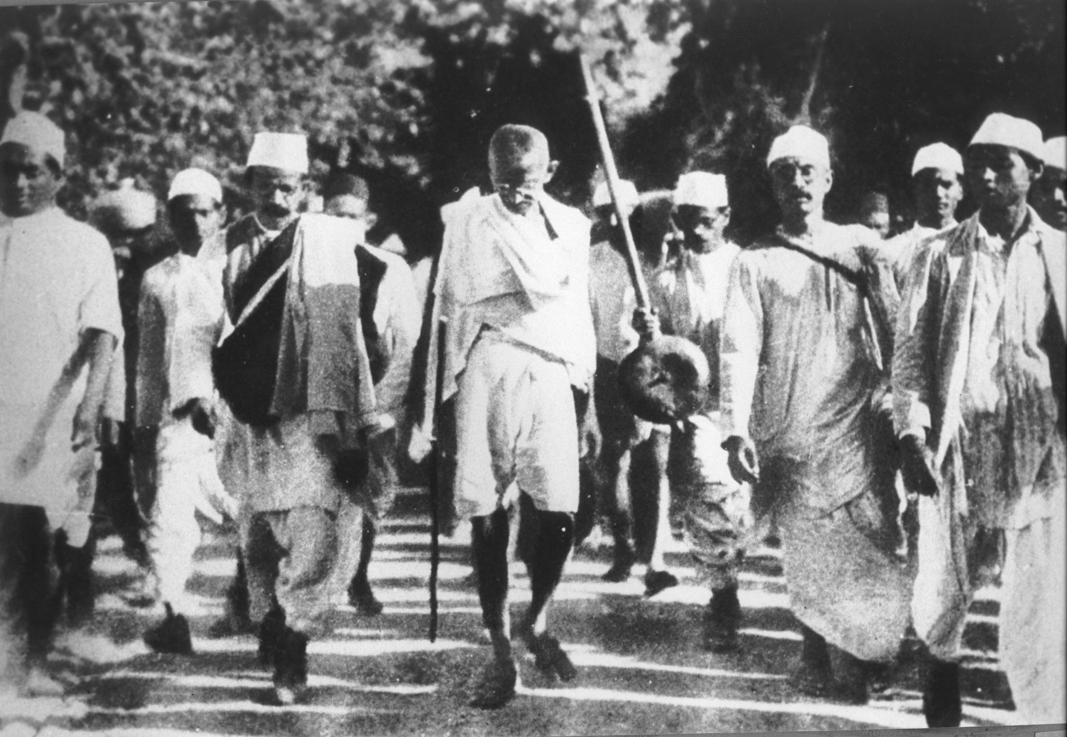
Gandhi during the Salt March, 1930.

Slide 18
Independence
Many Indians followed Gandhi’s nonviolent acts of protest and forced the British to recognize their desire for independence.
After fighting in WWII, Britain no longer had enough money or people to keep India under its rule.
On August 15, 1947, Great Britain formally gave up their colonial claims to India and the Republic of India was established.
Today, many Indians credit India’s independence to the efforts of Gandhi.

Slide 19
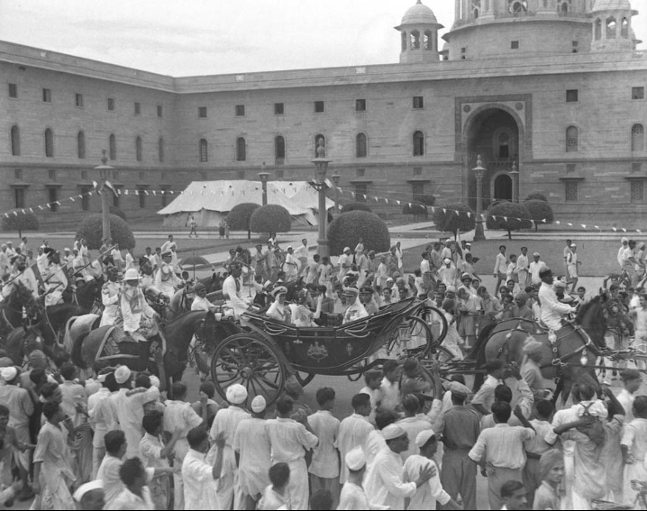
India’s Independence Day

Slide 20
More Problems
Even though India had won its independence, things were not peaceful in the country.
Hindus and Muslims could not reach a solution as to how to rule an independent India.
Eventually, the country was split into India for the Hindus and East & West Pakistan for the Muslims.
The partition of India led to genocide.
Hundreds of thousands of people were killed in widespread violence.

Slide 21
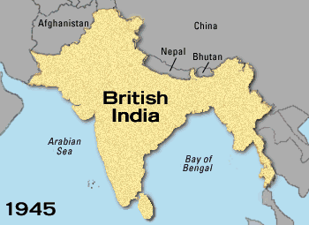
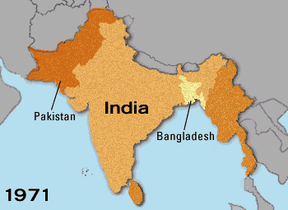

Slide 22
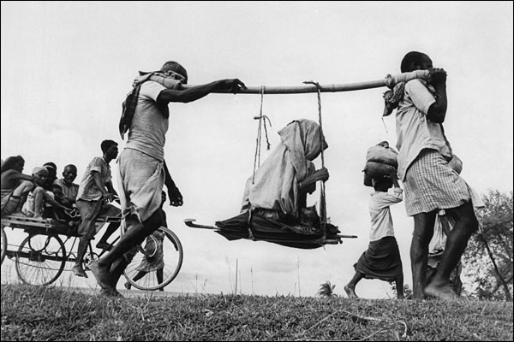
Two Muslim men carrying an old woman to their new home in Pakistan.

Slide 23
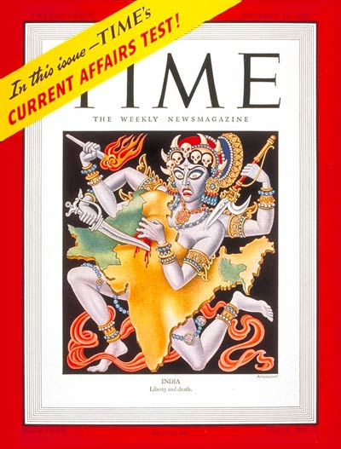
Time Magazine cover representing the partition of India – 1947.

Slide 24
Gandhi
Gandhi was very much disappointed by the partition; he wanted all Indians to live together peacefully in one country.
Even though he was Hindu, he felt that all religious groups should be welcomed in India.
In 1948, at the age of 78, Mohandas Gandhi was assassinated on his way to a prayer meeting in New Delhi.
He was shot three times by a high-ranking Brahmin who resented Gandhi’s concern for Muslims.

Slide 25
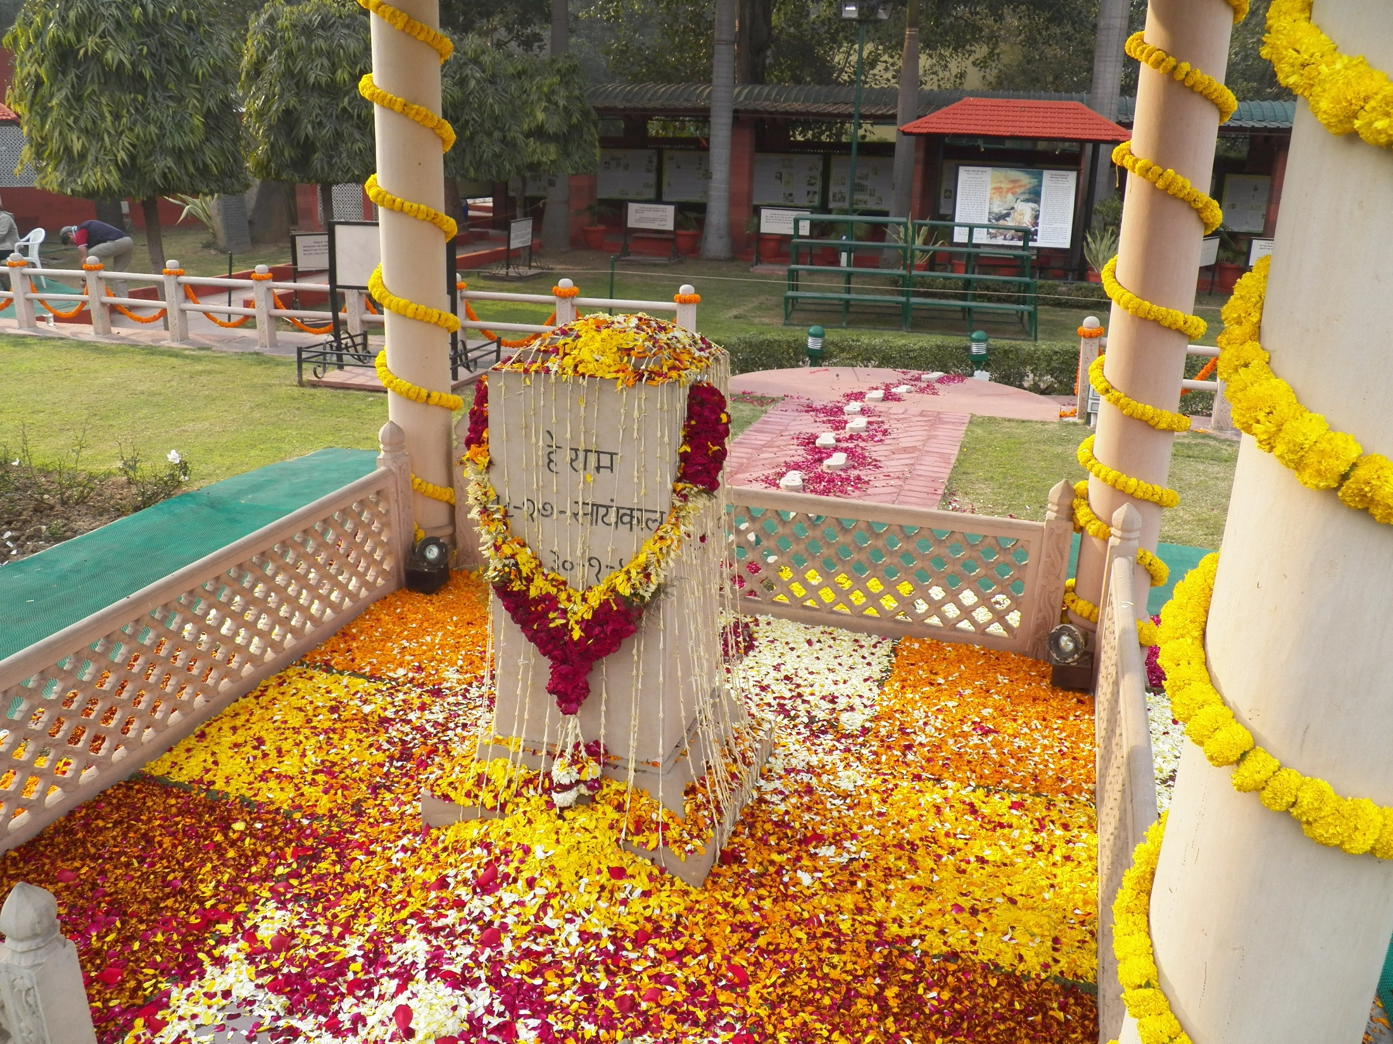
Memorial where Mohandas Gandhi was assassinated at 5:17 PM on January 30, 1948 on his way to a prayer meeting.

Slide 26
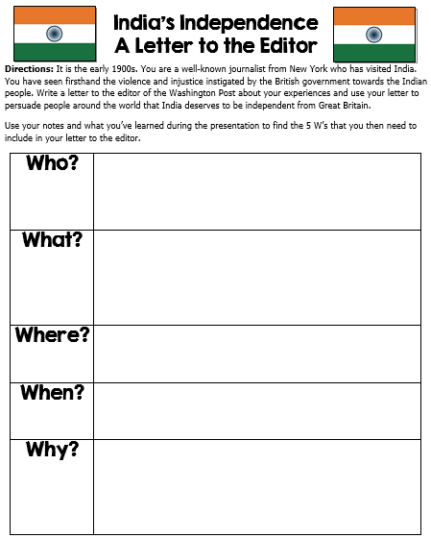

Slide 27
Teachers
Divide the class into 6 groups and print off the following quotation pages (1 per group).
Have the students read & discuss what they think Gandhi meant and what the quote means to them.
After discussing, the students should write a Quick Quotation Response (usually a paragraph). *The directions are after the quotations.

Slide 28
“You must be the change you want to see in the world.”
- M. K. Gandhi

Slide 29
“You must not lose faith in humanity. Humanity is an ocean; if a few drops of the ocean are dirty, the ocean does not become dirty.”
- M. K. Gandhi

Slide 30
“Honest disagreement is often a good sign of progress.”
- M. K. Gandhi

Slide 31
“I object to violence because when it appears to do good, the good is only temporary; the evil it does is permanent.”
- M. K. Gandhi

Slide 32
“An eye for an eye makes the whole world blind.”
- M. K. Gandhi

Slide 33
“When I despair, I remember that all through history the way of truth and love has always won. There have been tyrants and murderers and for a time they seem invincible but in the end, they always fall -- think of it, ALWAYS.”
- M. K. Gandhi

Slide 34
Quick Quotation Response
Directions: After discussing the quotation with your group, spend a few minutes writing a response to the quote.
*Some Ideas: What does the quotation mean?, Do you agree or disagree with Gandhi’s statement?, Do you think the quotation important?, etc.

Slide 35
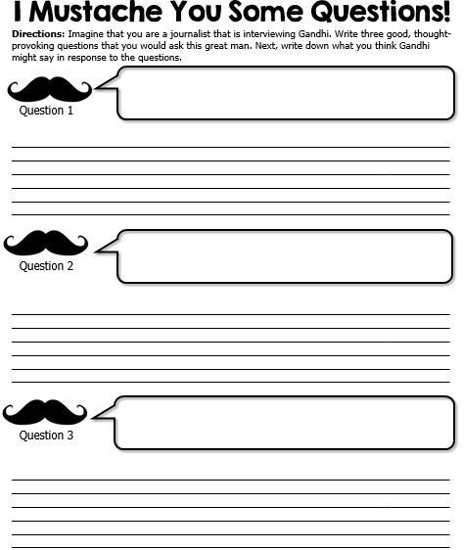

Slide 36
Ticket Out the Door
Ticket Out the Door
What things caused British control in India to weaken?
What things caused British control in India to weaken?
Ticket Out the Door
Ticket Out the Door
What things caused British control in India to weaken?
What things caused British control in India to weaken?

Slide 37
Ticket Out the Door
Ticket Out the Door
What was Gandhi’s role in India’s Independence Movement?
What was Gandhi’s role in India’s Independence Movement?
Ticket Out the Door
Ticket Out the Door
What was Gandhi’s role in India’s Independence Movement?
What was Gandhi’s role in India’s Independence Movement?

