Slide 1
Africa’s
Independence
Movements
South Africa, Kenya, & Nigeria

Slide 2
Standards
SS7H1 The student will analyze continuity and change in Africa leading to the 21st century.
b. Explain how nationalism led to independence in South Africa, Kenya, and Nigeria.

Slide 3
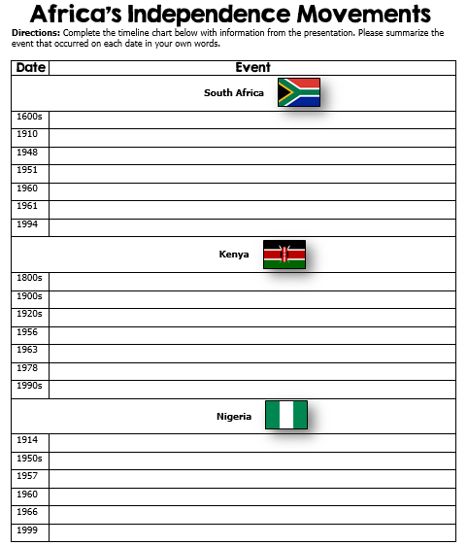

Slide 4
Africa’s
Independence
Movements
South Africa, Kenya, & Nigeria

Slide 5
Pan-Africanism
Pan-Africanism is the idea that there is a global African community made up of native Africans and the descendants of African slaves and migrants across the world.

Slide 6
Pan-Africanism
Began in the late 1800’s to early 1900’s as way to secure equal rights, self-government, independence, and unity for African peoples.
Inspired by Marcus Garvey, it encouraged self-awareness on the part of Africans by encouraging the study of their history and culture.
The Pan-African Movement marked the beginning of the Nationalist Movements that started to sweep across the continent.

Slide 7
Nationalism
By the 20th century, European powers had colonized the majority of Africa.
The only independent countries were Liberia and Ethiopia.
Liberia was founded in 1822 by former American slaves.
Nationalism, a feeling of strong pride for one’s country, fed the desire for independence from foreign rule.
Africans wanted to take control of their own governments and natural resources.

Slide 8
Changes
Africa began to change by the 1940s.
The rule of tribal chiefs had weakened because of their links with colonial governments, thus limiting their ability to control people.
An educated middle class that disliked colonial life began to grow in the cities.
The cost for European countries to maintain colonies was rising.
By the second half of the century, unrest arose throughout the continent and African nations fought to free themselves from European control.

Slide 9
South
Africa

Slide 10
Colonization
In the 1600s, the British and the Dutch colonized South Africa.
More European settlers came to South Africa than to anywhere else on the continent.
In 1910, Great Britain established the Union of South Africa, and power was only given to whites.
In 1948, a new political party, the National Party, came to power and enforced the policy of apartheid through legislation across South Africa.
Apartheid was a system of racial segregation.

Slide 11
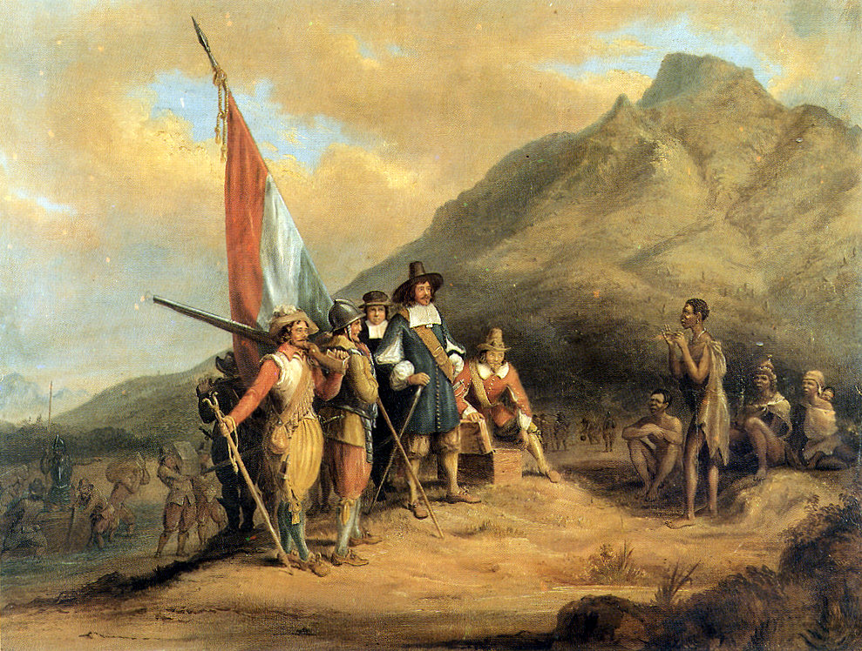
The arrival of the first European settlers -- Jan van Riebeeck (Dutch East India Company) in Table Bay in April 1652.

Slide 12
Apartheid
Apartheid allowed many Europeans to grow wealthy and powerful, while millions of South Africans suffered.
In 1951, European government officials created the Bantu Authorities Act, which created “homelands” for black South Africans.
At this time, whites owned 80% of the land, although they only represented 10% of the population.
As a result of this law, 9 million South Africans were excluded from participating in the government.

Slide 13
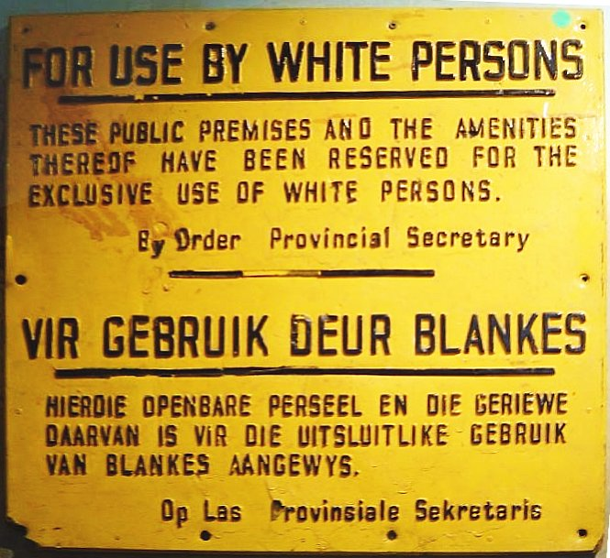
Sign during the apartheid era.

Slide 14
Independence
South Africa’s National Party, which was white-only and in favor of apartheid, had a goal to gain independence from Great Britain.
In a white-only election in 1960, voters approved independence.
On May 31, 1961, the Republic of South Africa gained its independence from Britain.
It took years of protests, several more decades, and a change of government leaders before blacks began to have a role in the government of South Africa.

Slide 15
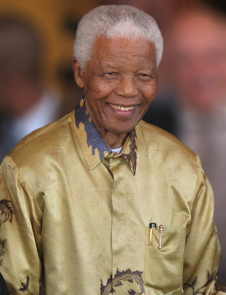
Nelson Mandela was South Africa's first black chief executive, and the first elected in a fully representative democratic election (1994).

Slide 16
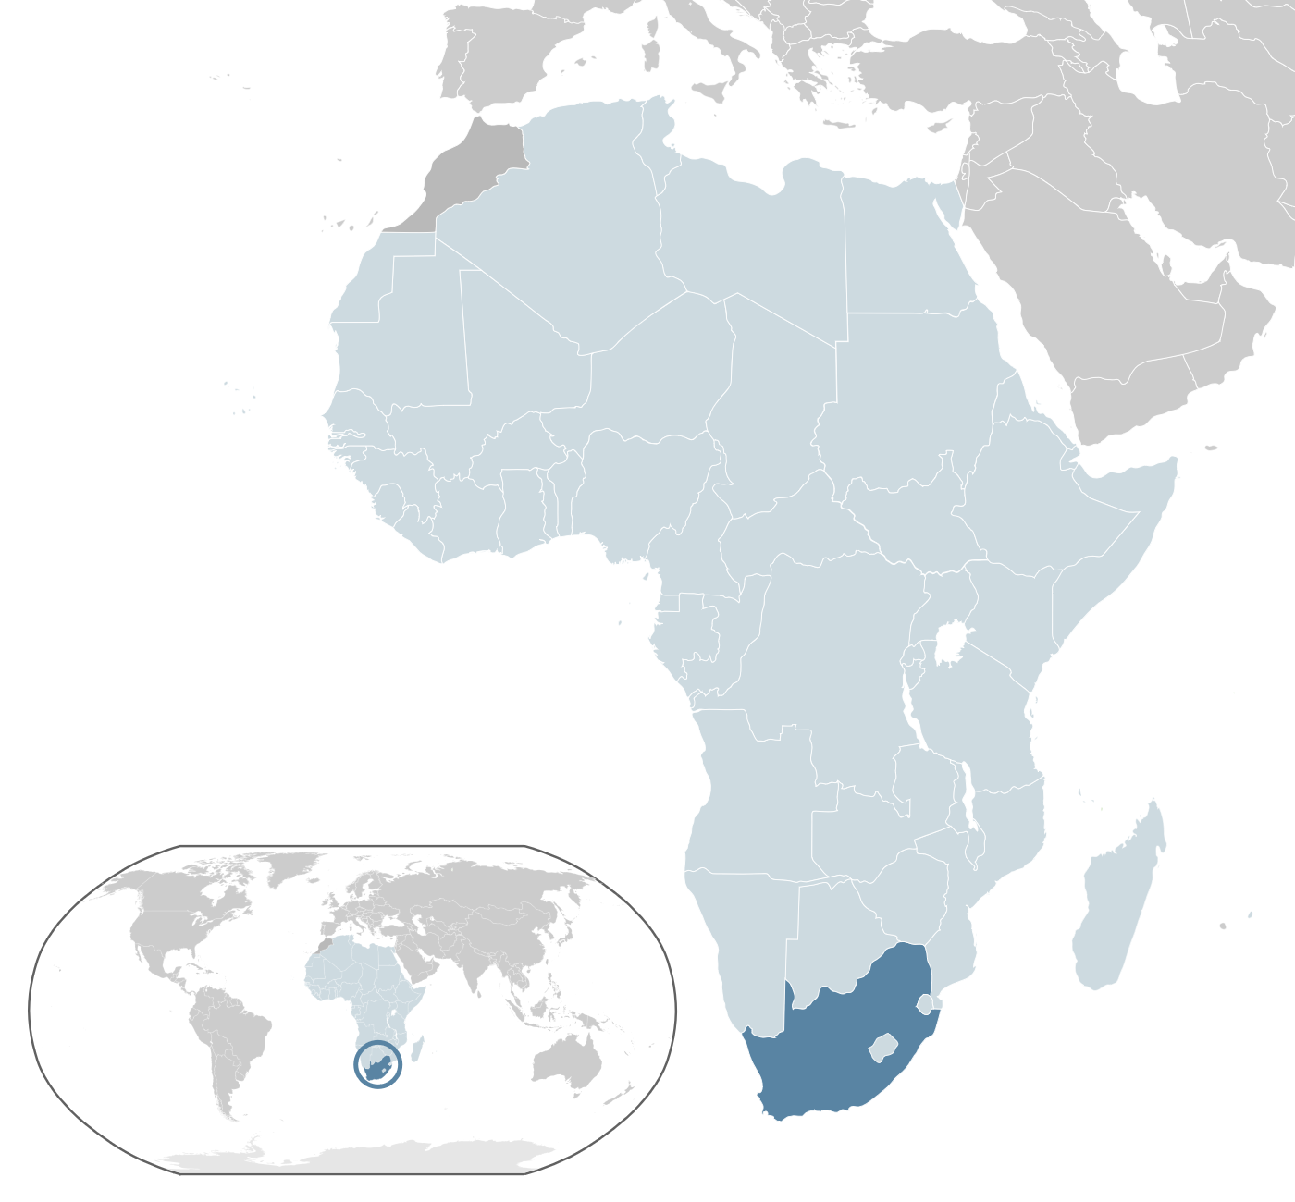
Republic of South Africa

Slide 17
Kenya

Slide 18
Colonization
For hundreds of years, outsiders did not enter the region now known as Kenya because of the fierce warrior tribes that inhabited the area.
Arab traders took control of Kenya’s coast during the 1800s.
Next came Germany and Great Britain, but by the 1900s, the British were the only foreigners who remained.

Slide 19
Rebellion
Most Kenyans were upset by their loss of rights as landowners to the British.
They believed that their land was taken unfairly and opposition groups began to form in the 1920s.
For several decades, small bands of armed resistance forces (guerillas) fought to eliminate white settlers in Kenya, as well as any Africans who sided with them.
In 1956, there was a violent rebellion that resulted in the deaths of tens of thousands of Africans.
Although the British army mostly defeated the guerillas, this movement gained a great deal support among Kenyans.

Slide 20
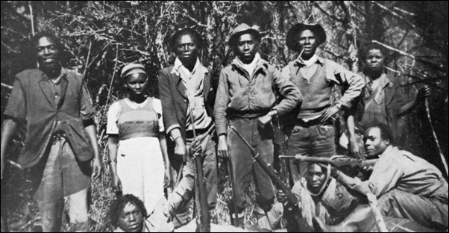
The Mau Mau was a secret society that believed force was the only way to win Kenyan rights and independence.

Slide 21
Independence
Kenyans were tired of being treated unfairly, and it was time for a change.
Great Britain began to rethinking its policy on colonization, and on December 12th, 1963, the British Empire granted Kenya its independence.
Jomo Kenyatta was the most influential leader of the freedom movement in Kenya, and was appointed as the nation’s first president.

Slide 22
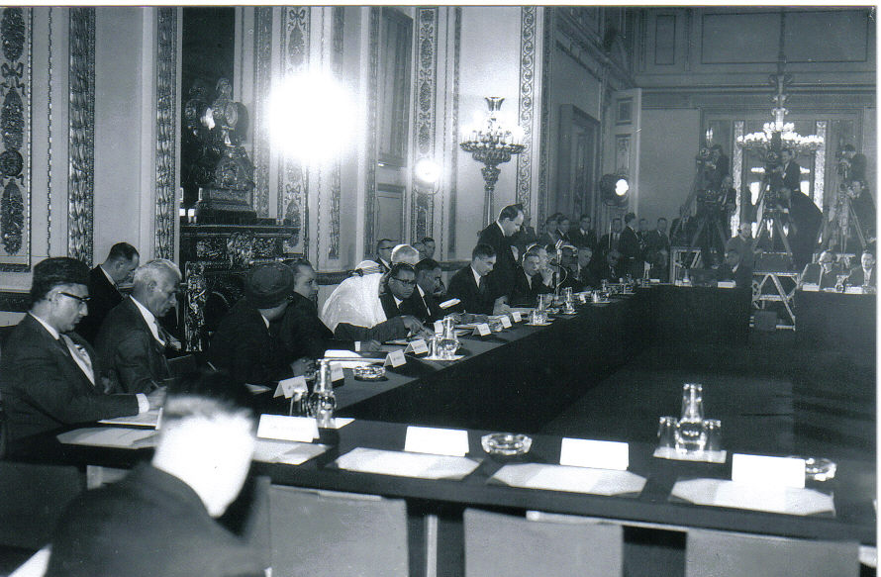
Lancaster House Conference for Kenya’s Independence in 1963.

Slide 23
Kenyatta
Kenyatta was a leader of the Kenyan African National Union, and during his presidency, began a campaign called harambee, which is Swahili for “let’s pull together.”
Under Kenyatta and his successor, Daniel arap Moi, the KNAU ran unopposed in elections until the 1990s.
The country remains a multi-party state, but the reality is that the KNAU is in control of the government.
By the time of his death in 1978, Kenyatta had helped Kenya become one of the most stable and economically dynamic countries in Africa.
Even though there has been improvement in the political rights of Kenya’s people, more is still needed.

Slide 24
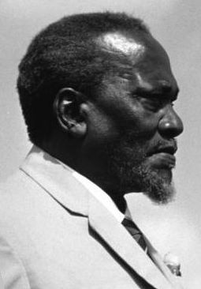
Jomo Kenyatta -- The first president and “founding father” of Kenya.

Slide 25
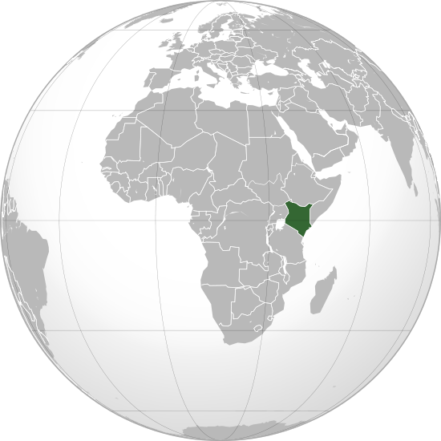
Republic of Kenya

Slide 26
Nigeria

Slide 27
Nigeria
The country now known as Nigeria was a diverse region with more than 250 ethnic groups.
Nigeria had maintained its independence until 1914 when Great Britain took over the area.
By the end of World War II, Nigerians had started political parties to work for Nigerian independence.
Most Nigerians believed that the only way to have rights was to be completely free of European rule.

Slide 28
Independence
During the 1950s, Great Britain allowed Nigeria to elect its own government.
In 1957, Nigerians elected Abubakar Tafawa Balewa as their first prime minister.
On October 1st, 1960, Great Britain granted Nigeria independence and an independent government was established.
At first, it was one of the most stable governments of the new African countries.

Slide 29
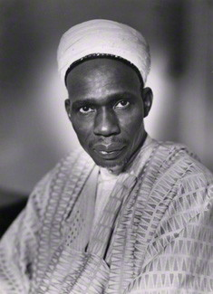
Abubakar Tafawa Balewa – Nigeria’s first prime minister. He was overthrown and murdered in a military coup in 1966.

Slide 30
Nigeria Today
At first, Nigeria was one of the more stable governments in Africa.
Unfortunately, struggles for power have resulted in many military coups in the country.
Nigeria suffered from violence and military rule from 1966 until 1999, when a democratic government was established.
In recent years, political instability, religious competition, ethnic differences and the need to become more modern continue to plague Nigeria.

Slide 31
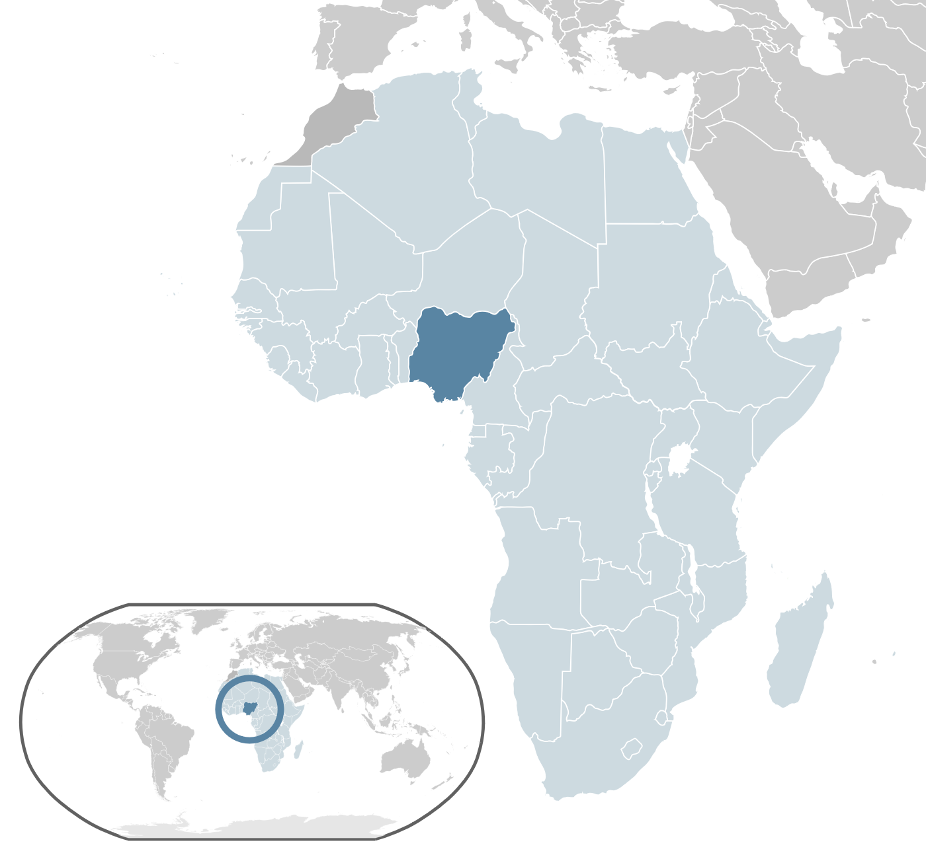
Federal Republic of Nigeria

Slide 32
The End
By 1966, all but six African countries were independent nation-states.
Unfortunately, once the countries were independent of European rule, they still faced many challenges.
Many of the new governments were politically unstable.
European powers did not teach new leaders how to govern.
In some African countries, military dictators took over the governments.

Slide 33
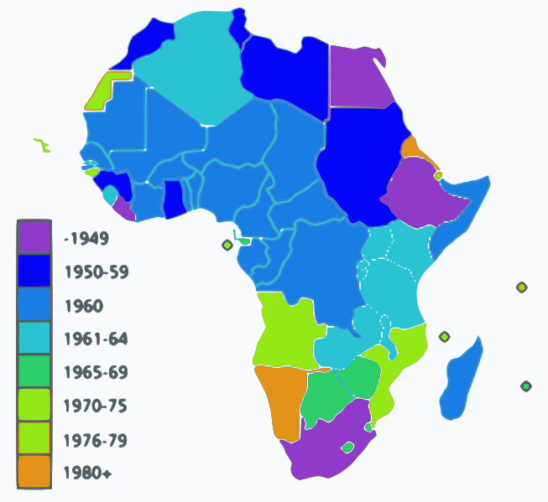
African Independence Dates

Slide 34
Pan-African Movement
After WWII, nationalism increased in Africa.
Pan-Africanism was a nationalist movement that called for the unity of all African nations.
Disunity and many other problems facing Africa can be blamed on European colonialism.
The Pan-African Movement united Africans in the goal for independence.

Slide 35
Pan-African Movement
Most Pan-African leaders were black intellectuals from the United States.
They helped to organize black leaders in Africa by creating nationalist movements in the colonies.
Some of the most influential Pan-African leaders became president or prime minister of their newly freed country.
The movement led to the creation of the African Union, a loose organization of African states.

