Slide 1
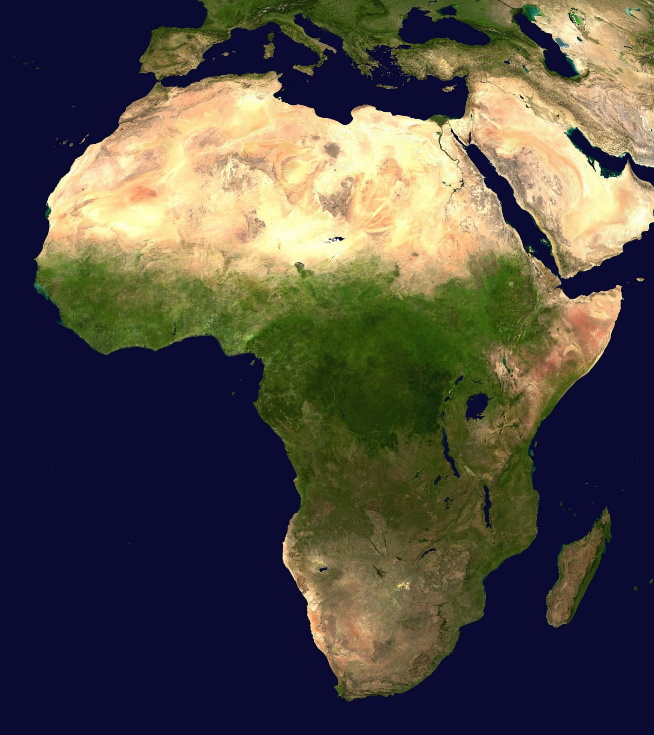
Africa’s
Geography

Slide 2
Africa
Africa is the world’s second largest continent (11,700,000 miles).
It is home to 52 countries, 1,000 different languages, and 800 million people.
10% of the world’s population lives in Africa.
The one thing that all African nations have in common is their reliance on the land’s physical characteristics, which affect where people live, work, & trade.
Africa can be divided into many different regions:
The Sahara, the Sahel, the savannahs, the tropical rain forests, the Ethiopian Highlands, and Southern Africa.

Slide 3
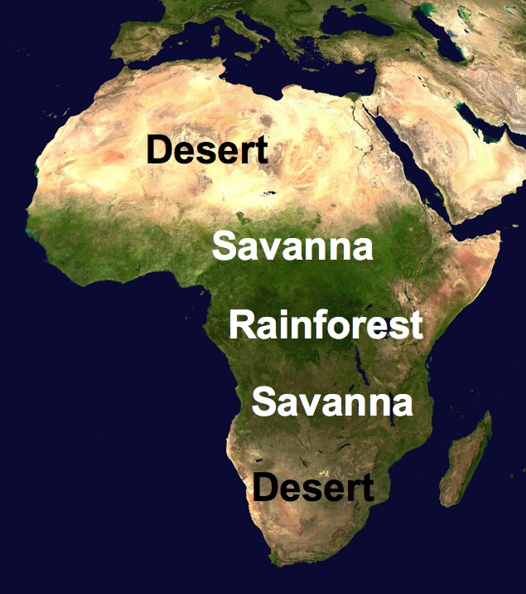

Slide 4
Sahara Desert
The Sahara is the world’s largest desert (3,500,000 miles).
It runs across the width of northern Africa.
It covers 1/3rd of the continent.
It divides the continent into two distinct regions – North Africa and sub-Saharan Africa.
The Sahara is covered with sand dunes, rocky hills, and stretches of gravel that continue for miles and miles.
Very few people live in the desert because it is considered one of the harshest places to live in the world.
The people who do live here are called nomads.
They move from place to place, usually traveling by camel, looking for food & water.

Slide 5
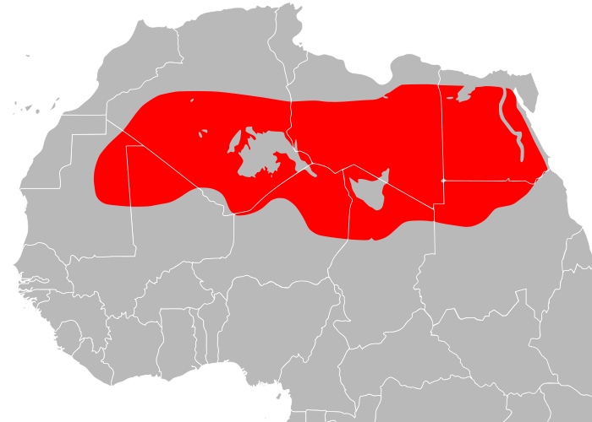

Slide 6
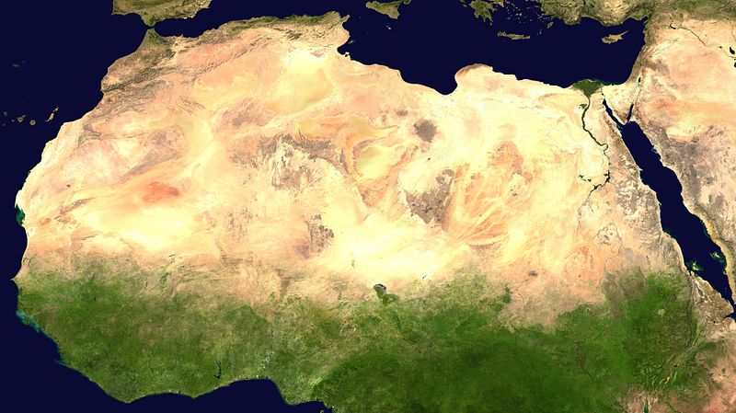

Slide 7
The Sahel
The Sahel is a strip of dry grassland that is located south of the Sahara.
The word “Sahel” means “border” or “margin”.
It is the region between the desert to the north and the grasslands and rainforest to the south.
It is a dry, semi-arid region that is slowly turning into desert.
It gets more rainfall than the desert, but still receives very little, ranging from 6-20 inches.
People have tried to live here but generations of overgrazing and desertification have caused soil erosion.
Vegetation is sparse here—grasses are shrubs are unevenly distributed.
The Sahel is relatively flat with few mountains and hills.

Slide 8
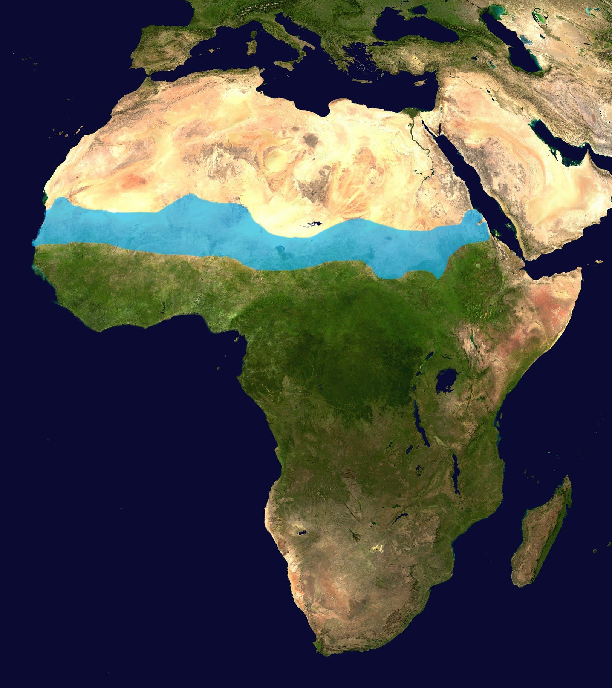
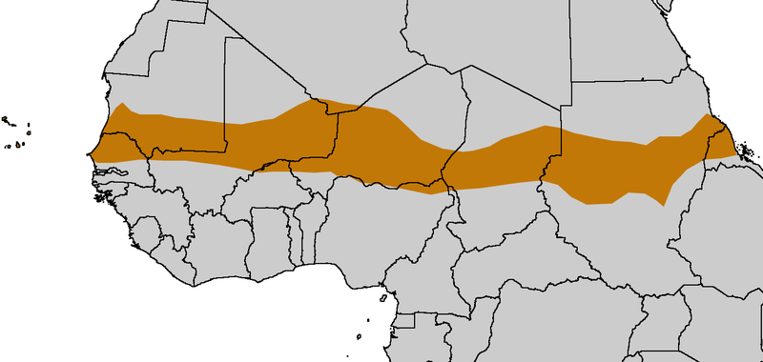

Slide 9
Savanna
The African savannas are hot, dry grasslands that are located near the Equator and cover almost half of Africa.
They actually cover the regions just north and south of the rainforests that lie along the equator.
The African savanna is the largest in the world.
There is a large variety of wildlife here, including lions, zebras, & elephants.
Farming is good here, but only if there is good rainfall.
Grasses and grains like wheat, oats, and sorghum grown in the region.
The area receives enough rain to support drought resistant undergrowth, but not enough to support forest-type vegetation.
Grasses are tall and thick, while trees are short and scattered.

Slide 10
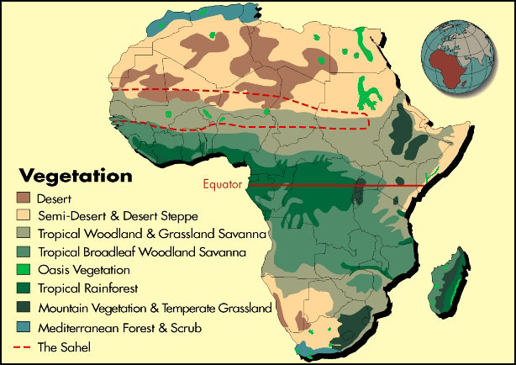

Slide 11
Tropical Rain Forest
Africa’s tropical rain forest is located along the central coast of Africa, near the Equator.
It lies in the Congo River Basin.
The rain forest covers 1/5th of the land surface of Africa and touches 37 countries.
The rain forest has a hot, humid climate.
The annual rainfall is over 17 feet.
There is a large variety of animals found in this region.
Trees are so thick and tall that sunlight never reaches the forest floor!
The trees grow hundreds of feet tall.
It’s the second largest rain forest in the world; the Amazon rain forest in Brazil is the largest.
Unfortunately, this rain forest has shrunk due to deforestation.
.

Slide 12
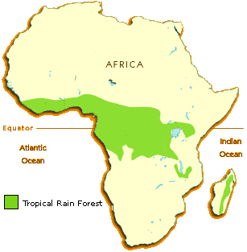

Slide 13
Congo River
The Congo River is located in western central Africa.
It begins in central Africa, near Lake Tanganyika, and flows west through the tropical rain forest.
The Congo River is the second largest river in Africa.
It’s over 3,000 miles long.

Slide 14
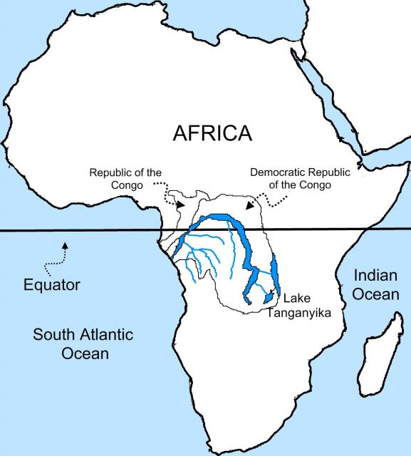

Slide 15
Niger River
The Niger River is located in western Africa.
It flows through Guinea, Mali, Niger, Benin, & Nigeria.
The Niger River is the third largest river in Africa.
It runs over 2,600 miles.
The mouth of the Niger River flows through a large delta, often referred to as the “Oil Delta” because of the petroleum industry that’s centered here.

Slide 16
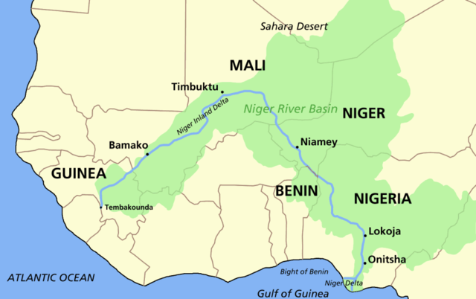

Slide 17
Nile River
The Nile River is located in eastern Africa.
It starts in East Burundi and flows northward and empties into the Mediterranean Sea.
The Nile is the world’s longest river at 4,150 miles.
It provides water for Sudan and Egypt.
It’s an important waterway for transporting people and goods.
The Nile also provides a source of irrigation for agriculture.

Slide 18
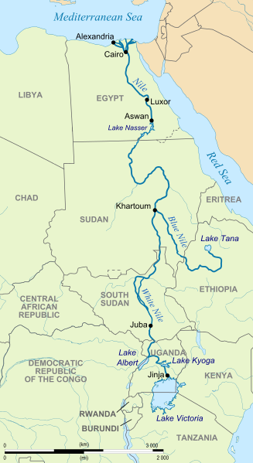

Slide 19
Great Rift Valley
The Great Rift Valley is a name given to the continuous geographical trench, about 3,700 miles in length, that runs from northern Syria in Southwest Asia to central Mozambique in east Africa. The rift is bordered by a series mountains and active volcanoes. It is a site of faults and earthquakes.
Basically, the western part of Africa is pulling away from the eastern part.
This causes all the geological activity at the Valley. Far in the future, a sea will run between these two parts of Africa.

Slide 20
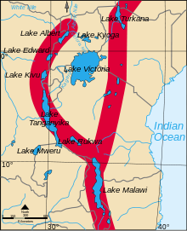
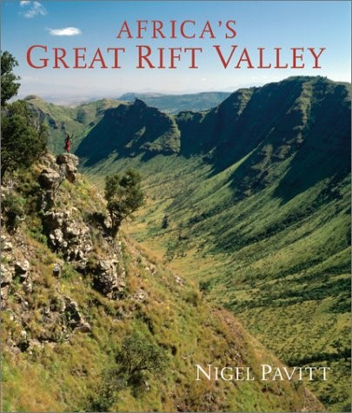

Slide 21
Lake Tanganyika
Lake Tanganyika is located in central Africa.
It’s divided between Burundi, Congo, Tanzania, and Zambia.
Lake Tanganyika is the deepest lake in Africa and one of the deepest in the world.
It’s also one of the largest freshwater lakes in the world.

Slide 22
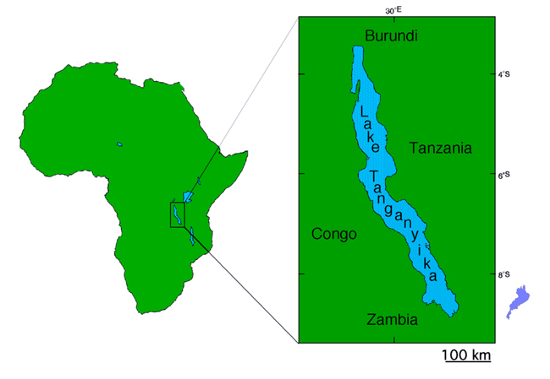

Slide 23
Lake Victoria
Lake Victoria is the largest lake in Africa and the second largest freshwater lake in the world (Lake Superior is the largest).
It is located in central Africa and extends into three countries: Tanzania, Uganda, and Kenya.
White Nile begins here.
Lake Victoria is vital in supporting the millions of people that live nearby.
It provides a living for many fishermen and attracts millions of tourists each year.

Slide 24
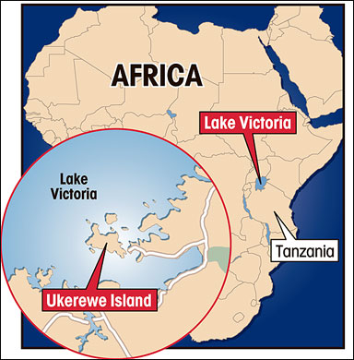

Slide 25
Atlas Mountains
The Atlas Mountains are a mountain range in north Africa.
The mountains extend from Morocco to Tunisia, between the Mediterranean Sea and the Sahara desert.
They separate the coastal regions from the Sahara Desert.

Slide 26
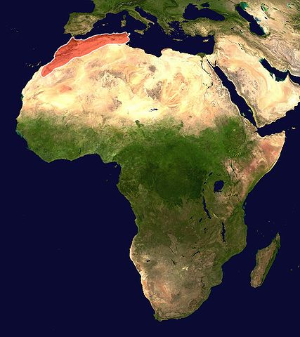

Slide 27
Kalahari Desert
The Kalahari Desert is located in southwestern Africa.
It covers parts of Botswana, Namibia, and South Africa.
The region is surrounded by semi-arid areas that are slowly becoming more dry.
It is not a “true” desert because it receives 3-10 inches of rain per year.
Because of the precipitation and underground water supplies, grass, shrubs, and wild animals manage to live in the Kalahari desert.

Slide 28
