Slide 1
European
Partitioning
Across
Africa
Colonization, Conflict, &
Artificial Boundaries

Slide 2
Standards
SS7H1 The student will analyze continuity and change in Africa leading to the 21st century.
a. Explain how the European partitioning across Africa contributed to conflict, civil war, and artificial political boundaries.

Slide 3
Teachers
Print off the following page for each student. They should complete the CLOZE notes while discussing the presentation.

Slide 4
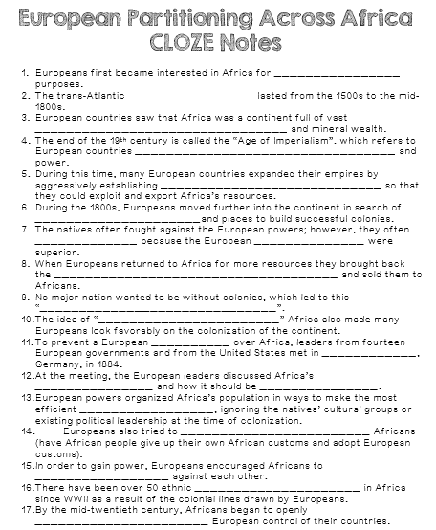

Slide 5
European
Partitioning
Across
Africa
Colonization, Conflict, &
Artificial Boundaries

Slide 6
Trade Routes
Europeans first became interested in Africa for trade route purposes.
They were looking for ways to avoid the taxes of the Arab and Ottoman empires in Southwest Asia.
Sailing around Africa was the obvious choice, but it was a long voyage and could not be completed without “pit stops” along the way.
Europeans created ports in southern and eastern Africa so traders could restock supplies before crossing the Indian Ocean.

Slide 7
Slave Trade
During the 16th century, Portuguese explorers became engaged in the African slave trade.
They kidnapped Africans and forced them to work on plantations and mines in their colonies in the New World.
Other European countries soon participated in the slave trade as well.
The trans-Atlantic slave trade lasted from the 1500s to the mid-1800s.
Even after the slave trade had ended, European interest in Africa was still going strong.
European countries saw that Africa was a continent full of vast natural resources and mineral wealth.

Slide 8
Imperialism
The end of the 19th century is called the “Age of Imperialism”, which refers to European countries competing for land and power.
Imperialism is a system were a strong country takes wealth and raw materials from another country.
A “strong” country was supposed to have many colonies to increase its wealth and importance around the world.

Slide 9
Colonialism
During this time, many European countries expanded their empires by aggressively establishing colonies in Africa so that they could exploit and export Africa’s resources.
Raw materials like rubber, timber, diamonds, and gold were found in Africa.
Europeans also wanted to protect trade routes.

Slide 10
Europeans in Africa
During the 1800s, Europeans moved further into the continent in search of raw materials and places to build successful colonies.
Great Britain, France, & Germany fought over control of land that is now Egypt and Sudan.
Belgians took control of the Congo.
The natives often fought against the European powers; however, they often lost because the European weapons were superior.
The Zulu nation fought the British in South Africa and the Ashanti struggled to hold onto what is now Ghana.

Slide 11
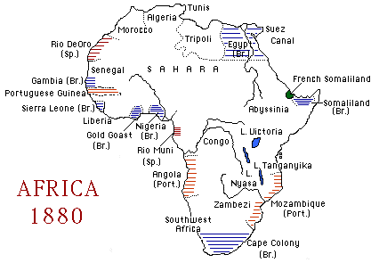

Slide 12
Economic Reasons
Economic motivation played a large part in the colonization of Africa.
The 1800s was a time of great industrialization in Europe (Industrial Revolution).
Factories required raw materials that could be manufactured into marketable products.
When Europeans returned to Africa for more resources they brought back the manufactured goods and sold them to Africans.
Africa became a new market for Europe to sell goods.

Slide 13
Political Reasons
Politics in Europe also led to the colonization of Africa.
Nationalism, a strong sense of pride in one's nation, resulted in competition between European nations.
No major nation wanted to be without colonies, which led to this “Scramble for Africa”.
The competition was particularly fierce between Great Britain, France, and Germany, the strongest European nations in the 1800s.

Slide 14
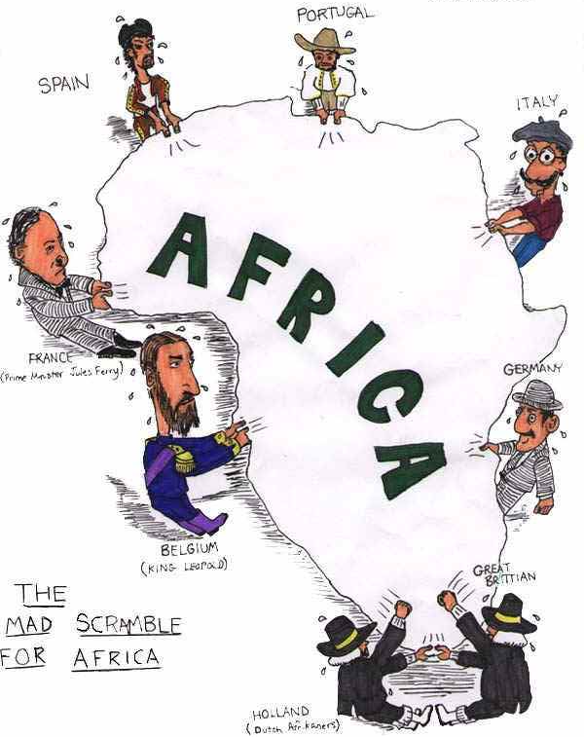

Slide 15
Religious Reasons
Christian missionary work gained strength during the 1800s as European countries were becoming more involved in Africa.
Many missionaries were supportive of the colonization of Africa because they believed that European control would provide a political environment that would help missionary activity.
The idea of “Christianizing” Africa also made many Europeans look favorably on the colonization of the continent.

Slide 16
Berlin Conference
By the 1880s, Great Britain, France, Germany, Belgium, Spain, and Portugal all wanted part of Africa.
To prevent a European war over Africa, leaders from fourteen European governments and from the United States met in Berlin, Germany, in 1884.
No Africans attended the meeting.
At the meeting, the European leaders discussed Africa’s land and how it should be divided.

Slide 17
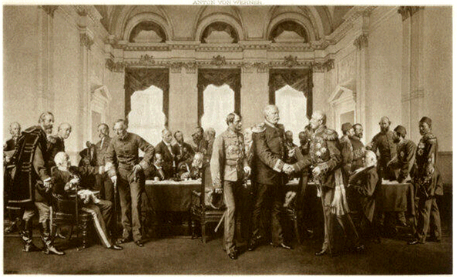
Berlin Conference

Slide 18
Berlin Conference
Going into the meeting, roughly 10% of Africa was under European colonial rule.
By the end of the meeting, European powers “owned” most of Africa and drew boundary lines that remained until 1914.
Great Britain won the most land in Africa and was “given” Nigeria, Egypt, Sudan, Kenya, and South Africa after defeating the Dutch Settlers and Zulu Nation.
The agreements made in Berlin still affect the boundaries of African countries today.

Slide 19
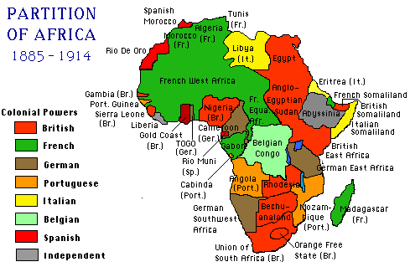
Political Boundaries after Berlin Conference

Slide 20
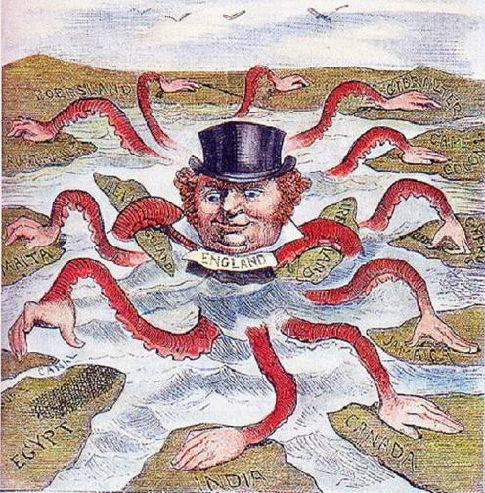

Slide 21
Artificial Boundaries
European powers organized Africa’s population in ways to make the most efficient workforce, ignoring the natives’ cultural groups or existing political leadership at the time of colonization.
Sometimes they grouped together people who had never been united under the same government before.
Sometimes they divided existing groups of people.
The creation of these borders had a negative impact on Africa’s political and social structures by either dividing groups that wanted to be together or combining ethnic groups that were enemies.

Slide 22
Artificial Boundaries
Europeans placed colonies into administrative districts and forced the Africans to go along with their demands.
In order to establish their indirect rule, Europeans used local chiefs as their enforcers in the colonies.
Europeans also tried to assimilate Africans (have African people give up their own African customs and adopt European customs).
Protests and revolts were common and starvation and disease became widespread.

Slide 23
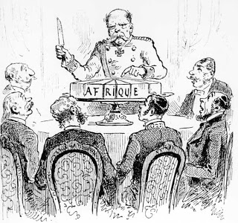

Slide 24
Lasting Effects
Europeans took the best land by force.
African farmers were forced to grow cash crops like cocoa and coffee, causing there to be a shortage of food in many areas of Africa.
Africans were forced to work under terrible conditions on plantations, railways, and logging.
In order to gain power, Europeans encouraged Africans to fight against each other.
New political boundaries caused ethnic groups to clash.
This has led to ethnic and political unrest in Africa today.
There have been over 50 ethnic conflicts in Africa since WWII as a result of the colonial lines drawn by Europeans.

Slide 25
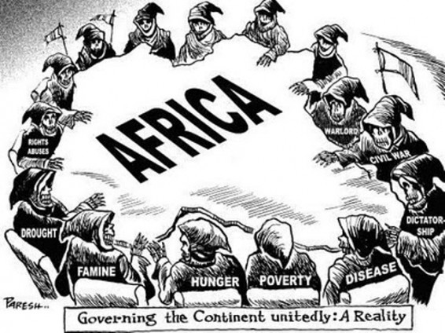

Slide 26
African Unrest
By the mid-twentieth century, Africans began to openly oppose European control of their countries.
It was obvious that colonialism was not fair, as it only benefitted the Europeans.
Africans were tired of being treated like second-class citizens on their own land.
They soon begin to demand freedom for themselves…

Slide 27
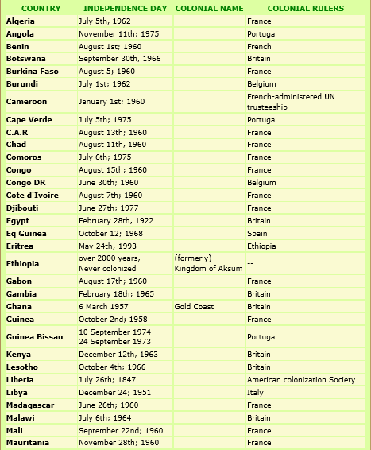
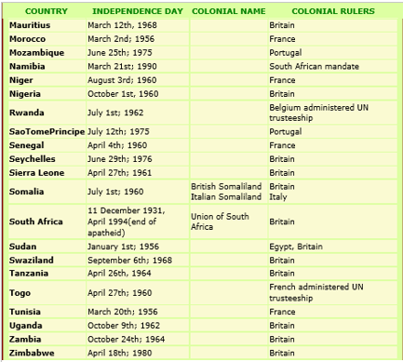
http://www.japanafricanet.com/directory/presidents/africanindependence.html

Slide 28
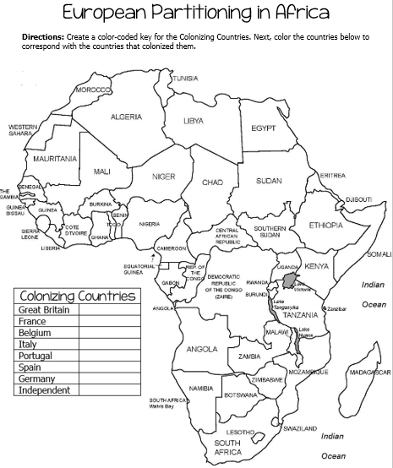

Slide 29
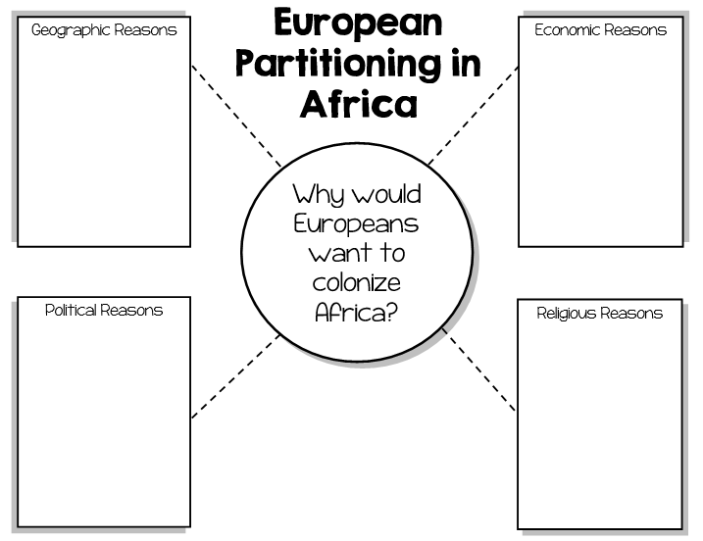

Slide 30
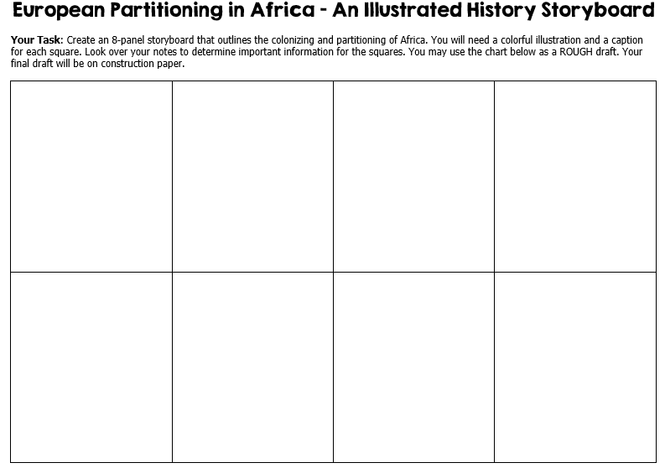

Slide 31
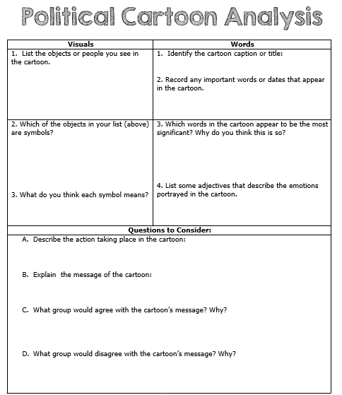

Slide 32
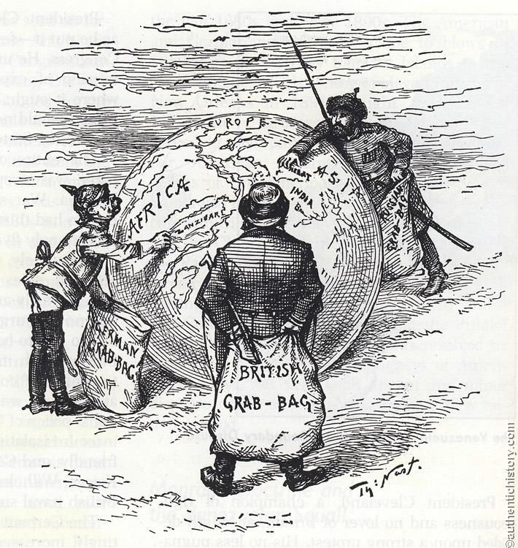
“World’s Plunderers”
Published - June 20, 1885

Slide 34
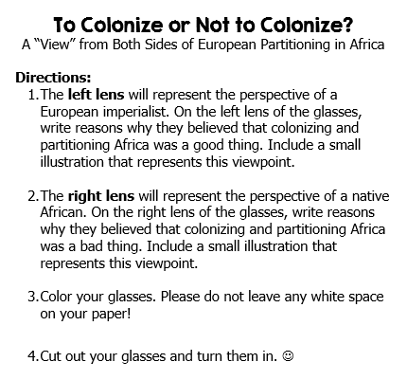

Slide 39
Teachers
Thank you for downloading this file. I hope you enjoy using it with your students, and I can’t wait to read your feedback in my TPT store! ☺
For more social studies materials, please visit my store: http://www.teacherspayteachers.com/Store/Brain-Wrinkles
I teach Language Arts and Social Studies in Georgia, so my products are aligned with Common Core (LA) and Georgia Performance Standards (SS).
© Copyright 2013. Brain Wrinkles. All rights reserved. Permission is granted to copy pages specifically designed for student or teacher use by the original purchaser or licensee. The reproduction of any other part of this product is strictly prohibited. Copying any part of this product and placing it on the Internet in any form (even a personal/classroom website) is strictly forbidden. Doing so makes it possible for an Internet search to make the document available on the Internet, free of charge, and is a violation of the Digital Millennium Copyright Act (DMCA).

Slide 40
Credits:
All photos were found via Creative Commons and labeled for reuse.
Fonts:
Backgrounds & Graphics:

