Slide 1








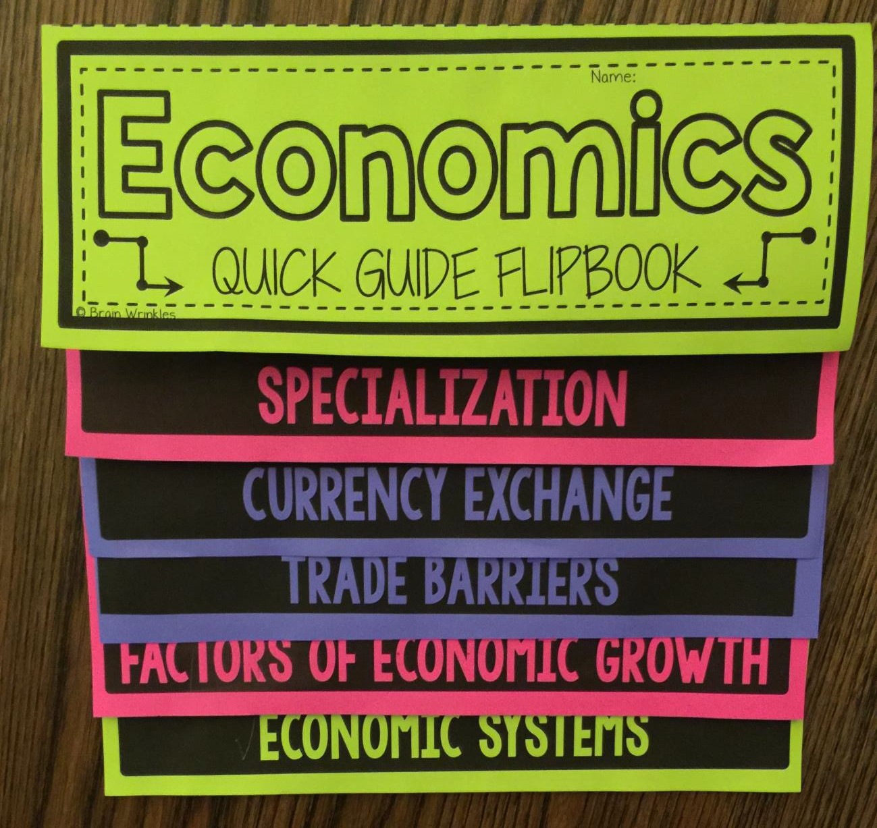


Quick Guide

Slide 2







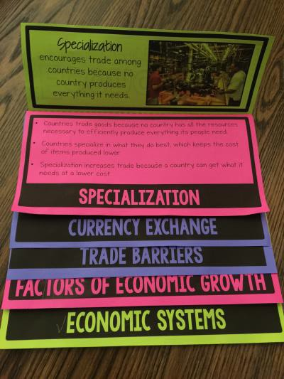
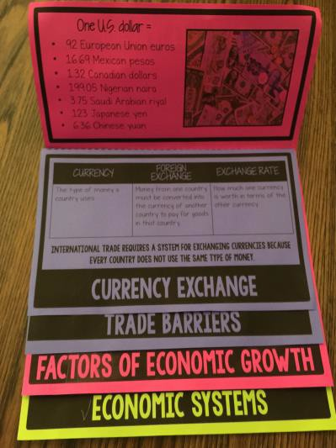
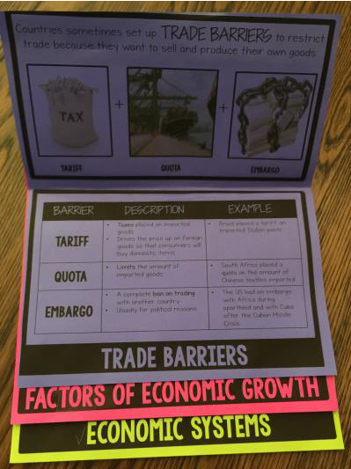
How to Print:
-Select front/back on your printer settings (if you have that option)
-Print all slides.
-If you don’t have a front/back option, print out the odd pages first (3,5,7).
-Insert them back into your printer and print the even pages (4,6,8). Print page 4 on the back of page 3, page 6 on the back of page 5, and page 8 on the back of page 7.
*Please remember that our printers may be different and what works on mine, may not work the same way on yours. You may have to adjust the settings on your printer in order for the pages to print properly.
How to Assemble:
-Fold pages along the fold lines. (The dashed fold lines should be on the outside of the flipbook.)
-Line up pages in the correct order.
-Staple at the top where you fold the pages.
*Use these images to help you as you assemble your book:
*When the students are creating their flipbooks, be sure to model which pages to fold. I find it works best if each page is a different color so that they know exactly what page to work with.
I have included a version with fill-in-the-blank slots in case you want your students to write in the information while you’re discussing the flipbooks.

Slide 3









Name:
QUICK GUIDE FLIPBOOK
© Brain Wrinkles

Slide 4


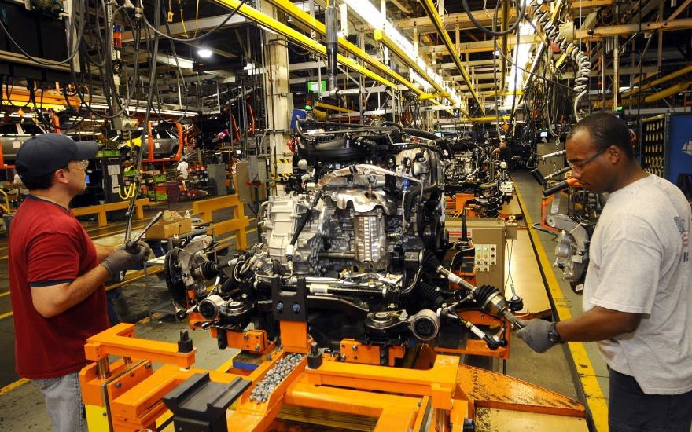


Specialization
encourages trade among countries because no country produces everything it needs.
AN ECONOMIC SYSTEM _{1. What to produce?} MUST ANSWER 3 BASIC ^{2. How to produce?} _{QUESTIONS:} 3. For whom to produce? SYSTEM DESCRIPTION EXAMPLES Produce what they • Tribes in South need to survive America and Africa _{TRADITIONAL} • Based on customs & • Inuit in Canada beliefs of the past • Aborigines in Australia All economic • No pure command _{COMMAND} decisions are made systems, but Cuba by the government & North Korea are close Private citizens • No pure market _{MARKET} make economic systems, but US, decisions based on Australia, & Japan supply and demand are close
ECONOMIC SYSTEMS

Slide 5


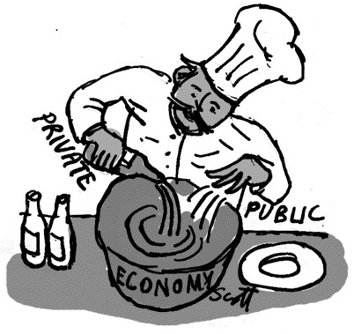

These countries have a _{MIXED} economic system.
Most democratic countries have a mix of government control and private individuals making economic decisions.
Australia
Canada
Brazil
Mexico
US
Germany
Russia
United Kingdom
Japan
Israel
Turkey
Saudi Arabia
Nigeria
India
South Africa
China (mostly)
Countries trade goods because no country has all the resources necessary to efficiently produce everything its people need.
Countries specialize in what they do best, which keeps the cost of items produced lower.
Specialization increases trade because a country can get what it needs at a lower cost.
SPECIALIZATION

Slide 6




One U.S. dollar =
.92 European Union euros
16.69 Mexican pesos
1.32 Canadian dollars
199.05 Nigerian naira
3.75 Saudi Arabian riyal
123 Japanese yen
6.36 Chinese yuan
FACTOR DEFINITION EXAMPLES Resources that come Trees, oil, minerals NATURAL RESOURCES _{from the earth} People who perform labor Education and skills HUMAN CAPITAL _{training} Items that people need in Factories, machinery, _{CAPITAL GOODS} order to perform their technology jobs People with new ideas who Walt Disney, Thomas are willing to take risks to Edison, Beyoncé ENTREPRENEURSHIP start a business or make a product How a country manages its productive resources makes a big difference in the strength of its economy.
FACTORS OF ECONOMIC GROWTH

Slide 7






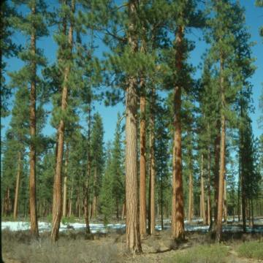


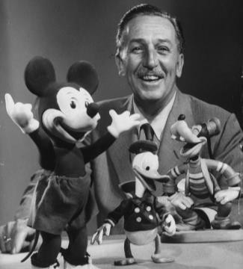

GDP: the total market value of the goods and services produced by a country’s economy during a specific period of time.
Economists measure a nation’s economic performance by Gross Domestic Product (GDP).
Economists use GDP to determine the health of a country’s economy and compare it to other economies.
There are 4 basic factors that influence economic growth:
CAPITAL RESOURCES
ENTREPRENEURSHIP
HUMAN CAPITAL
NATURAL RESOURCES
CURRENCY ^{FOREIGN} EXCHANGE RATE EXCHANGE The type of money a Money from one country How much one currency country uses must be converted into is worth in terms of the the currency of another other currency country to pay for goods in that country. international trade requires a system for exchanging currencies because every country does not use the same type of money.
CURRENCY EXCHANGE
3

Slide 8





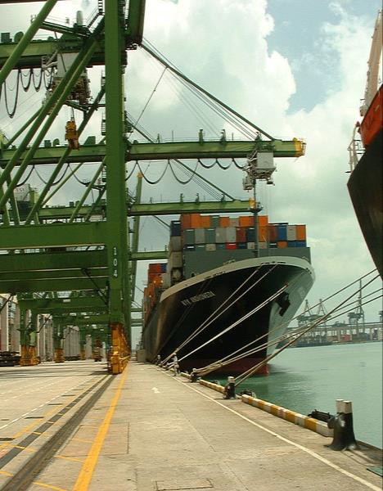


Countries sometimes set up TRADE BARRIERS to restrict
trade because they want to sell and produce their own goods.
+
+
TARIFF
QUOTA
EMBARGO
BARRIER DESCRIPTION EXAMPLE Taxes placed on imported • Brazil placed a tariff on goods imported Italian pasta _{TARIFF} • Drives the price up on foreign goods so that consumers will buy domestic items Limits the amount of • South Africa placed a _{QUOTA} imported goods quota on the amount of Chinese textiles imported A complete ban on trading • The US had an embargo with another country with Africa during _{EMBARGO} • Usually for political reasons apartheid and with Cuba after the Cuban Missile Crisis.
TRADE BARRIERS

Slide 9




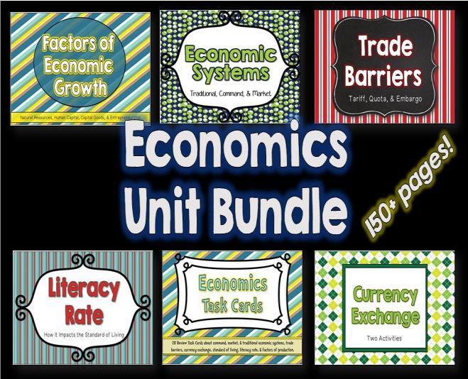
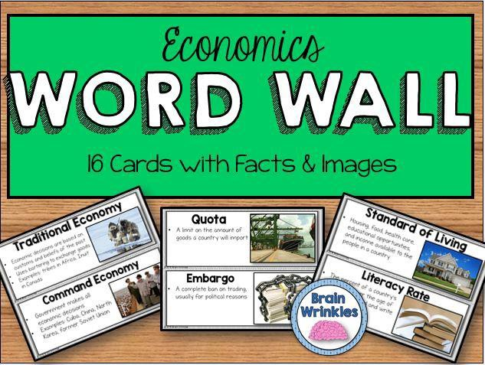

Thank you so much for downloading this file. I sincerely hope you find it helpful and that your students learn a lot from it! I look forward to reading your feedback in my store.
If you like this file, you might want to check out some of my other products that teach social studies topics in creative, engaging, and hands-on ways.
Best wishes,
Ansley at Brain Wrinkles

Slide 10



© 2015 Brain Wrinkles. Your download includes a limited use license from Brain Wrinkles. The purchaser may use the resource for personal classroom use only. The license is not transferable to another person. Other teachers should purchase their own license through my store.
This resource is not to be used:
By an entire grade level, school, or district without purchasing the proper number of licenses. For school/district licenses at a discount, please contact me.
As part of a product listed for sale or for free by another individual.
On shared databases.
Online in any way other than on password-protected website for student use only.
© Copyright 2015. Brain Wrinkles. All rights reserved. Permission is granted to copy pages specifically designed for student or teacher use by the original purchaser or licensee. The reproduction of any other part of this product is strictly prohibited. Copying any part of this product and placing it on the Internet in any form (even a personal/classroom website) is strictly forbidden. Doing so makes it possible for an Internet search to make the document available on the Internet, free of charge, and is a violation of the Digital Millennium Copyright Act (DMCA).
Thank you,
Ansley at Brain Wrinkles
Clipart, fonts, & digital papers for this product were purchased from:

