Slide 1
Digital Gallery Walk
Explore Each Exhibit and complete your notes

Slide 2
Exhibit 1 — Transatlantic Slave Trade Article: Read the article and answer the questionaire
The Atlantic slave trade or transatlantic slave trade took place across the Atlantic Ocean from the 16th through to the 19th centuries. The vast majority of slaves transported to the New World were Africans from the central and western parts of the continent, sold by Africans to European slave traders who then transported them to North and South America. The numbers were so great that Africans who came by way of the slave trade became the most numerous Old-World immigrants in both North and South America before the late eighteenth century. The South Atlantic economic system centered on making goods and clothing to sell in Europe and increasing the numbers of African slaves brought to the New World. This was crucial to those European countries which, in the late seventeenth and eighteenth centuries, were vying with each other to create overseas empires.

Slide 3
The first Africans imported to the English colonies were also called “indentured servants” or “apprentices for life”. By the middle of the seventeenth century, they and their offspring were legally the property of their owners. As property, they were merchandise or units of labor, and were sold at markets with other goods and services.
The Portuguese were the first to engage in the New World slave trade, and others soon followed. Slaves were considered cargo by the ship owners, to be transported to the Americas as quickly and cheaply as possible, there to be sold to labour in coffee, tobacco, cocoa, cotton and sugar plantations, gold and silver mines, rice fields, construction industry, cutting timber for ships, and as house servants.
Triangular trade
The first side of the triangle was the export of goods from Europe to Africa. A number of African kings and merchants took part in the trading of enslaved people from 1440 to about 1833. For each captive, the African rulers would receive a variety of goods from Europe. These included guns, ammunition and other factory made goods. The second leg of the triangle exported enslaved Africans across the Atlantic Ocean to the Americas and the Caribbean Islands. The third and final part of the triangle was the return of goods to Europe from the Americas. The goods were the products of slave-labor plantations and included cotton, sugar, tobacco, molasses and rum
Next: Complete Exhibit 1 questionnaire.

Slide 4
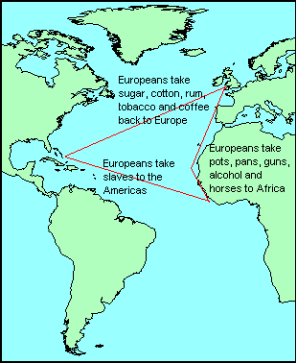
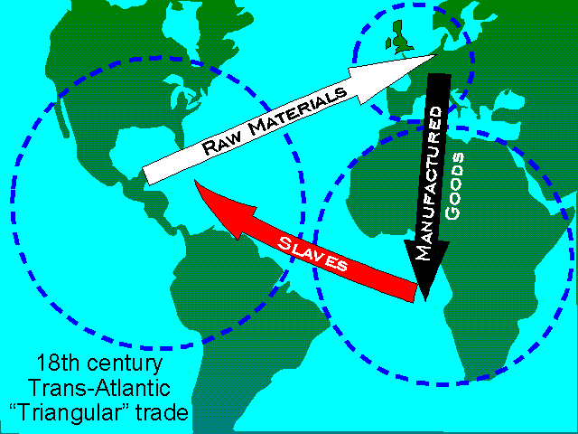
Exhibit 2: Triangle Trade Map

Slide 5
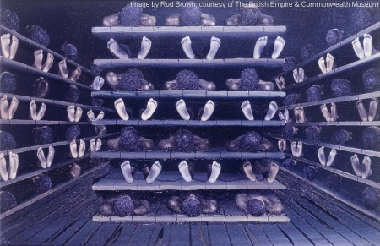
Exhibit 3: Coffin Ship
“Coffin Ship” Illustration

Slide 6
“Coffin Ship” Diagrams (1648)
Look at the diagrams on the following 2 slides and answer the questionaire about this exhibit.

Slide 7
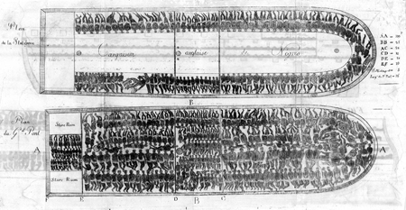

Slide 8
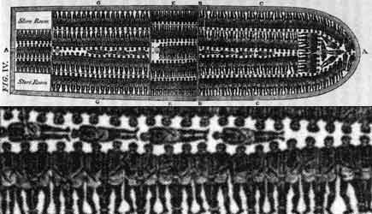

Slide 9
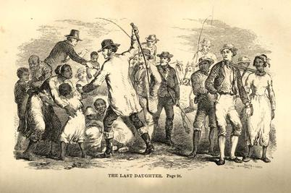
Exhibit 4 — “The Last Daughter” Illustration

Slide 10
Homework
Answer the following--What was the most moving document from the gallery walk? Why?

