Slide 1
1901-1919
Stephanie Hosch

Slide 2
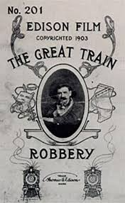
Entertainment
In 1903, the first narrative, silent film was released. The Great Train Robbery was directed and photographed by Edwin S. Porter. It was a one-reel action picture that was about 10 minutes. Movie

Slide 3
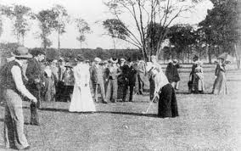
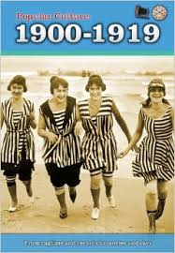
Recreation and Leisure
The Americans of that time were starting to get more leisure time, their working hours cut short, and vacation time. Around this time for leisure people went to amusement parks, attended baseball, basketball and boxing matches and engaged in other fun activities locally and around the country.
Video

Slide 4
Recreation and Leisure
In the 1900s families came together and read the bible where as family time today is not valued as much.
Many Americans participated fairs and expositions held in different U.S. cities, This allowed Americans a chance to "tour the world" in one place.
1904 World’s Fair in St. Louis

Slide 5
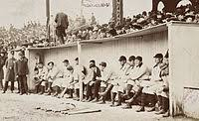
Sports
Oct 1, 1903 – Oct 13, 1903, the first World Series was played between the Boston Americans and the Pittsburgh Pirates. In a best-of-nine series, Boston won 5 games to 3.
One of the most famous athletes of the time was George Herman (Babe) Ruth. His career in Major League Baseball (MLB) spanned 22 seasons, from 1914 through 1935. Nicknamed "The Bambino" and "The Sultan of Swat", he began his MLB career as a stellar left-handed pitcher for the Boston Red Sox, but achieved his greatest fame as a slugging outfielder for the New York Yankees.
Babe Ruth’s 60th Homerun

Slide 6
Values/Culture

Slide 7
Politics

Slide 8
Economy

Slide 9
Inventions/Technology

