Slide 1
SS7H3e
Containment
of
Communism
Korea
© 2015 Brain Wrinkles

Slide 2
Standards
SS7H3 The student will analyze continuity and change in Southern and Eastern Asia leading to the 21st century.
e. Explain the reasons for foreign involvement in Korea and Vietnam in terms of containment of Communism.
© 2015 Brain Wrinkles

Slide 3
Teacher Directions – CLOZE Notes
The next pages are handouts for the students to use for note-taking during the presentation. (Print front to back to save paper and ink.)
Check the answers as a class after the presentation.
© 2015 Brain Wrinkles

Slide 4
End of WWII
The United States, Soviet Union, and Great Britain made an agreement on how they would _________________________________________________ after World War II.
Each country was supposed to _________________________________________________ the lands that were impacted by the war.
They would work to _________________________________________________ would be held so that they people could _________________________________________________ .
Soviet Union
Once peace was declared, the Soviet Union found itself _________________________________________________ its occupied countries.
The Soviet Union worked hard to be sure that the _________________________________________________ .
It eventually began to take over Eastern European and _________________________________________________ in order to spread this form of government.
United States
The _________________________________________________ and saw this as breaking the promises made after WWII.
The US _________________________________________________ threatened by the Soviets so that they could protect their individual rights.
The US and the Soviet Union found themselves _________________________________________________ , where they competed to become the dominating world power.
Post-WWII Korea
One place where this struggle was seen was on the _________________________________________________ .
After World War II, Japanese-occupied Korea was temporarily divided into _________________________________________________ .
The Soviet Union controlled Korea north of the 38th parallel and established a _________________________________________________ .
The United States would be in charge of Korea _________________________________________________ and promoted a democratic system.
© 2015 Brain Wrinkles
Containment of Communism
CLOZE Notes 1

Slide 5
Korean War
In 1950, Kim Il Sung, the leader of North Korea, sent his powerful army to _________________________________________________ .
The US had to take a _________________________________________________ and was willing to go to war to keep communism from spreading to this area.
US President Truman _________________________________________________ to support Korean ground troops, and asked the United Nations to approve the use of force to _________________________________________________ .
The United Nations responded quickly, _________________________________________________ . The U.S. and 19 other nations committed troops to the area.
The UN force, commanded by American _________________________________________________ , forced Korean soldiers out of South Korea and farther north to the _________________________________________________ .
Despite initial heavy losses, the combined UN forces _________________________________________________ .
Going _________________________________________________ into North Korea brought communist China’s well-trained and well-equipped army into the war.
The _________________________________________________ , forcing the UN soldiers to retreat.
When the fighting finally ended in 1953, _________________________________________________ (stalemate).
The 38th parallel _________________________________________________ between the two countries.
Korea Today
The Korean peninsula was badly damaged, and _________________________________________________ .
_________________________________________________, so containment of communism had worked.
Today, South Korea has free elections and a _________________________________________________ .
North Korea remains a _________________________________________________ under the autocratic rule of Premiere Kim Jong-Il.
Vietnam
Vietnam was also caught in the _________________________________________________ .
The country was divided into _________________________________________________ .
_________________________________________________ led North Vietnam, while the United States provided _________________________________________________ from falling to the Communists.
The United States did not want any new communist countries _________________________________________________ .
© 2015 Brain Wrinkles
Containment of Communism
CLOZE Notes 2

Slide 6
Vietnam War
In 1965, the US became involved in the Vietnam War when it began _________________________________________________ .
Billions of dollars were spent and thousands of _________________________________________________ in Vietnam to prevent the country from becoming communist.
Many Americans _________________________________________________ , and in 1973, US _________________________________________________ .
The Vietnam War ended in a _________________________________________________ .
Vietnam Today
In 1975, North Vietnam took over South Vietnam for good and the country was _________________________________________________ .
The People’s Republic of Vietnam was _________________________________________________ .
Democracy
In order to protect democracy and citizens’ _________________________________________________ , the US intervened in both Korea and Vietnam to fight against communism.
Today, South Korea has a _________________________________________________ similar to that of the US, while _________________________________________________ nation.
Although there are still a few communist countries left in the world today, the US successfully _________________________________________________ .
© 2015 Brain Wrinkles
Containment of Communism
CLOZE Notes 3

Slide 7
SS7H3e
Containment
of
Communism
Korea & Vietnam
© 2015 Brain Wrinkles

Slide 8
End of WWII
The United States, Soviet Union, and Great Britain made an agreement on how they would put the world back together after World War II.
Each country was supposed to temporarily occupy the lands that were impacted by the war.
They would work to restore order and free elections would be held so that they people could decide on their future government.
© 2015 Brain Wrinkles

Slide 9
Soviet Union
Once peace was declared, the Soviet Union found itself reluctant to leave its occupied countries.
The Soviet Union worked hard to be sure that the new governments were communist.
It eventually began to take over Eastern European and Asian countries by force in order to spread this form of government.
© 2015 Brain Wrinkles

Slide 10
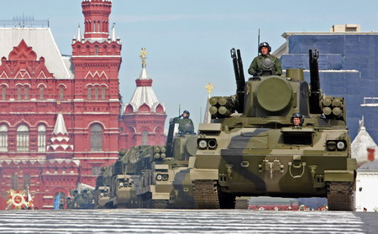
© 2014 Brain Wrinkles

Slide 11
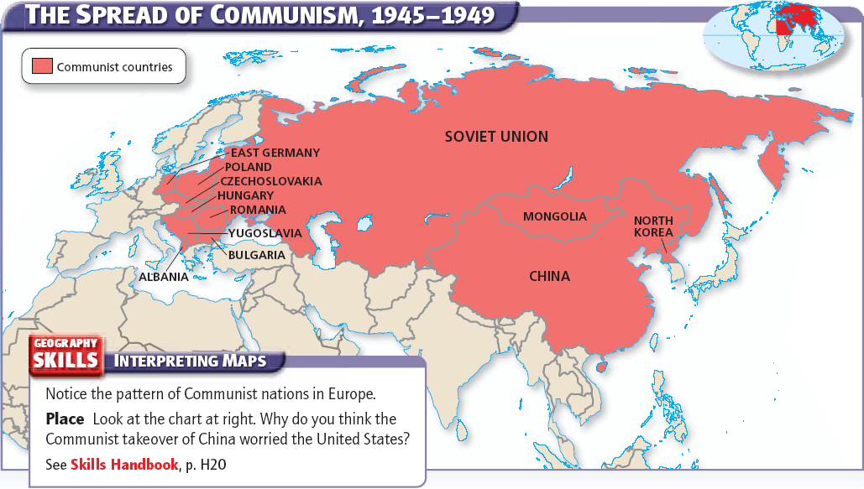
© 2014 Brain Wrinkles

Slide 12
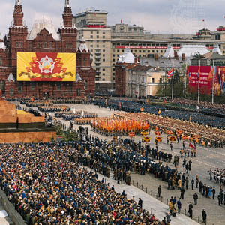
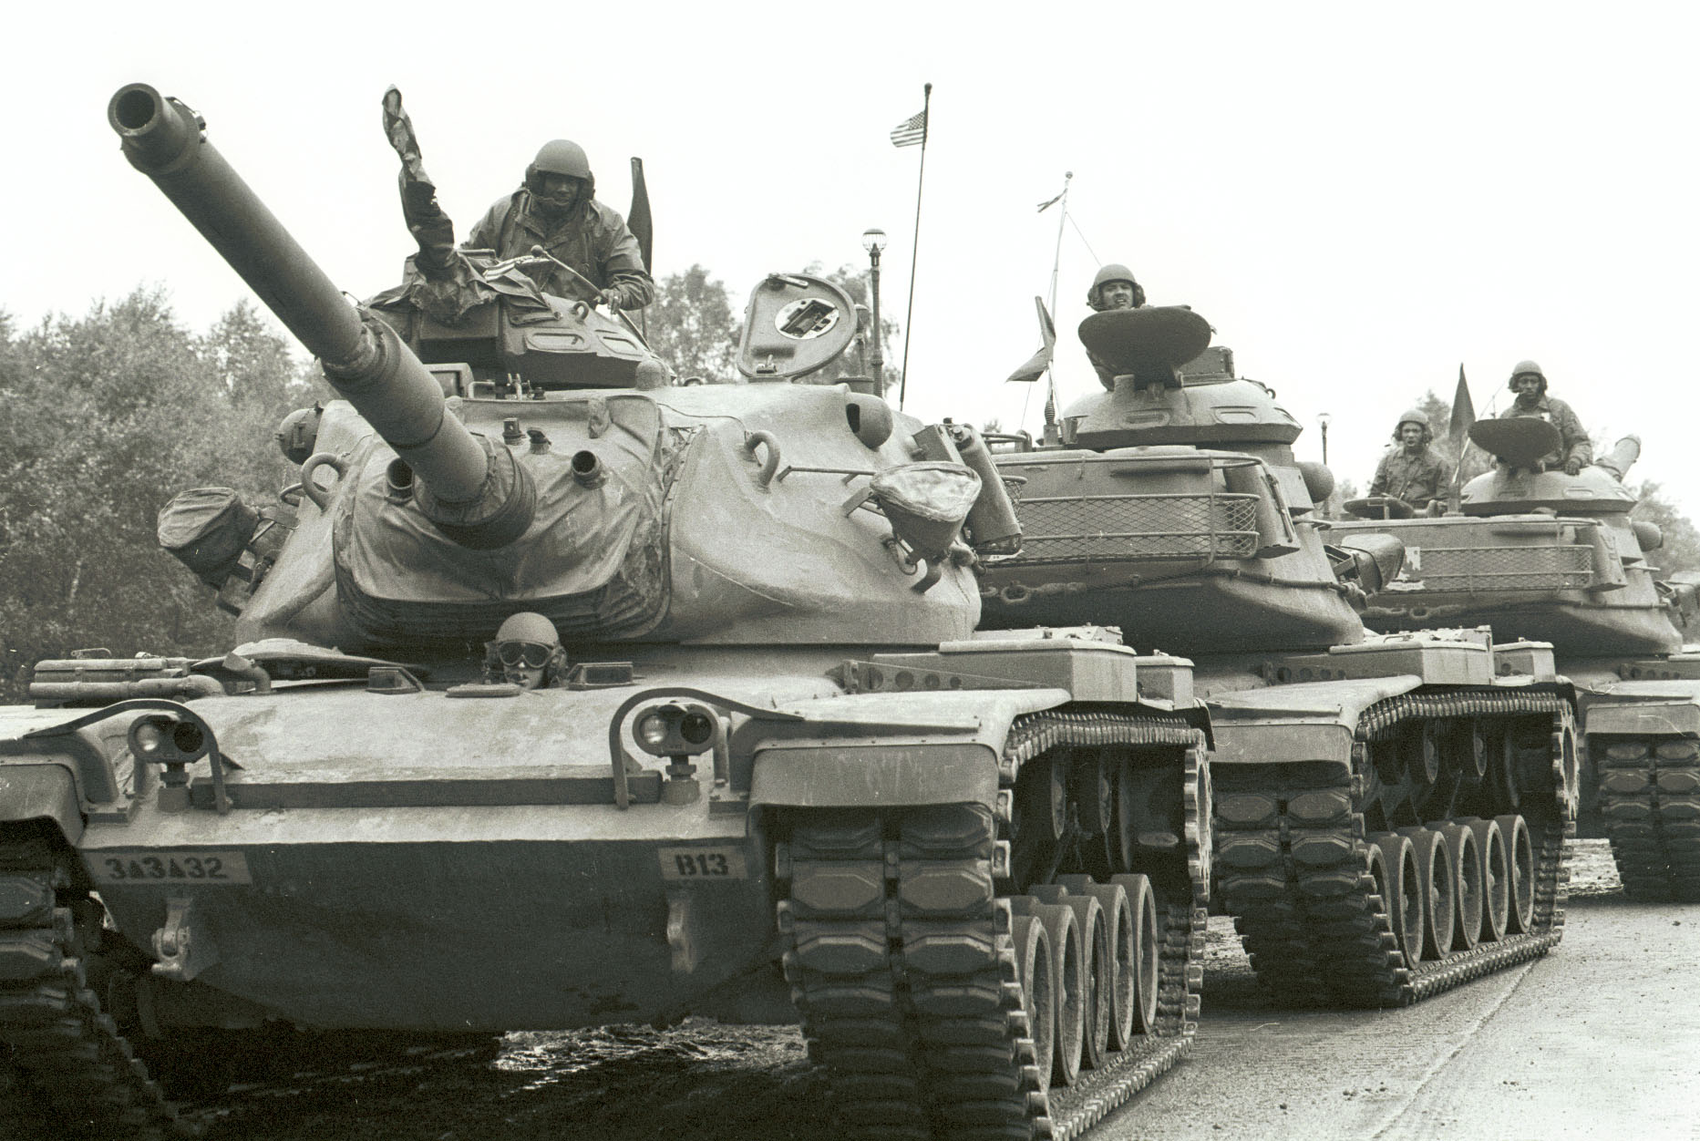
© 2015 Brain Wrinkles

Slide 13
United States
The United States was furious and saw this as breaking the promises made after WWII.
The US offered aid to the countries threatened by the Soviets so that they could protect their individual rights.
The US and the Soviet Union found themselves engaged in a Cold War, where they competed to become the dominating world power.
© 2015 Brain Wrinkles

Slide 14
Post-WWII Korea
One place where this struggle was seen was on the Korean peninsula.
After World War II, Japanese-occupied Korea was temporarily divided into northern and southern parts.
The Soviet Union controlled Korea north of the 38th parallel and established a communist government.
The United States would be in charge of Korea south of the 38th parallel and promoted a democratic system.
© 2015 Brain Wrinkles

Slide 15
Korean War
In 1950, Kim Il Sung, the leader of North Korea, sent his powerful army to invade South Korea.
The US had to take a stand against Communist aggression and was willing to go to war to keep communism from spreading to this area.
US President Truman ordered American naval and air forces to support Korean ground troops, and asked the United Nations to approve the use of force to stop the North Korean invasion.
© 2015 Brain Wrinkles

Slide 16
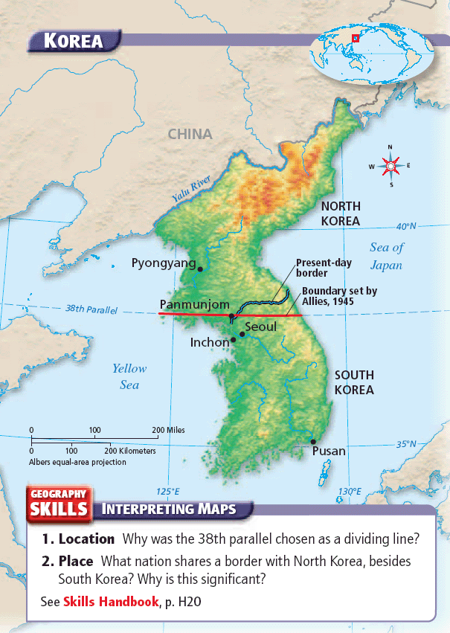
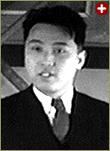
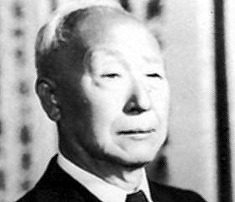
Kim Il-Sung
Syngman Rhee
© 2015 Brain Wrinkles

Slide 17
Korean War
The United Nations responded quickly, imposing military sanctions. The U.S. and 19 other nations committed troops to the area.
The UN force, commanded by American General Douglas MacArthur, forced Korean soldiers out of South Korea and farther north to the Chinese border.
Despite initial heavy losses, the combined UN forces finally began to win.
© 2015 Brain Wrinkles

Slide 18
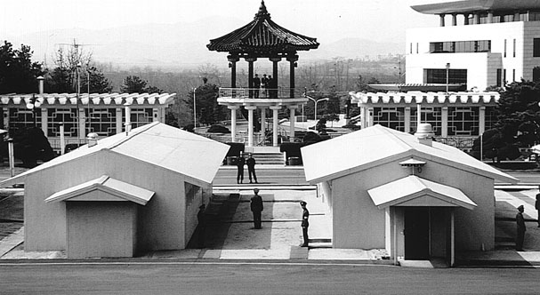

Slide 19
Korean War
Going beyond the 38th parallel into North Korea brought communist China’s well-trained and well-equipped army into the war.
The Communist Chinese attacked, forcing the UN soldiers to retreat.
When the fighting finally ended in 1953, no one was truly victorious (stalemate).
The 38th parallel dividing line remained intact between the two countries.
© 2015 Brain Wrinkles

Slide 20
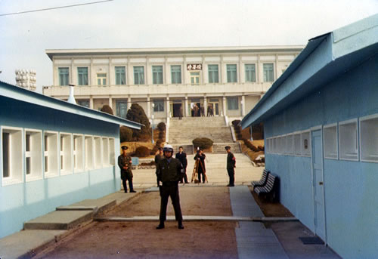
© 2015 Brain Wrinkles

Slide 21
Korea Today
The Korean peninsula was badly damaged, and many lives were lost.
South Korea remained “free”, so containment of communism had worked.
Today, South Korea has free elections and a democratic constitution.
North Korea remains a communist country under the autocratic rule of Premiere Kim Jong-Un.
© 2015 Brain Wrinkles

Slide 22
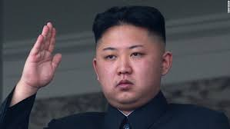
Chairman and Supreme Leader of North Korea, Kim Jong Un
© 2015 Brain Wrinkles

Slide 23
Teacher Info – Venn Diagram
Have the students compare and contrast the US’ involvement with the containment of communism in both Korea and Vietnam.
They can work with a partner to complete this activity.
© 2014 Brain Wrinkles

Slide 24
Containment of Communism
Compare and Contrast
Korea
Vietnam
© 2015 Brain Wrinkles

Slide 25
Teacher Info – Containment of Communism Caricatures
Have the students create a caricature for different people during this time period. *You may need to explain what a caricature is (thought bubble & facial expressions that show what the person is thinking).
The students will write a statement from the point of view of each person.
The students should also draw facial expressions to represent each person’s feelings.
© 2015 Brain Wrinkles

Slide 26
Containment of Communism Caricatures
Directions: What would the different people during the 1950s say about the US’ involvement with the containment of communism? Create a caricature (thought bubble) for each of the people listed below. Include their opinions and views on what they are experiencing. Add facial expressions to each person.
American soldier in SE Asia: | North Korean boy who just escaped to South Korea:
Soviet government official: | Vietnamese farmer who supports Ho Chi Minh:
© 2015 Brain Wrinkles

Slide 27
Teacher – Ticket Out the Door
“Pick Your Brain”
Have the students write down which government that they felt was more successful (democracy vs. communism). They should briefly explain their opinion.
Collect at the end of class, quickly read their opinion statements, and share a few during the next class.
© 2015 Brain Wrinkles

Slide 28
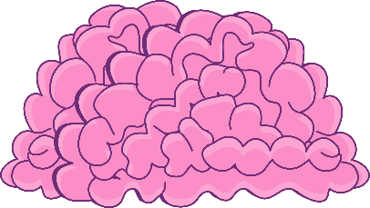
Pick Your Brain
Pick Your Brain
Which government, the US’ democracy or the Soviet Union’s communism was ultimately more successful? Explain.
Which government, the US’ democracy or the Soviet Union’s communism was ultimately more successful? Explain.
© 2015 Brain Wrinkles
© 2015 Brain Wrinkles

