Slide 1
Comparing
Asian
Governments
India, China, & Japan

Slide 2
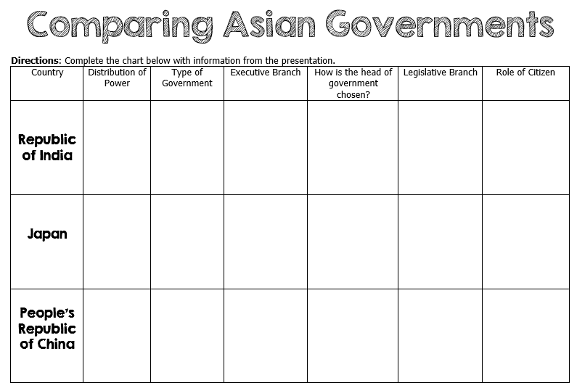

Slide 3
Comparing
Asian
Governments
India, China, & Japan

Slide 4
Let’s Review
Government Systems – Who has the power?
Unitary--power is held by one central authority
Confederation--association of independent states that agree to certain limitations on their freedoms by joining together
Federal--power is divided between central authority & several regional authorities

Slide 5
Let’s Review
Government Types – how do citizens participate?
Autocracy-- 1 person possesses unlimited power & citizens have limited role in government
Oligarchy-- small group exercises control & citizens have limited role in government
Democracy--supreme power is vested in the people & exercised by them directly or indirectly through a system of representation involving free elections

Slide 6
Let’s Review
Two Types of Democratic Governments:
Parliamentary– citizens elect members of Parliament, and then the members select the leader
Leader works with or through the legislature
Presidential--system of government in which the leader is constitutionally independent of the legislature; citizens directly elect leader
Leader works separate from legislature

Slide 7
Republic of
India
Federal Republic

Slide 8
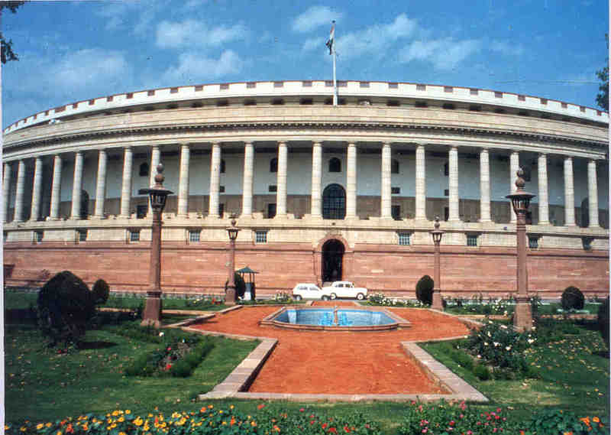
Sansad Bhavan – India’s Parliament Building

Slide 9
Federal System
India has a federal system, which means that the national government and the state governments SHARE power.
There are 28 states and 7 union territories in India.

Slide 10
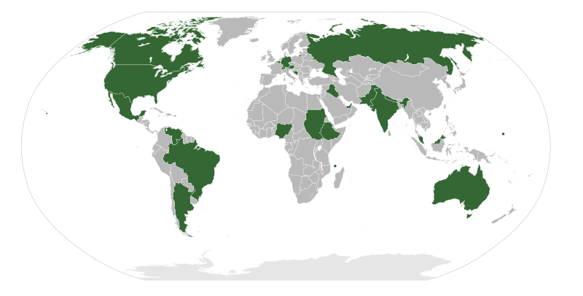
Federal Governments

Slide 11
Leadership
1. Prime Minister: holds the most political power; the prime minister is the head of government.
2. President: is the chief of state; mostly performs ceremonial duties (holds no real political power).

Slide 12
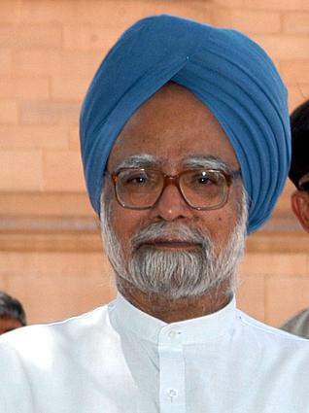
Manmohan Singh
India’s Prime Minister

Slide 13
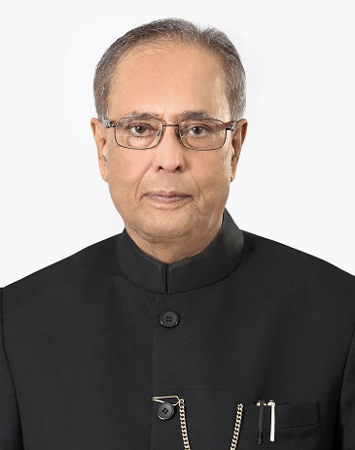
Pranab Mukherjee
India’s President

Slide 14
How Leaders
Are Chosen
Prime Minister: is the leader of the majority party in India’s Parliament; indirectly elected by the Indian people.
President: elected by an electoral college consisting of elected members of Parliament and the legislatures of the states for a five-year term.

Slide 15
Legislature
Legislature = the central authority of a government
India’s legislature is called Parliament.
The citizens of India vote for members of Parliament.
Members of Parliament belong to many different political parties.

Slide 16
Legislature
Parliament is the country’s bicameral legislature.
It consists of:
Lok Sabha “House of the People” (545 seats) – members are elected by Indian citizens.
Rajya Sabha “Council of States” (245 seats) – members are elected by the Lok Sabha.
Members serve five- and six-year terms.

Slide 17
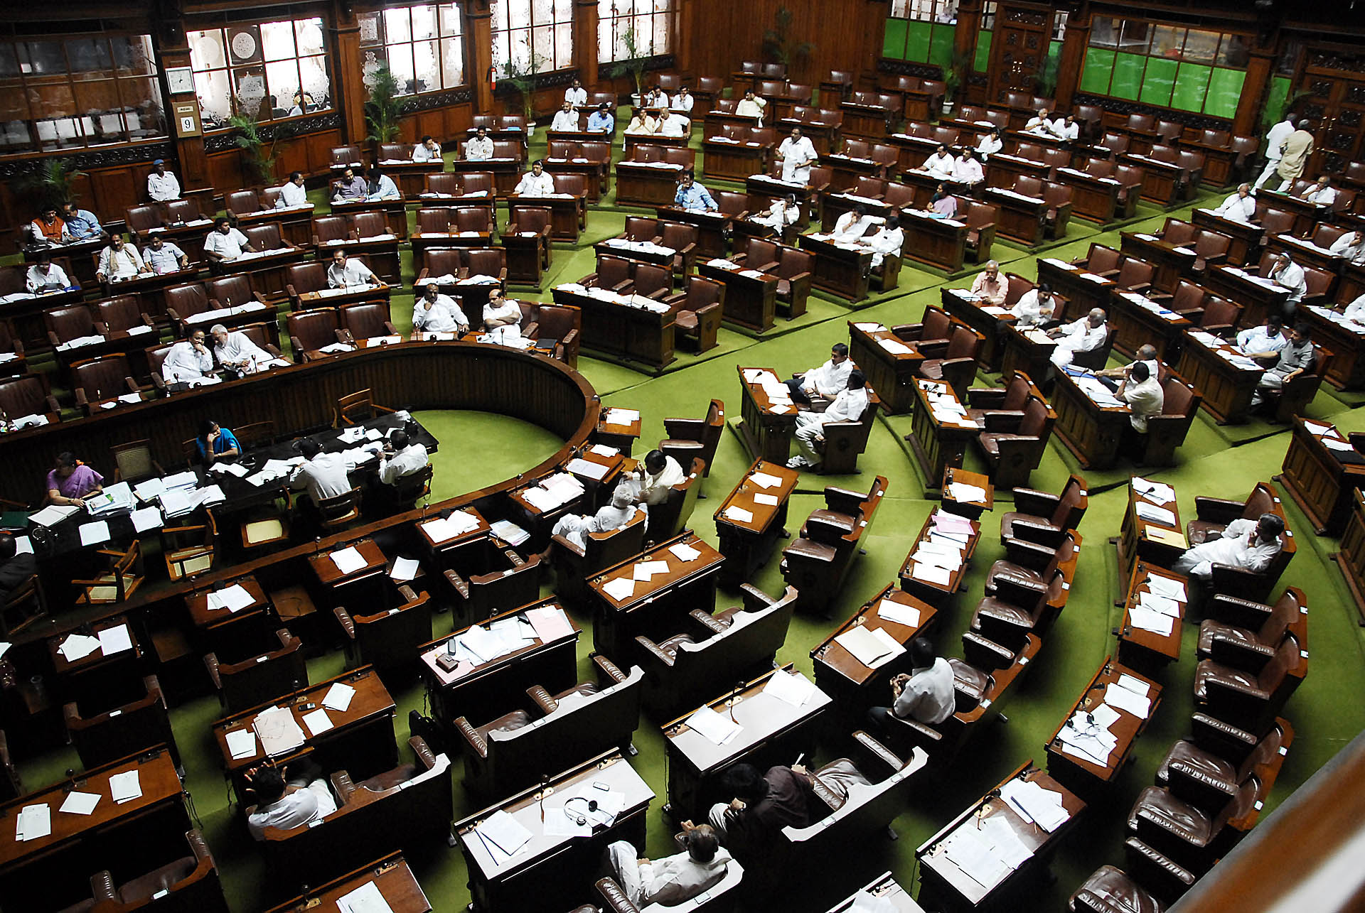
Inside Lok Sabha

Slide 18
Parliamentary
Democracy
Whichever political party has the most members in the legislature selects the Prime Minister.
This is the major difference between a Presidential Democracy and a Parliamentary Democracy!
Parliamentary Democracy – legislature (Parliament) chooses Head of Government (Executive Leader)
Citizens vote for members of Parliament, members choose the Prime Minister.

Slide 19
Role of the Citizen
The Indian Constitution of 1950 granted many rights and personal freedoms to Indian citizens.
All Indians over the age of 18 are guaranteed the right to vote.
Indians also have freedom of speech, freedom of religion, and freedom of assembly.
They are also given the right to conserve their language and culture.

Slide 20
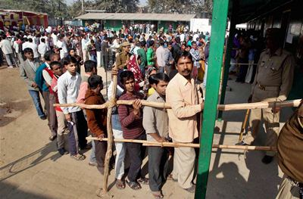
Voting lines in Delhi– December 2013

Slide 21
Japan
Parliamentary Constitutional Monarchy

Slide 22
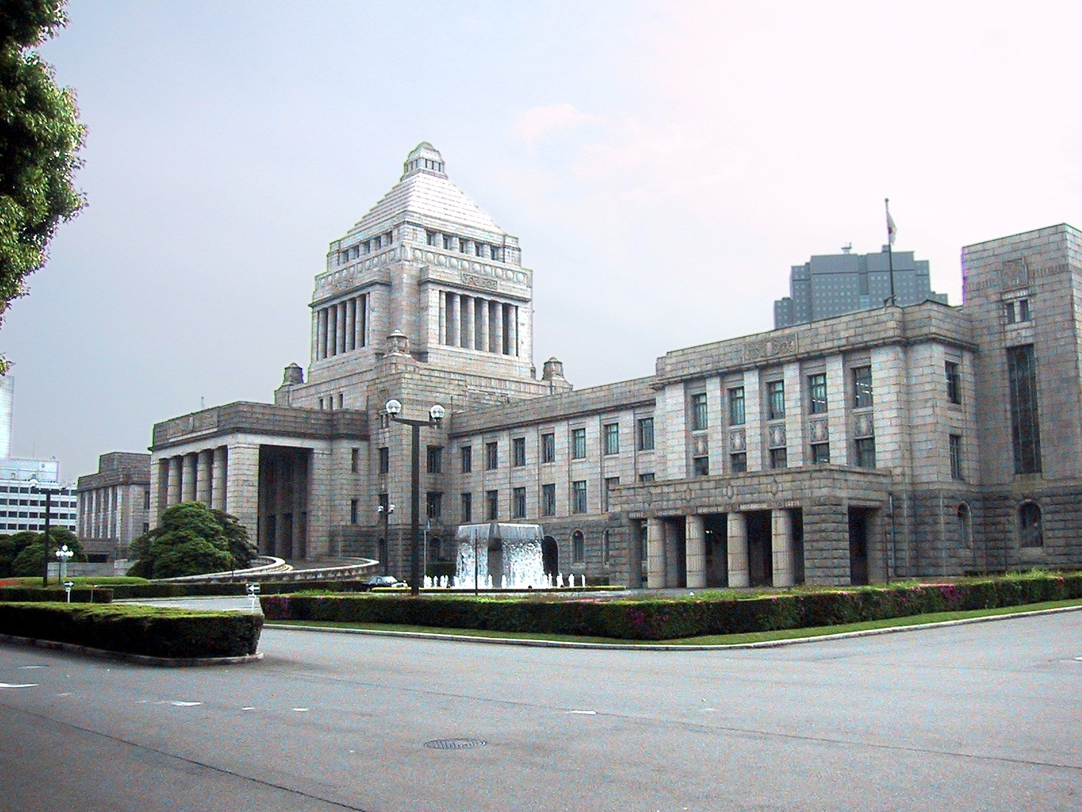
Japan’s Diet Building in Tokyo

Slide 23
Unitary System
Japan has a unitary system, which means that the national (central) government holds all of the power.
The prefectures (like states) are under central government control.
There are 47 prefectures in Japan.

Slide 24
Unitary Governments

Slide 25
Leadership
Emperor: ceremonial position; holds no political power—power was limited by the constitution .
Prime Minister: holds the most political power; the prime minister is the head of government.

Slide 26
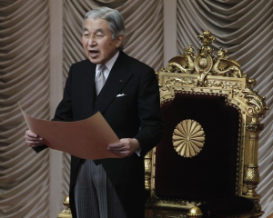
Emperor Akihito

Slide 27
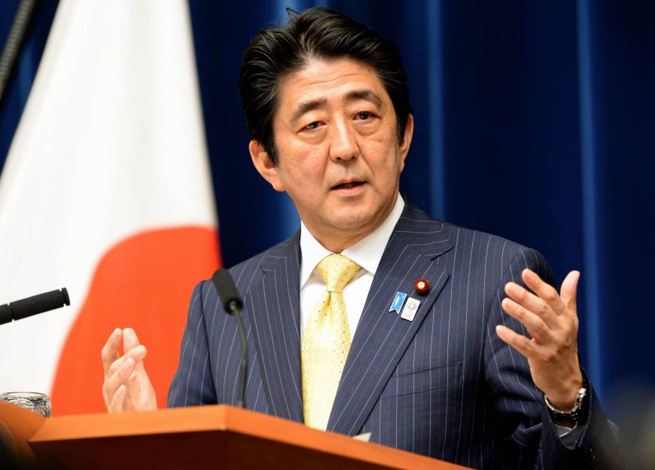
Shinzo Abe
Japan’s Prime Minister

Slide 28
How Leaders
Are Chosen
Emperor: hereditary position.
Prime Minister: is the leader of the majority party in Japan’s Diet (parliament); indirectly elected by the Japanese people.

Slide 29
Legislature
The Japanese Diet is the country’s bicameral legislature.
It consists of:
House of Representatives (480 seats) – members elected to serve four-year terms.
2. House of Councillors (242 seats) – members elected to serve six-year terms.
*The Prime Minister has the right to dissolve the House of Representatives at any time.

Slide 30
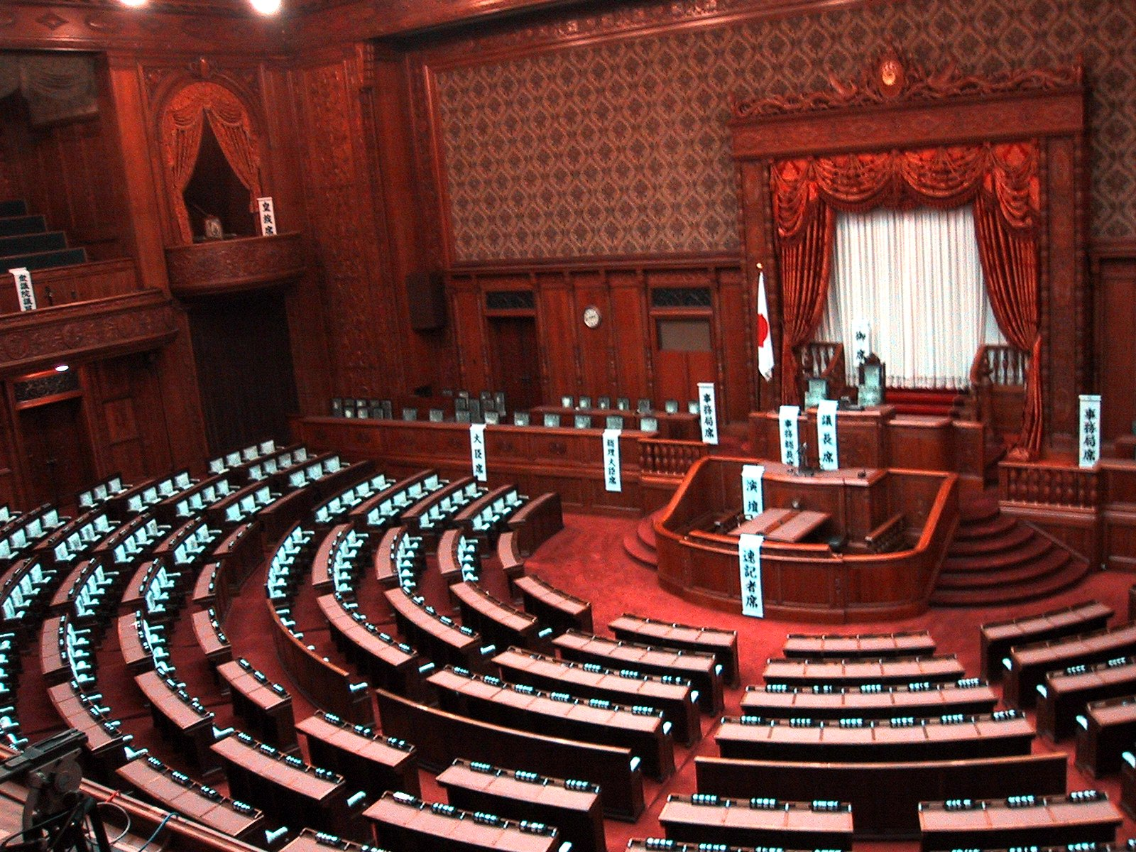

Slide 31
Parliamentary
Democracy
Japan has a parliamentary democracy.
Japanese citizens elect members of the House of Representatives.
The leader of the majority party of the House of Representatives becomes the Prime Minister.
The citizens indirectly elect the leader.

Slide 32
Role of the Citizen
Japanese citizens can vote after age 20.
Japan’s constitution of 1947 established rights and personal freedoms for Japan’s citizens, including freedom of speech and religion, equal rights for women, and equal education for all.

Slide 33
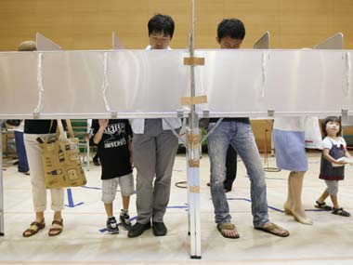
Voting in Japan – 2013

Slide 34
People’s
Republic of
China
Communist State

Slide 35
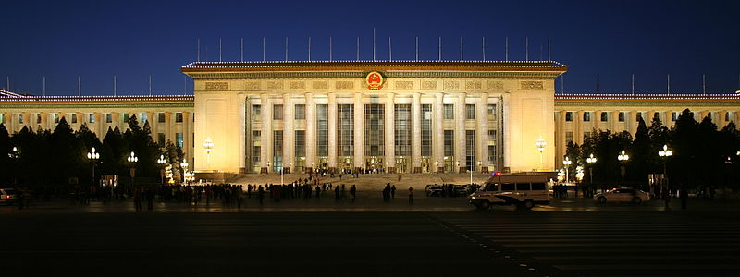
Great Hall of the People in Beijing

Slide 36
Unitary System
China has a unitary system, which means that the national (central) government holds all of the power.
The provinces are under central government control.
There are 23 provinces in China.

Slide 37
Leadership
President: head of state; largely a ceremonial office that holds little political power.
Premier: head of government – highest ranking administrative official in China’s government.

Slide 38
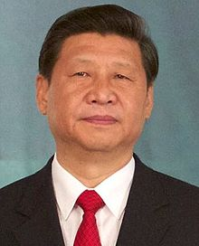
Xi Jinping
China’s President

Slide 39
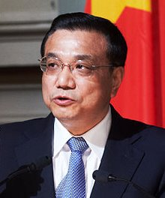
Li Keqiang
China’s Premier

Slide 40
How Leaders
Are Chosen
President: elected* by National People’s Congress for a five-year term.
Premier: nominated by the president and confirmed by the National People’s Congress.
*Chinese Communist Party is the only legal party, and officially sanctioned candidates run unopposed.

Slide 41
Legislature
The National People’s Congress is the country’s unicameral legislature.
The number of seats is based on China’s population.
As of the most recent election, there were 2,987 seats.
Candidates are selected and approved by the government before the people can vote for them.
Members serve five-year terms.
Only members of the CCP are elected.

Slide 42
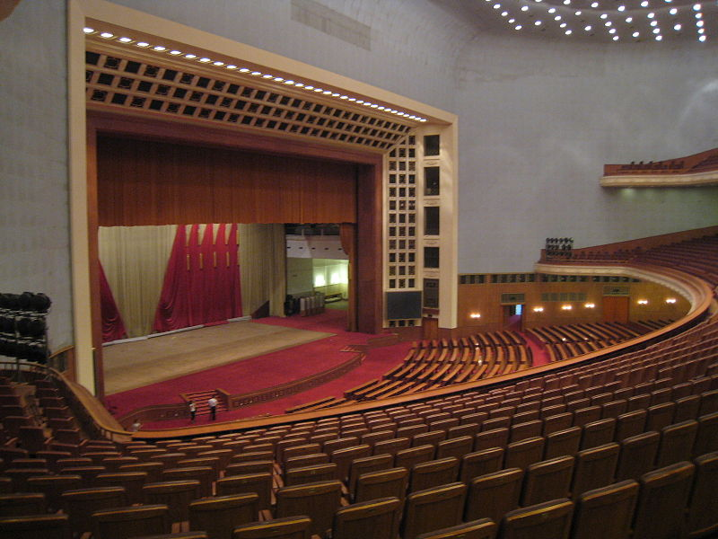
Great Hall of the People
(National People’s Congress Resides Here)

Slide 43
Oligarchy
Oligarchy means “government by the few”.
A political party or group takes over a government and makes all decisions.
This type of government is similar to an autocracy.
China’s government could be considered an oligarchic government because the leaders of the Chinese Communist Party control most of what goes on in the country.

Slide 44
Role of the Citizen
China’s communist government has a history of violating the personal freedoms of Chinese citizens by denying them basic rights such as freedom of speech and religion.
Even though the constitution gives every person over 18 the right to vote, these rights are mostly meaningless because they are only allowed to vote for members of the Chinese Communist Party.
The government chooses the candidates and then dictates what they do once they are “elected”.

Slide 45
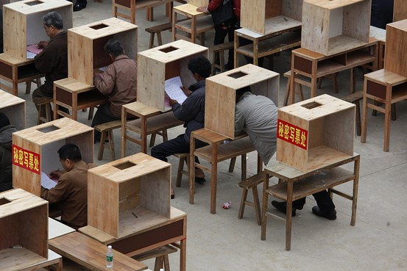
Voting in China - 2012

