Slide 1
Comparing
Asian
Economies
China, India, Japan,
& North Korea

Slide 2
Comparing
Asian
Economies
China, India, Japan,
& North Korea

Slide 3
Let’s Review
Economic Systems
Do you remember the three questions that every country must answer when developing its economic plan?
What goods/services will be produced?
How will goods/services be produced?
Who will consume the goods/services?
The way a country answers these questions determines what kind of economic system it will have:
Traditional Command Market

Slide 4
Traditional Economy
All economic decisions are based on customs, traditions, & beliefs of the past.
People will make what they always made & do the same things their parents did.
The exchange of goods is done through bartering.
Bartering = trading without using money
Some examples: villages in Africa & South America, the Inuit in Canada, Aborigines in Australia

Slide 5
Command Economy
All economic decisions are made by the Government.
The government owns most of the property, sets the prices of goods, determines the wages of workers, plans what will be made…everything.
This system has not been very successful. More and more countries are abandoning it.
This system is very harsh to live under; because of this, there are no PURE command countries in the world today.
Some countries are close: Cuba, former Soviet Union, North Korea, former East Germany, etc.
All of these countries have the same type of government: Communist! The government is in control of everything.

Slide 6
Market Economy
Economic decisions are made based on the changes in prices that occur as buyers & sellers interact in the market place.
The government has no control over the economy; private citizens answer all economic questions.
In a truly free market economy, the government would not be involved at all. Scary…
There would be no laws to make sure goods/services were safe. *Food! Medicine!
There would be no laws to protect workers from unfair bosses.
Because of this, there are no PURE market economies, but some countries are closer than others.
Some Examples: US, UK, Australia, etc.

Slide 7
Hmmm…
Since there are no countries that are purely command or purely market, what does that make them?
Most democratic countries have some characteristics of both systems, so we keep it simple and call them: MIXED
Of course, most countries’ economies are closer to one type of system than another.

Slide 8
Let’s Review
Factors of Production
There are 4 factors of production that influence economic growth within a country:
Natural Resources available
Investment in Human Capital
Investment in Capital Goods
Entrepreneurship
The presence or absence of these 4 factors determine the country’s Gross Domestic Product (GDP) for the year.

Slide 9
Gross Domestic
Product
GDP is the total value of all the goods and services produced in that country in one year.
It measures how rich or poor a country is.
It shows if the country’s economy is getting better or worse.
Raising the GDP of a country can improve the country’s standard of living.

Slide 10
Natural Resources
“Gifts of Nature”
Natural resources are important to countries because without them, countries must import the resources they need (can be costly).
A country is better off if it can use its own resources to supply the needs of its people.
If a country has many natural resources, it can trade/sell them with other countries.

Slide 11
Capital Goods
To increase GDP, countries must invest in capital goods:
All of the factories, machines, technologies, buildings, and property needed by businesses to operate.
If a business is to be successful, it cannot let its equipment break down or have its buildings fall apart.
New technology can help a business produce more goods for a cheaper price.

Slide 12
Human Capital
To increase GDP, countries must invest in human capital.
Human capital is the knowledge and skills that make it possible for workers to earn a living producing goods and services.
This includes education, training, skills, and healthcare of the workers in a business or country.

Slide 13
Entrepreneurship
People who provide the money to start and operate a business are called entrepreneurs.
These people risk their own money and time because they believe their business ideas will make a profit.
Entrepreneurs must organize their businesses well for them to be successful .
They bring together natural, human, and capital resources to produce goods or services to be provided by their businesses.

Slide 14
Specialization
Not every country can produce all of the goods and services it needs.
Countries specialize in producing those goods and services they can provide best and most efficiently.
They look for others who may need these goods and services so they can sell their products.
The money earned by such sales then allows the purchase of goods and services the first county is unable to produce.
In international trade, no country can be completely self-sufficient (produce all the goods and services it needs).
Specialization creates a way to build a profitable economy and to earn money to buy items that cannot be made locally.

Slide 15
China

Slide 16
Economic System
China is transitioning from a command economy that was completely controlled by the Chinese Communist government to a mixed economy that is overseen by the Communist government.
China calls its economy a “socialist market economy”.
During the 1970s, China’s government began to reorganize the economy with a plan called the Four Modernizations.
These reforms have led to excellent growth in China’s economy.
China is gradually reducing government control and allowing more foreign investment.
Today, China’s economy continues to be growing and strong, and many Chinese enjoy a higher standard of living than ever before.

Slide 17
GDP
China’s GDP is $12.26 trillion (US dollars).
It is ranked 3rd in the world (after the US and EU).
China’s GDP goes up about 8% every year.
The GDP per capita (value of goods and services produced per person) is $9,100.

Slide 18
Natural Resources
The massive country of China has an abundance of natural resources.
What are China’s major natural resources?
coal, iron ore, petroleum, natural gas, mercury, tin, tungsten, antimony, manganese, molybdenum, vanadium, magnetite, aluminum, lead, zinc, rare earth elements, uranium, hydropower potential (world's largest)
Even though much of China’s land is not arable (good for farming), the country’s land and rivers provide a good foundation for China’s industry and economic growth.

Slide 19
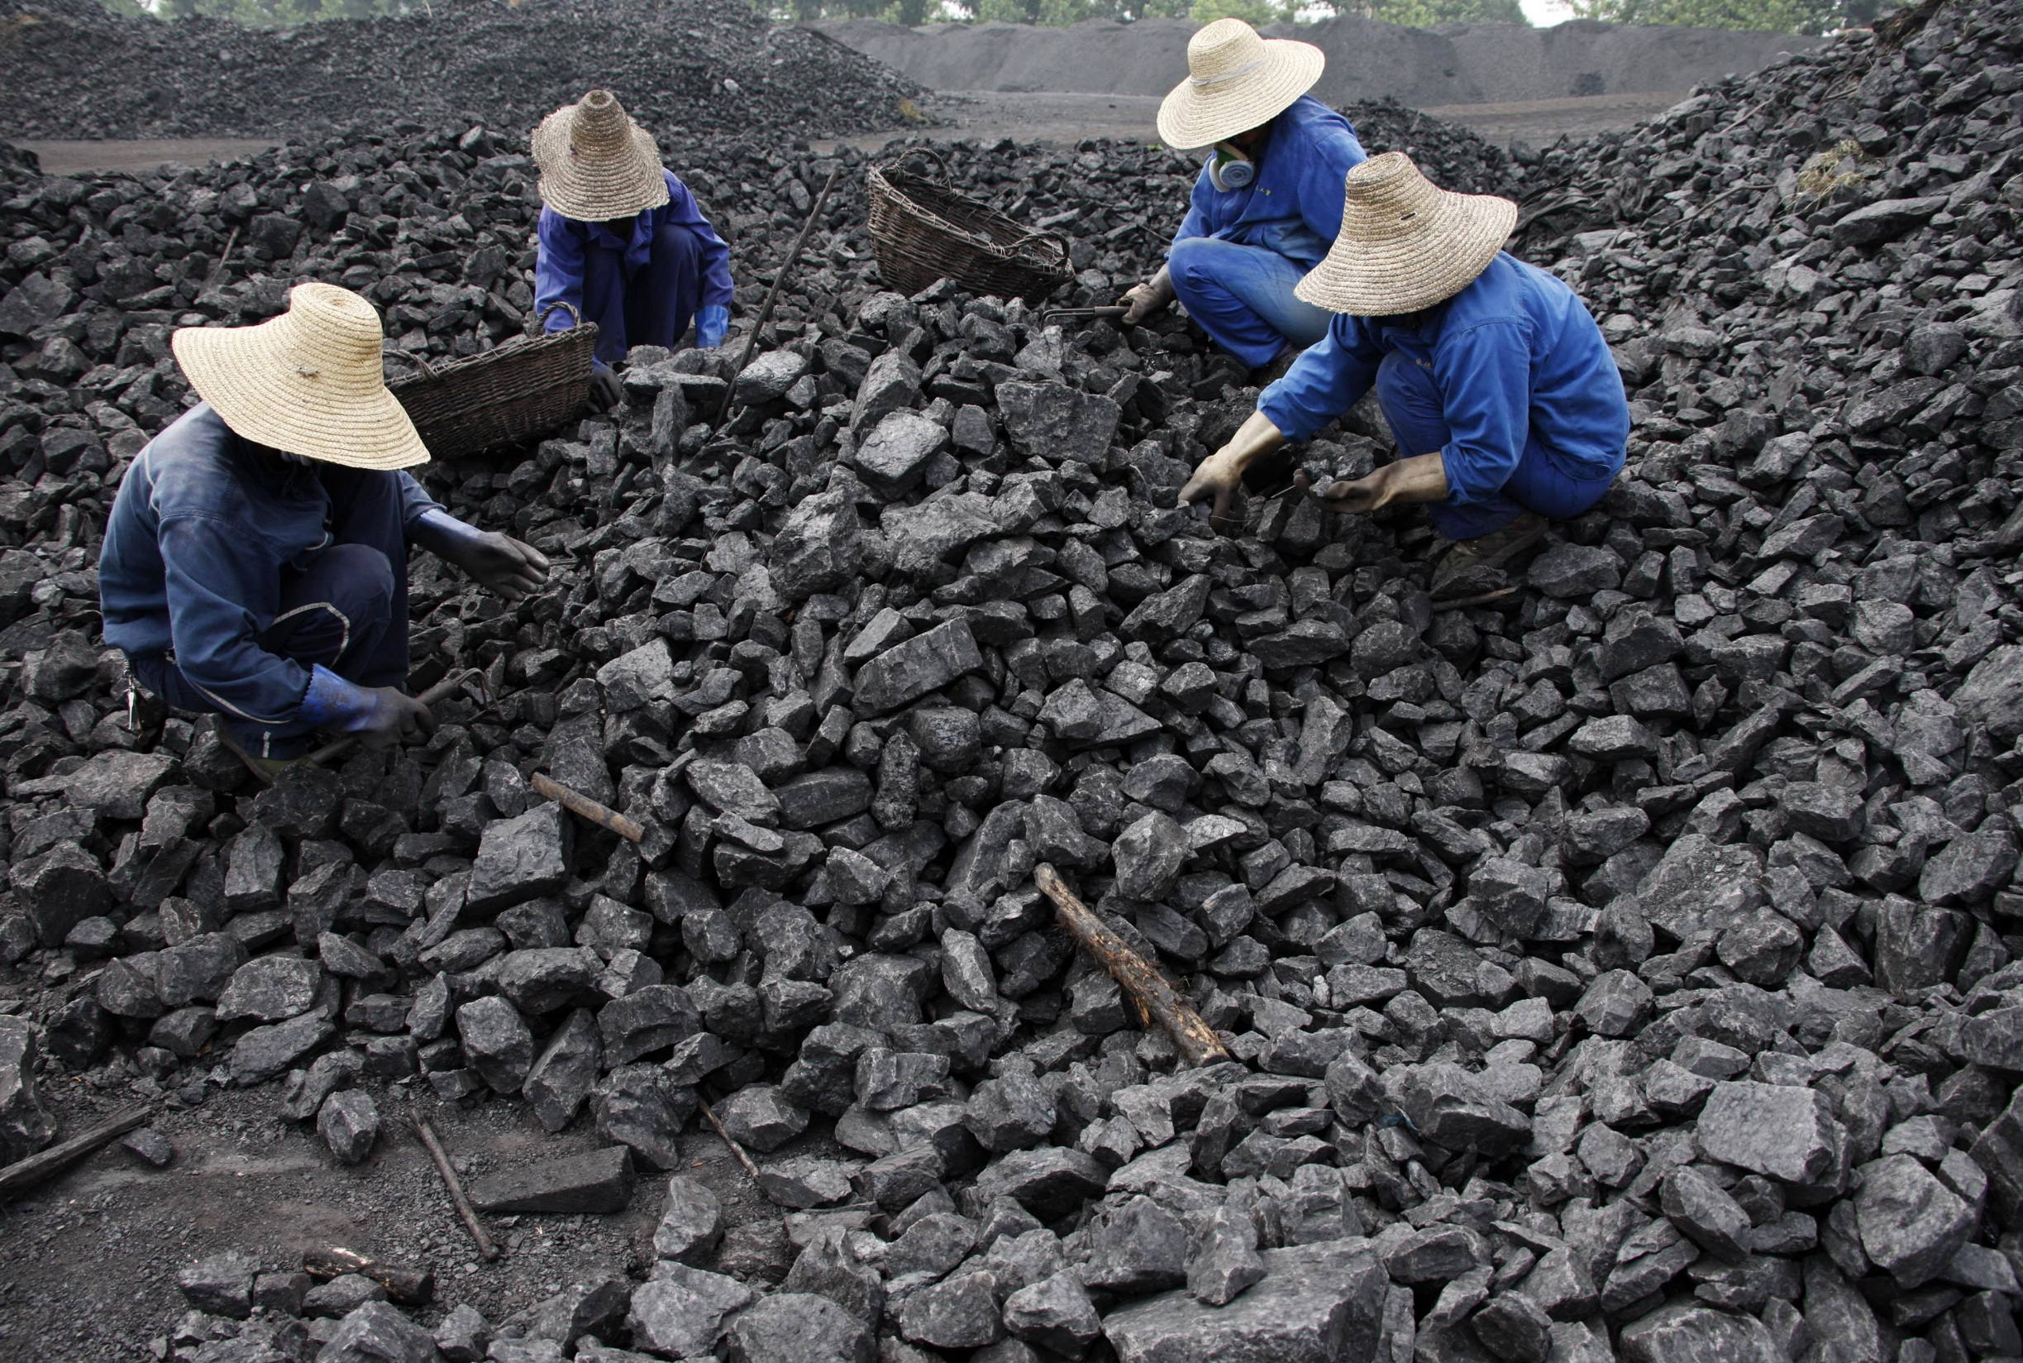
Chinese Coal Miners

Slide 20
Land Use
What percentage of the land is arable (capable of being farmed)?
11.6%
China is the world leader in gross agricultural output.
What are the major agricultural products?
rice, wheat, potatoes, corn, peanuts, tea, millet, barley, apples, cotton, oilseed, pork, fish

Slide 21
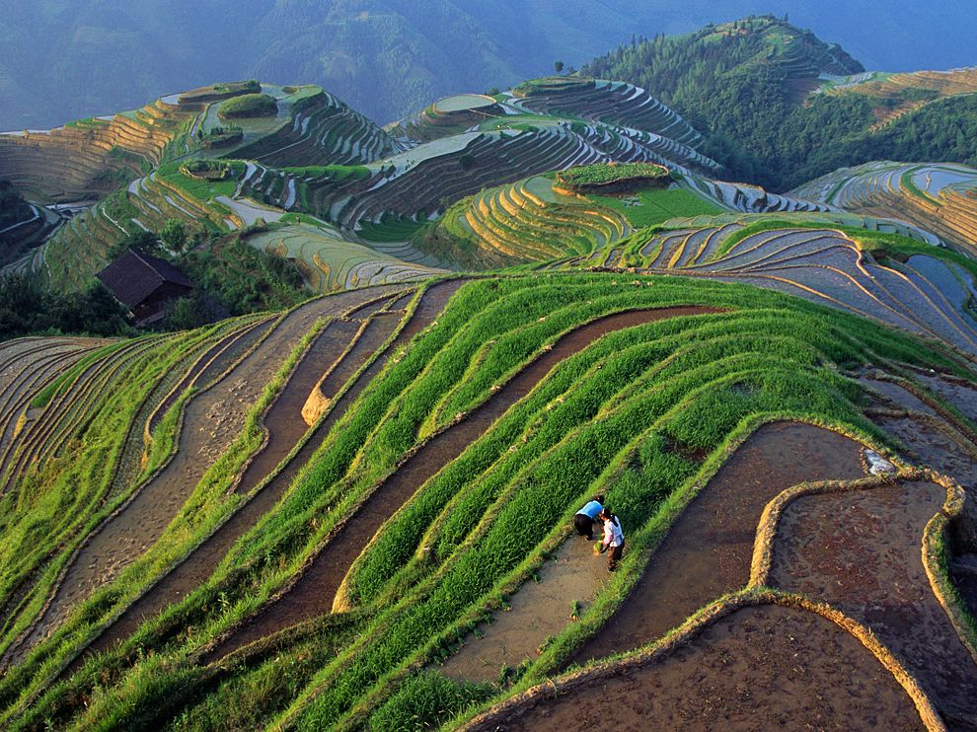
Longji Rice Terraces, China

Slide 22
Industries
China has made important capital investments that serve as the foundation for its growing GDP.
It has poured lots of money into its manufacturing sector, which accounts for 46% of its GDP.
It is the world leader in gross value of industrial output.
What’s produced in China’s factories?
mining and ore processing, iron, steel, aluminum, and other metals, coal, machine building, armaments, textiles and apparel, petroleum, cement, chemicals, fertilizers, consumer products - including footwear, toys, and electronics, food processing, transportation equipment - including automobiles, rail cars and locomotives, ships, & aircraft, telecommunications equipment, commercial space launch vehicles, satellites

Slide 23
Specialization
China has become a leader in exporting consumer goods to the world market.
China’s chief exports include:
electrical and other machinery, including data processing equipment, apparel, radio telephone handsets, textiles, integrated circuits

Slide 24
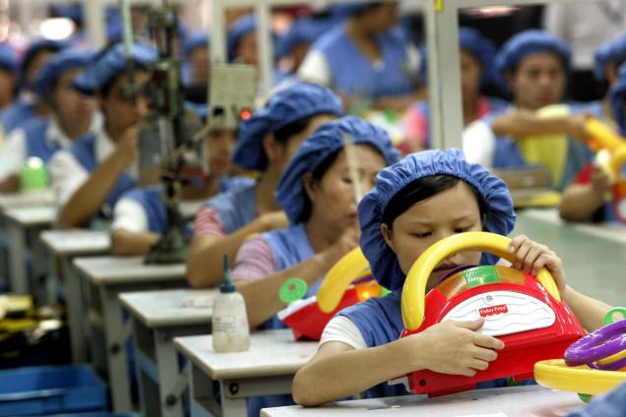
Toy Assembly Line in China

Slide 25
Literacy Rate
What percentage of the population over the age of 15 can read and write?
95%
How long are students expected to stay in school?
Most students drop out of school when they are 12 years old.

Slide 27
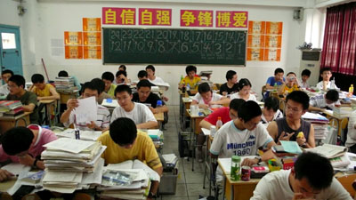
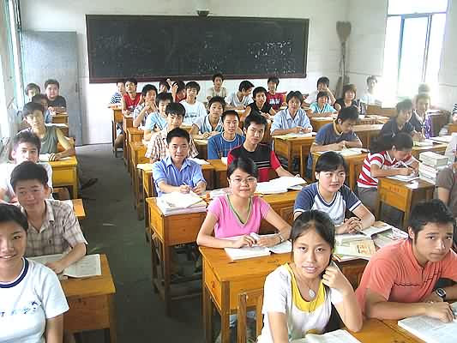
Chinese Middle School

Slide 28
Unemployment Rate
What percentage of people do not have jobs?
6.5% of China’s workforce is unemployed.
What percentage of people live in poverty?
13.4% of China’s population live below the poverty line and cannot meet basic needs.

Slide 29
Entrepreneurship
The Chinese government did not let people start their own businesses until the late 1970s, so entrepreneurship is still relatively new.
The government realizes that the country has to be more competitive in the world market, so they have decided to let entrepreneurs help lead the way.
Now, private business is the fastest growing segment of China’s economy.
Many Chinese people today have small businesses of their own, even though the government still has final authority.

Slide 30
India

Slide 31
Economic System
After India’s independence in 1947, the government set up a command economy.
Starting in 1991, India began to lift some government control and allow citizens a role in running some of India’s industries.
Today, India has a mixed economy that is moving away from a command system.
India’s government makes some decisions about agriculture and industry, but free enterprise and entrepreneurship are very common.

Slide 32
GDP
India’s GDP is $4.7 trillion (US dollars).
It is ranked 4th in the world.
The country’s GDP has been growing at a rate of about 8.5% per year.
The GDP per capita (value of goods and services produced per person) is $3,800.

Slide 33
Natural Resources
India’s fertile land and ample water supply are its most valuable resources.
What are India’s major natural resources?
Coal, iron ore, manganese, mica, bauxite, rare earth elements, titanium ore, chromite, natural gas, diamonds, petroleum, limestone, & arable land
India has the fourth-largest coal reserves in the world.

Slide 34
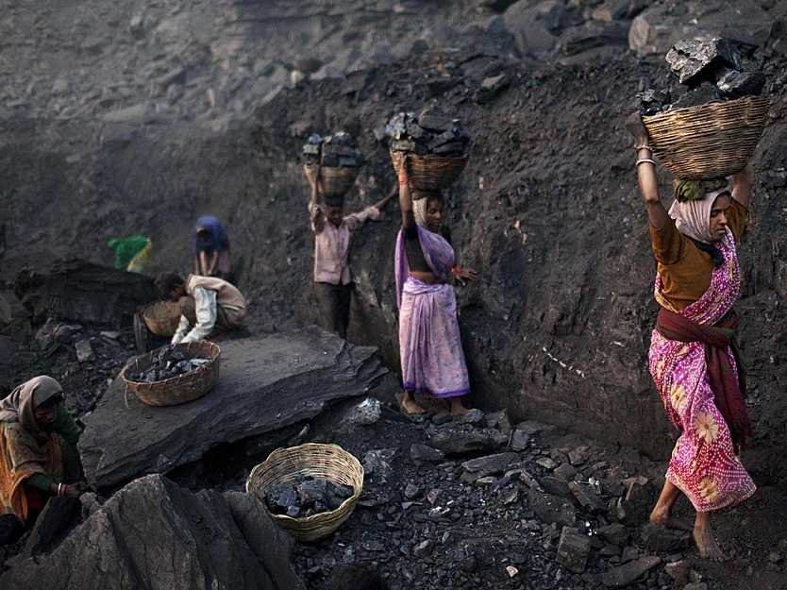
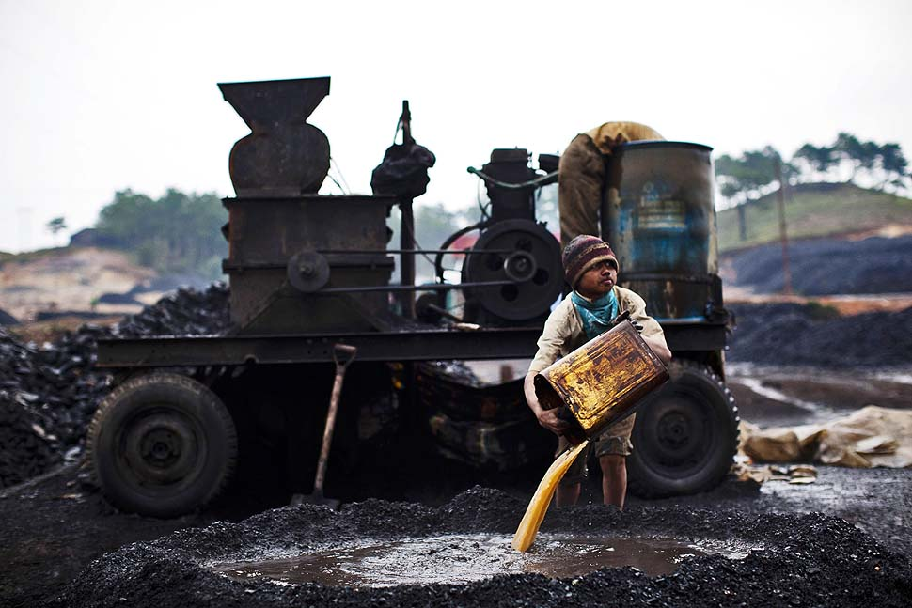
India’s Coal Mines

Slide 35
Land Use
What percentage of the land is arable (capable of being farmed)?
47.9%
About half of India’s land can be farmed, and its most important crops are rice and wheat.
What are the major agricultural products?
rice, wheat, oilseed, cotton, jute, tea, sugarcane, lentils, onions, potatoes, dairy products, sheep, goats, poultry, & fish

Slide 36
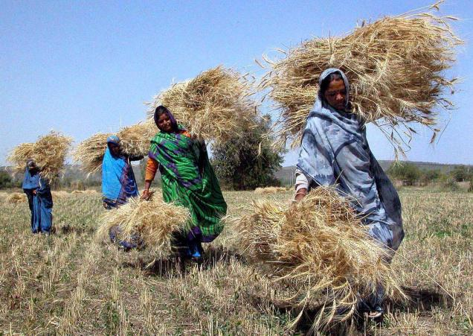
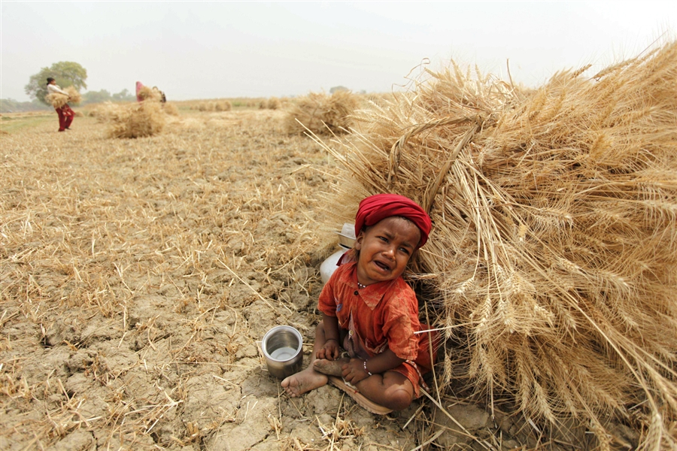
Indian Wheat Fields

Slide 37
Industries
India has invested heavily in the factories, modern machinery, and technology that make up what is known as capital goods.
Now, India is one of the world’s top ten industrial nations.
What’s produced in India’s factories?
textiles, chemicals, food processing, steel, transportation equipment, cement, mining, petroleum, machinery, software, & pharmaceuticals
Service industries are also booming in India, with thousands of people employed to handle technology questions, airline reservations, and customer service help for customers around the world.

Slide 38
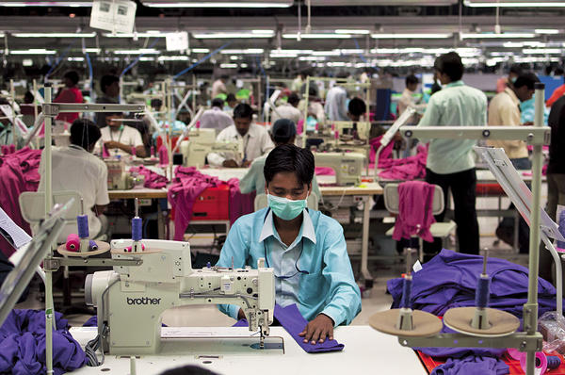
Textile Factory

Slide 39
Specialization
India has a booming industrial and technological economy.
This specialization makes it possible for India’s economy to focus on the businesses that are the most profitable in the world market.
India’s chief exports include:
petroleum products, precious stones, machinery, iron and steel, chemicals, vehicles, & apparel

Slide 40
Literacy Rate
What percentage of the population over the age of 15 can read and write?
62.8% (Male – 75%, Female -- 50%)
How long are students expected to stay in school?
Most students drop out of school when they are 11 years old.
India has made investment in human capital a major priority over the past few decades.
Although India’s literacy rate is low, the rate among children is much higher.
India’s investment in human capital will benefit the economy greatly in the future as educated children enter the workforce.

Slide 41
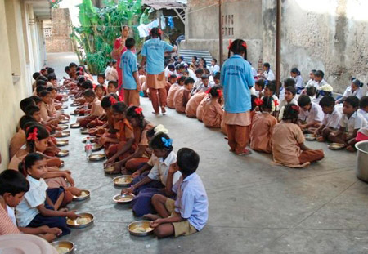
Middle School Lunch

Slide 42
Unemployment Rate
What percentage of people do not have jobs?
8.5% of India’s workforce is unemployed.
What percentage of people live in poverty?
29.8% of India’s population live below the poverty line and cannot meet basic needs.
In 2011, India had the largest concentration of people living below the international poverty line of $1.25 of all Asian countries.

Slide 43
Entrepreneurship
Entrepreneurship is rising dramatically in India.
India has a high rate of entrepreneurship, partly because the government supports new business owners with training and facilities.

Slide 44
Japan

Slide 45
Economic System
Japan has one of the most technologically advanced economies in the world.
Japan has a mixed economy; the Japanese government has a close and cooperative relationship with major industries in the country.
The government owns few businesses other than the country’s major TV network, but does oversee many aspects of the economy like banking and trade.
Japan has few natural resources and little farmland, but it has one of the strongest economies in the world because it built its economy on manufacturing.

Slide 46
GDP
Japan’s GDP is $4.56 trillion (US dollars).
It is ranked 5th in the world.
The GDP per capita (value of goods and services produced per person) is $35,900.

Slide 47
Natural Resources
Japan has very little farmland and few natural resources.
It imports the raw materials that it needs for industry.
Japan is the world’s largest importer of coal and natural gas, and the second largest importer of oil.
What are Japan’s major natural resources?
Very few mineral resources & fish

Slide 48
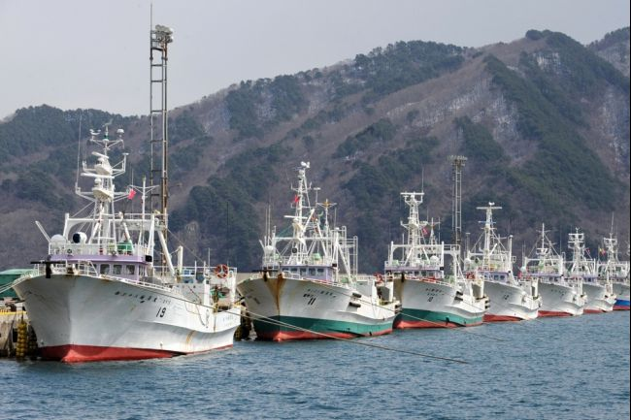
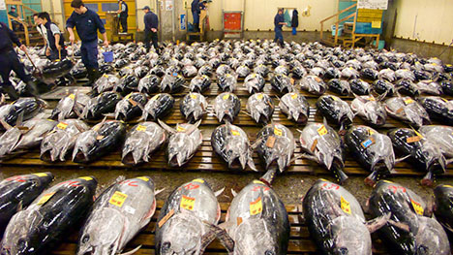

Slide 49
Land Use
What percentage of the land is arable (capable of being farmed)?
11.3%
Because there is so little arable land, crops are often planted in terraces carved out of hillsides.
What are the major agricultural products?
rice, sugar beets, vegetables, fruit, pork, poultry, dairy products, eggs, & fish
One of Japan’s largest industries is the fishing industry.

Slide 50
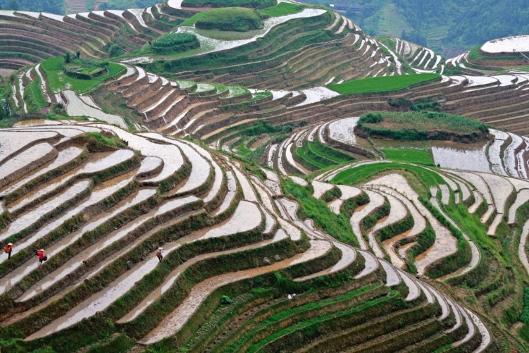
Terraced Rice Field

Slide 51
Industries
Investment in capital goods makes Japan a world leader in industrial production and in providing the wide range of services demanded by the world market.
What’s produced in Japan’s factories?
motor vehicles, electronic equipment, machine tools, steel and nonferrous metals, ships, chemicals, textiles, & processed foods
Japan is among the world’s largest and most technologically advanced producers of motor vehicles and electronic equipment.
Industrial production and work in providing services account for almost 98% of Japan’s GDP.

Slide 52
Specialization
Japan is a country with very few natural resources, so specialized industries have been developed to earn money needed to buy food and raw material from other countries.
Japan’s chief exports include:
motor vehicles, semiconductors, iron and steel products, auto parts, plastic materials, & power generating machinery

Slide 53
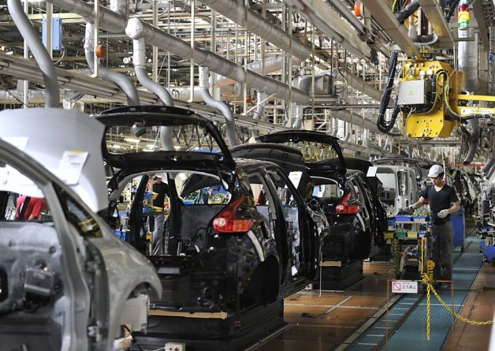
Nissan Motor Vehicles Plant

Slide 54
Literacy Rate
Japan places a high emphasis on education; the Japanese are among the most highly educated people in the world.
What percentage of the population over the age of 15 can read and write?
99%
How long are students expected to stay in school?
Most students drop out of school when they are 15 years old.

Slide 55
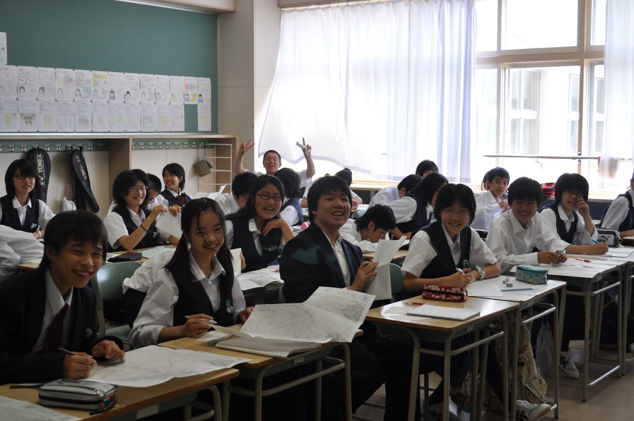
Japanese Middle School

Slide 56
Unemployment Rate
What percentage of people do not have jobs?
4.4% of Japan’s workforce is unemployed.
What percentage of people live in poverty?
16% of Japan’s population live below the poverty line and cannot meet basic needs.

Slide 57
Entrepreneurship
Japan has one of the lowest rates of entrepreneurship of the world’s top economic powers.
Japanese entrepreneurs face difficulties getting business loans from banks and there is very little training on how to run a business.
Japanese companies typically guarantee lifetime employment, so it is very rare for a person to leave a job to start a new business venture.

Slide 58
North
Korea

Slide 59
Economic System
North Korea has one of the least open and most government-controlled economies in the world today.
The Communist party controls the government and the economy, though most of power lies with the dictator, Kim Jong-il.
North Korea has a command economy.
The government controls all the resources and decided what is to be produced.
The North Korean economy has serious problems, and the government is finally making some reforms and relaxing some of its controls.

Slide 60
GDP
North Korea’s GDP is estimated at $40 billion (US dollars).
It is ranked 103rd in the world.
The GDP per capita (value of goods and services produced per person) is $1,800.
*North Korea does not post reliable income data so these amounts are estimated.

Slide 61
Natural Resources
What are North Korea’s major natural resources?
coal, lead, tungsten, zinc, graphite, magnesite, iron ore, copper, gold, pyrites, salt, fluorspar, & hydropower

Slide 62
Land Use
What percentage of the land is arable (capable of being farmed)?
19%
Farms are owned and organized by the government: farmers are told what to grow and how much.
What are the major agricultural products?
rice, corn, potatoes, soybeans, cattle, pigs, pork, & eggs
Agriculture in North Korea does not produce enough food to feed its people.
Food aid from other countries has been needed to avoid widespread starvation.

Slide 63
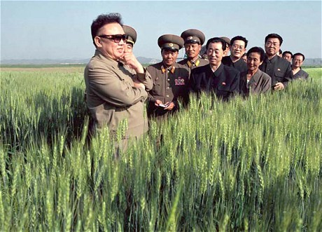
Kim Jong-il Inspecting A Farm

Slide 64
Industries
Premier Kim Jong-il has tried to build up North Korea’s industries in recent years.
The production of steel and machinery are leading industries in the country.
What’s produced in North Korea’s factories?
military products, machine building, electric power, chemicals, mining (coal, iron ore, limestone, magnesite, graphite, copper, zinc, lead, and precious metals), metallurgy, textiles, & food processing

Slide 65
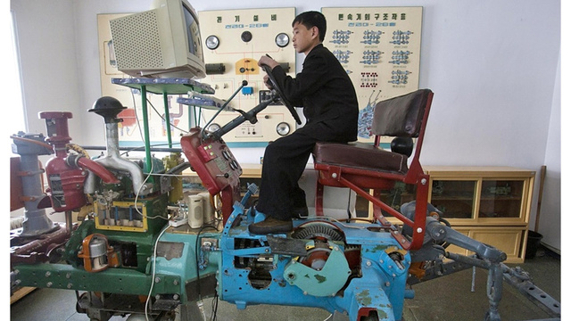
“Farming Simulator – How North Korea Trains Future Farmers”

Slide 66
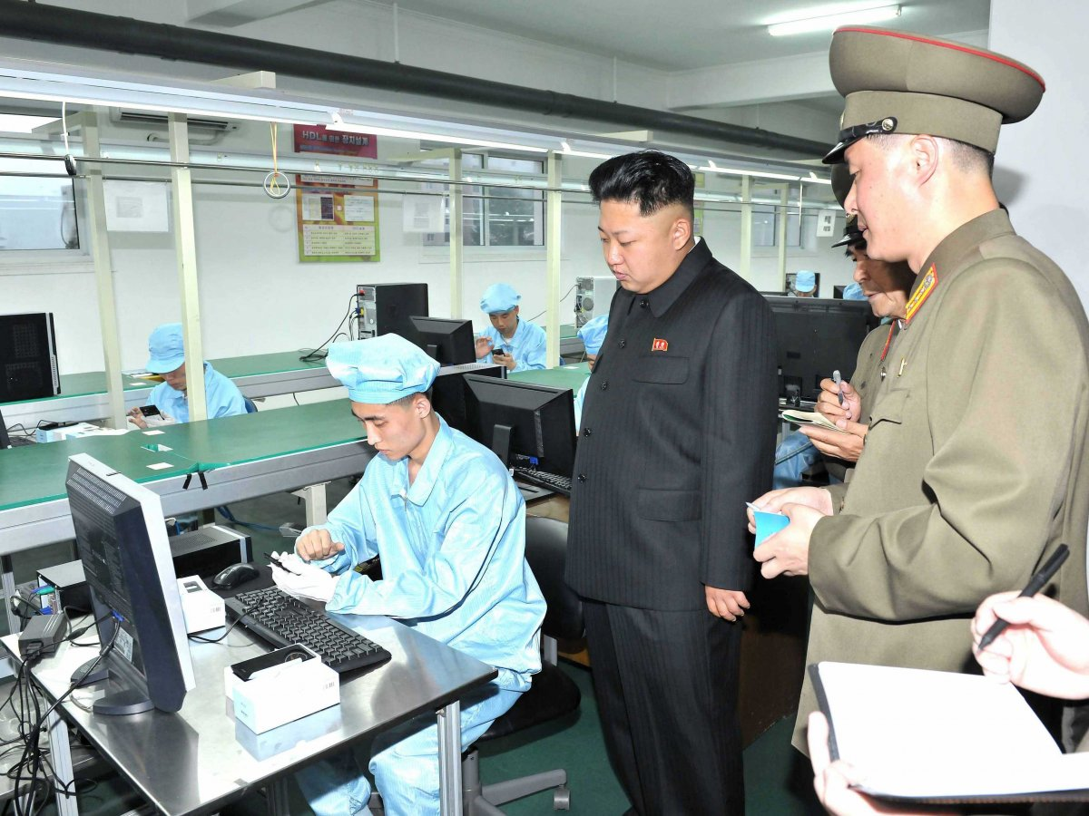
Factory Inspection

Slide 67
Specialization
North Korea’s chief exports include:
minerals, metallurgical products, manufactures (including armaments), textiles, agricultural & fishery products

Slide 68
Literacy Rate
What percentage of the population over the age of 15 can read and write?
100%

Slide 69
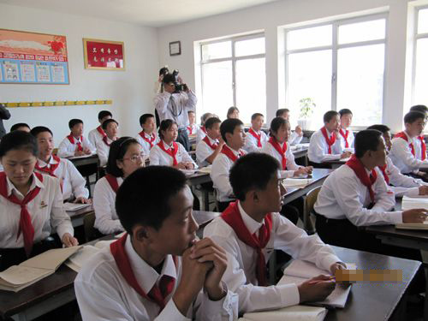
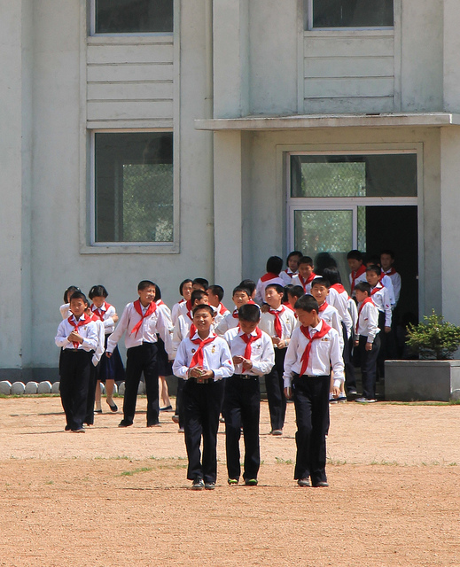
v
North Korea Middle School

Slide 70
Unemployment Rate
What percentage of people do not have jobs?
North Korea’s government does not make this information available.
What percentage of people live in poverty?
North Korea’s government does not make this information available.

Slide 71
Currency Exchange
Currency exchange is the price of one country’s currency compared to another.
1 US dollar = 6 Chinese yuan
1 US dollar = 62 Indian Rupee
1 US dollar = 103 Japanese yen
1 US dollar = 131 North Korean won
What does this mean?
China’s economy is the strongest of the Asian countries, but the US’s economy is stronger than China’s.

