Slide 1













Autocracy, Oligarchy, & Democracy

Slide 2




In each country, the people have different rights to
participate in the government.
•In some countries, any citizen can run for office or vote in elections.
•In other countries, there are restrictions placed on who can run for office and who can vote.
•There are also countries where NO citizen can vote and there are no elections.

Slide 3


Types of Government are based on two key
questions:
Who governs the country?
What is the citizen participation like?
The way a country answers these questions determines its government type:
Autocracy Democracy
Oligarchy

Slide 4



Have a single ruler with unlimited power.
Citizens cannot participate in the selection of the
ruler or vote on the country’s laws.
One benefit – decisions for the country can be made quickly.
  However…the needs of the citizens may be
ignored.
  The leader may make poor or selfish decisions
that hurt the citizens.

Slide 5




Generally the power to rule the country is inherited (kings/queens) or is taken by military force.
There are two main types of autocracies:
Absolute Monarchy
The monarch has absolute power (no constitution) over the citizens.
Example: King Salam bin Abdul-Aziz Al Saud of Saudi Arabia.
Dictatorship
The leader uses force to control the citizens.
Example: Hitler

Slide 6



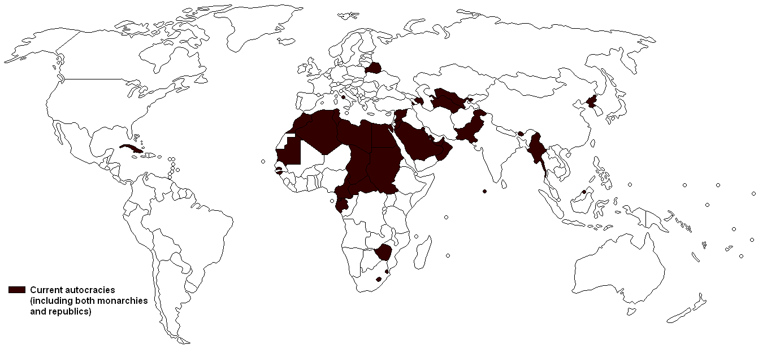

Slide 7




The country is ruled by a small group of people.
•The group gets their power from either religion, military force, or wealth & resources.
The citizens do not select the members of this group or vote on the country’s laws.

Slide 8

Two types of Oligarchy are Theocracy and Absolute Monarchy.
Theocracy—Example: Iran
Rule by a small group
Communism—Example: China
Rule by a small group of communist leaders with a communist government

Slide 9

The citizens hold the power of the government.
Citizens have the opportunity to participate in the government:
•All citizens have the opportunity to be a leader.
•All citizens have the opportunity to vote for leaders & laws.

Slide 10


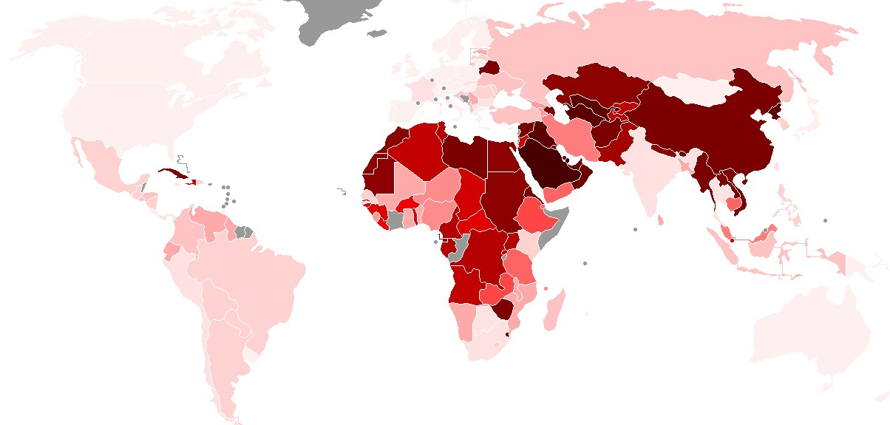
This Polity Data Series Map tries to measure a country’s true democracy in government. The countries in the lightest pink have the highest democracy score. The darker the color, the lower the score.

Slide 11


There are two forms of democratic
governments:
Both are designed to represent and protect the rights of the citizens.

Slide 12




The citizens vote directly for the leader of the country.
Citizens also vote for members of the legislature, but separately from the leader.
•The leader of the country does not make the
laws. The legislature does this.
•Example: US, Russia, Mexico

Slide 13



The citizens vote for members of the legislature, not directly for the leader.
The legislature then chooses the country’s leader among its members.
•The leader is part of the legislature, so he/she
has a hand in making laws.
Examples: United Kingdom, Canada, & Australia

