Slide 1
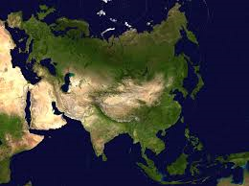
Welcome to South East Asia!

Slide 2
Countries of Southern Asia
China
North Korea
India
South Korea
Indonesia
Vietnam
Japan
You will label these countries by looking at the following slides.

Slide 3
China

Slide 4
North and South Korea

Slide 5
India

Slide 6
Indonesia

Slide 7
Vietnam

Slide 8
Japan

Slide 9
Physical Features
We will only look at a few physical features today.
Indian Ocean
South China Sea
Bay of Bengal
Yellow Sea
Sea of Japan

Slide 10
Indian Ocean

Slide 11
South China Sea

Slide 12
Bay of Bengal

Slide 13
Yellow Sea

Slide 14
Sea of Japan

Slide 15
Dreadful Air and Terrible Water
1. India and China are both facing serious air and water pollution problems.
In India, the Ganges River is polluted with bacteria from human ashes, animal carcasses, and the sewage system.
China is ranked to have 16 of the 20 most polluted cities in the world due to cars, industries, and coal burned to heat homes.

Slide 16
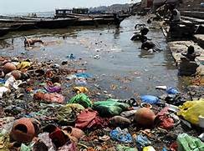
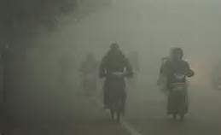
Ganges Pollution
China air pollution

Slide 17
Rain, Rain, Go Away
2. Monsoons- seasonal wind bringing heavy rainfall that can lead to flooding.
Monsoons in India have caused heavy flooding for their country, usually during the months of June thru September
China also faces monsoons- the Huang He River has killed more people due to flooding than any other river in the world

Slide 18
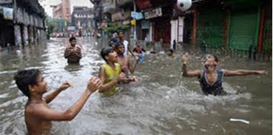
Monsoons in India

Slide 19
Religious Groups in Southern and Eastern Asia
3. Buddhism- 4th largest religion. Originated in India. Believe in reincarnation, a cycle of birth and rebirth, where one’s behavior determines the next life.
4. Hinduism- Largely practiced in India. (80% of Indians are Hindu) Believe in many gods (polytheism). Believe karma determines your next life.
5. Shintoism- Unique religion to Japan. Worship their ancestors, nature, life, and birth.
Buddhism Video

Slide 20
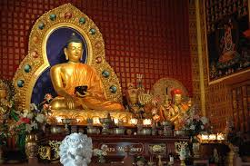
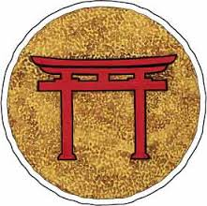
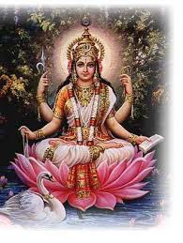
Buddhism Shintoism Symbol
Hinduism

Slide 21
Independence for India
Mohandas Gandhi resisted the rule of the British government and led Indian citizens to peacefully fight for full independence
Life of Gandhi
Think you can draw Gandhi? Let’s see who can draw him the best by watching this video!

Slide 22
Vietnam War
Vietnam was controlled by China for 1000 years
Late 1800’s the French claimed Vietnam
Ho Chi Minh, a communist leader, declared independence from France in 1945
Vietnam was split into North and South Vietnam, North being communist, south being anti-communism
1964- US helps South Vietnam
1975- Vietnam becomes an independent nation
Video

Slide 23
After Pearl Harbor- Rebuilding Japan
7. After Japan attacked the American military base in Pearl Harbor, the US dropped two atomic bombs on the cities of Hiroshima and Nagasaki
In effort to restore Japan to a thriving country, the US occupied Japan from 1945-1952
America had a lasting effect on Japan. They now have one of the strongest economies and a stable democratic government.

Slide 24
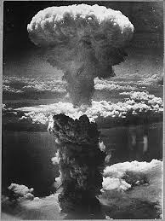
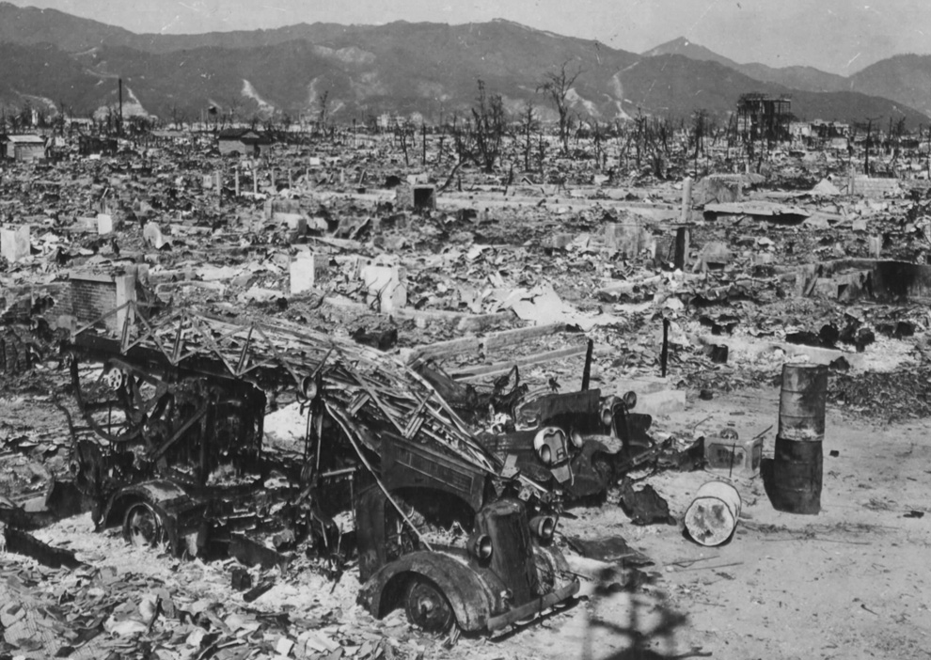
Hiroshima and Nagasaki

Slide 25
Communism in China
8. 1911- China had a new government called the Chinese Nationalist Party
Headed by Mao Zedong
His plan was called the “Great Leap Forward”- he wanted to speed up China’s economic development
This plan was a disaster- 20 million people died due to droughts and floods that damaged all of their crops from 1958-1960

Slide 26
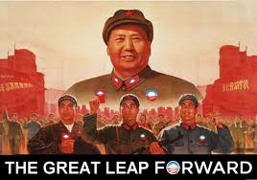
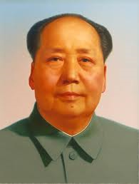
Mao Zedong

Slide 27
Review Quiz
1. Why is the Ganges River polluted?
Untreated sewage pours into it
Animal carcasses are thrown in it
Trash thrown in it
All of the above

Slide 28
2. A major environmental problem in China and India is:
Destruction of rain forest
Drought
Air pollution
Nuclear waste

Slide 29
3. This religion is unique to Japan:
Buddhism
Hinduism
Islam
Shintoism

Slide 30
4. Who urged non-violent protest to gain independence for India?
Ho Chi Minh
Mao Zedong
Mohandas Gandhi
Nelson Mandela

Slide 31
5. The U.S. helped rebuild this country and its economy after WWII:
Japan
Vietnam
India
China

Slide 32
Answers
1. Why is the Ganges River polluted?
D. All of the above
2. A major environmental problem of China and India is:
C. Air pollution
3. This religion is unique to Japan:
D. Shintoism
4. Who urged non-violent protest to gain independence for India?
C. Gandhi
5. The U.S. helped rebuild this country and its economy after WWII:
A. Japan

Slide 33
If time….
Learn how to Bhangra!
Bhangra is a dance originating in India.

