Slide 1
Comparing
Africa’s
Governments
Republic of Kenya &
Republic of South Africa

Slide 2
Standards
SS7CG1 The student will compare and contrast various forms of government.
a. Describe the ways government systems distribute power: unitary, confederation, and federal.
b. Explain how governments determine citizen participation: autocratic, oligarchic, and democratic.
c. Describe the two predominant forms of democratic governments: parliamentary and presidential.
SS7CG2 The student will explain the structures of the modern governments of Africa.
a. Compare the republican systems of government in the Republic of Kenya and the Republic of South Africa, distinguishing the form of leadership and role of the citizen in terms of voting and personal freedoms.

Slide 3
Comparing
Africa’s
Governments
Republic of Kenya &
Republic of South Africa

Slide 4
Let’s Review
Government Types – how do citizens participate?
Autocracy-- 1 person possesses unlimited power & citizens have limited role in government
Oligarchy-- small group exercises control & citizens have limited role in government
Democracy--supreme power is vested in the people & exercised by them directly or indirectly through a system of representation involving free elections

Slide 5
Let’s Review
Two Types of Democratic Governments:
Parliamentary– citizens elect members of Parliament, and then the members select the leader
Leader works with or through the legislature
Presidential--system of government in which the leader is constitutionally independent of the legislature; citizens directly elect leader
Leader works separate from legislature

Slide 6
Republic
of
Kenya
Presidential Representative Democratic Republic

Slide 7
Background Info.
Kenya became independent from Great Britain on December 12th, 1963 under the leadership of Jomo Kenyatta.
Kenya has recently experienced many changes in its government.
The new constitution (2010) introduced significant legislative changes, such as a new bicameral legislature, the abolishment of the prime minister, and switching from 8 provinces to 47 counties (“Districts of Kenya”).
Kenya is currently a democratic republic with an elected president and a bicameral legislature.

Slide 8
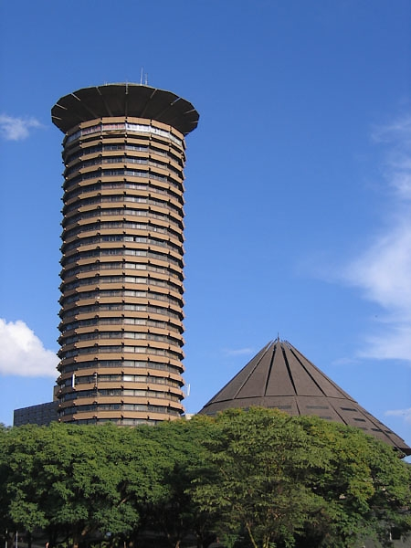
The Kenyatta International Conference Centre, in Nairobi, is home to Kenya’s government.

Slide 9
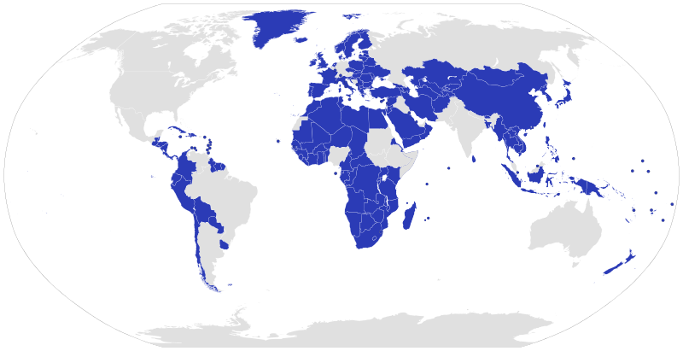
Unitary Governments

Slide 10
Leadership
1. President: holds the most political power; the president is both the chief executive and the head of state.
2. Vice President: helps in the day-to-day running of the government; performs ceremonial duties

Slide 11
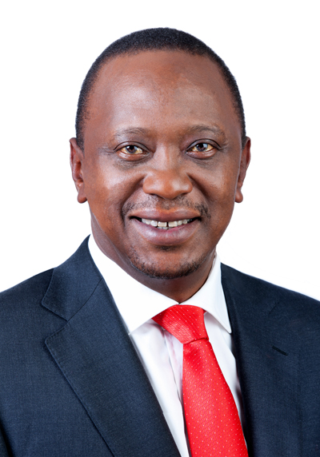
Uhuru Kenyatta
Kenya’s 4th President

Slide 12
How Leaders
Are Chosen
President: elected by popular vote for a five-year term (eligible for a second term)
Vice President: appointed by the president

Slide 13
Legislature
The Parliament of Kenya is the country’s bicameral legislature.
It consists of:
Senate (67 seats) - 47 members directly elected by their counties, 16 women nominated by the political parties, 2 members to represent the youth, and 2 members to represent persons with disabilities.
National Assembly (349 seats) - 290 elected from the constituencies, 47 women elected from the counties, and 12 nominated representatives
Members serve five-year terms.

Slide 14
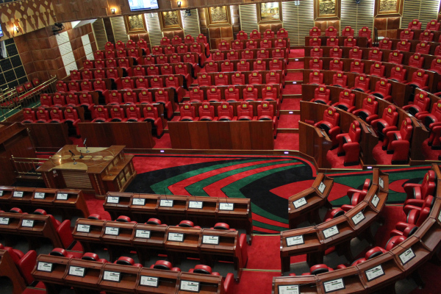
Inside Kenya’s Parliament

Slide 15
Presidential
Democracy
The citizens directly elect the president (every 5 years).
The last election was in March 2013 (next to be held in 2018).
The president works separately from Kenya’s Parliament.

Slide 16
Role of the Citizen
Citizens must be 18 to vote, but voting is not required by law.
As a democracy, its citizens can participate in voting and elections:
The citizens vote for the president, as well as for members of the parliament.
Even though Kenya is a democracy, the citizens do not have too much say in the government.
Much of the decision-making process is made by the president and his party.
Freedoms are written into the constitution, but government is dominated by the president.
However, there have been improvements in citizens’ rights in recent years.

Slide 17
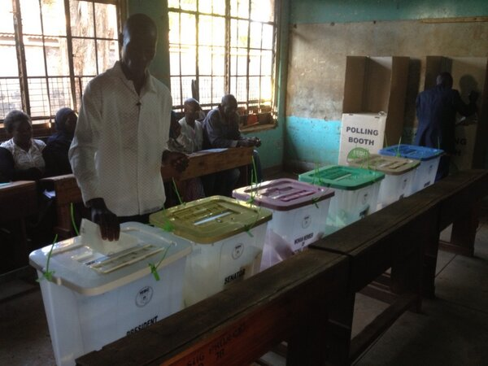
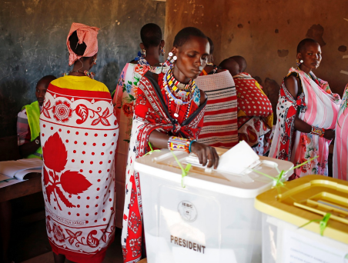
Voting in Kenya – March 2013

Slide 18
Republic
of
South Africa

Slide 19
Background Info.
South Africa became independent from Great Britain in 1910.
Until 1994, South Africa had an oligarchy that was controlled by the white leaders of Apartheid.
Today, the racially segregated government has ended and South Africa is a democracy.

Slide 20
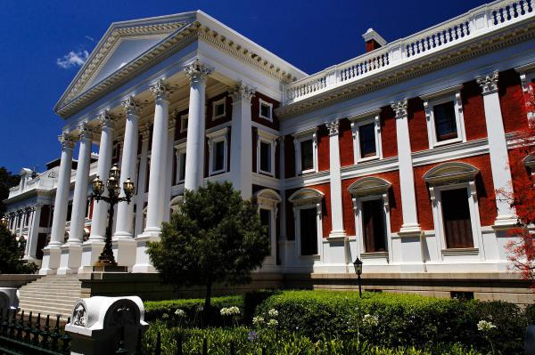
The Houses of Parliament, in Cape Town, is home to South Africa’s government.

Slide 21
Leadership
1. President: holds the most political power, is the head of government and head of state, & is the leader of the party with the most seats in National Assembly
2. Deputy President: helps in the day-to-day running of the government; performs ceremonial duties

Slide 22
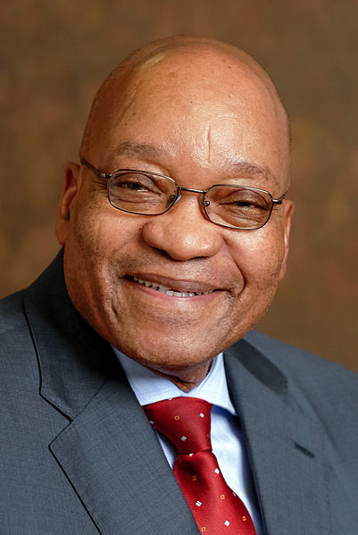
Jacob Zuma
South Africa’s President

Slide 23
How Leaders
Are Chosen
President: leader of the party with the most seats in the National Assembly; serves a five-year term (no more than two terms)
Deputy President: appointed by the president

Slide 24
Legislature
The Parliament of South Africa is the country’s bicameral legislature.
It consists of:
National Council of Provinces (90 seats) – the upper house of Parliament; each of the 9 provinces elect 10 members.
National Assembly (400 seats) - the lower house of Parliament; is elected every five years by a system of party-proportional representation

Slide 25
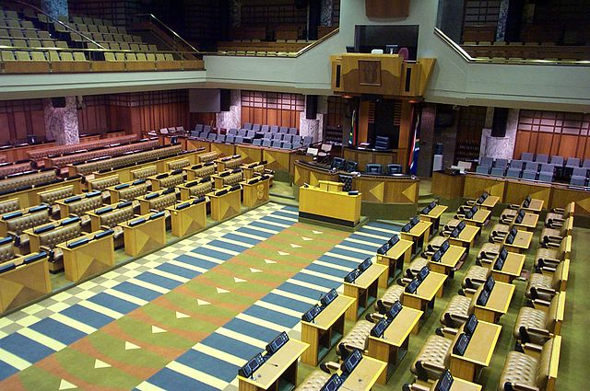
National Assembly Chamber

Slide 26
Parliamentary
Democracy
The political party with the most members in the National Assembly selects the President.
This is the major difference between a Presidential Democracy and a Parliamentary Democracy!
Parliamentary Democracy – legislature chooses the executive leader

Slide 27
Role of the Citizen
Citizens must be 18 to vote, but voting is not required by law.
As a democracy, its citizens can participate in voting and elections:
The citizens vote for members of the National Assembly (parliament), who then elects the president.
Personal freedoms are more numerous in South Africa since Apartheid (legal separation of the races) has ended.
Unfortunately, even though Apartheid has ended, much of South Africa’s wealth does not reach the black population.
This has caused a very low standard of living among half of the country’s population.

Slide 28
Credits:
All photos were found via Creative Commons and labeled for reuse. Facts were found via CIA World Factbook and updated in October 2013.
Fonts:
Backgrounds & Graphics:

Slide 29
Teachers
Thank you for downloading this file. I hope you enjoy using it with your students, and I can’t wait to read your feedback in my TPT store! ☺
Interested in more fun printables & activities? Please check out my Social Studies Interactive Notebook Kit: http://www.teacherspayteachers.com/Store/Brain-Wrinkles
I teach Language Arts and Social Studies in Georgia, so my products are aligned with Common Core (LA) and Georgia Performance Standards (SS).
© Copyright 2013. Brain Wrinkles. All rights reserved. Permission is granted to copy pages specifically designed for student or teacher use by the original purchaser or licensee. The reproduction of any other part of this product is strictly prohibited. Copying any part of this product and placing it on the Internet in any form (even a personal/classroom website) is strictly forbidden. Doing so makes it possible for an Internet search to make the document available on the Internet, free of charge, and is a violation of the Digital Millennium Copyright Act (DMCA).

